Slide 1
The Money Adviser Network (MAN) and self-referral
26 July 2022

Slide 2
What is the Money Adviser Network (MAN)?
The MAN is a new virtual contact centre (VCC) that simplifies how organisations can direct people in financial difficulty to free regulated debt advice
It provides people with a single point of entry to a panel of debt advice agencies with referrals routed to the next available debt advice agency
People seeking advice can choose from one of three channels:
Referral to
Online debt self-help tool
Immediate call-back from a
Debt Advice Agency
Scheduled call-back from a
Debt Advice Agency

Slide 3
What are the benefits to promoting MAN?
Access to a free, government sponsored process that aims to support people in financial difficult to get access to free, regulated debt advice.
Enhancing your employee wellbeing offer which can contribute to being an employer of choice.
Supporting your employees’ financial wellbeing by helping them access the support they need when they need it most.
Ongoing relationship support from MaPS to help promote the service and financial wellbeing to your employees.
Simple link that can be promoted through your communications channels.
Notes:
Partnerships team to input their standard FW pitch - as appropriate

Slide 4
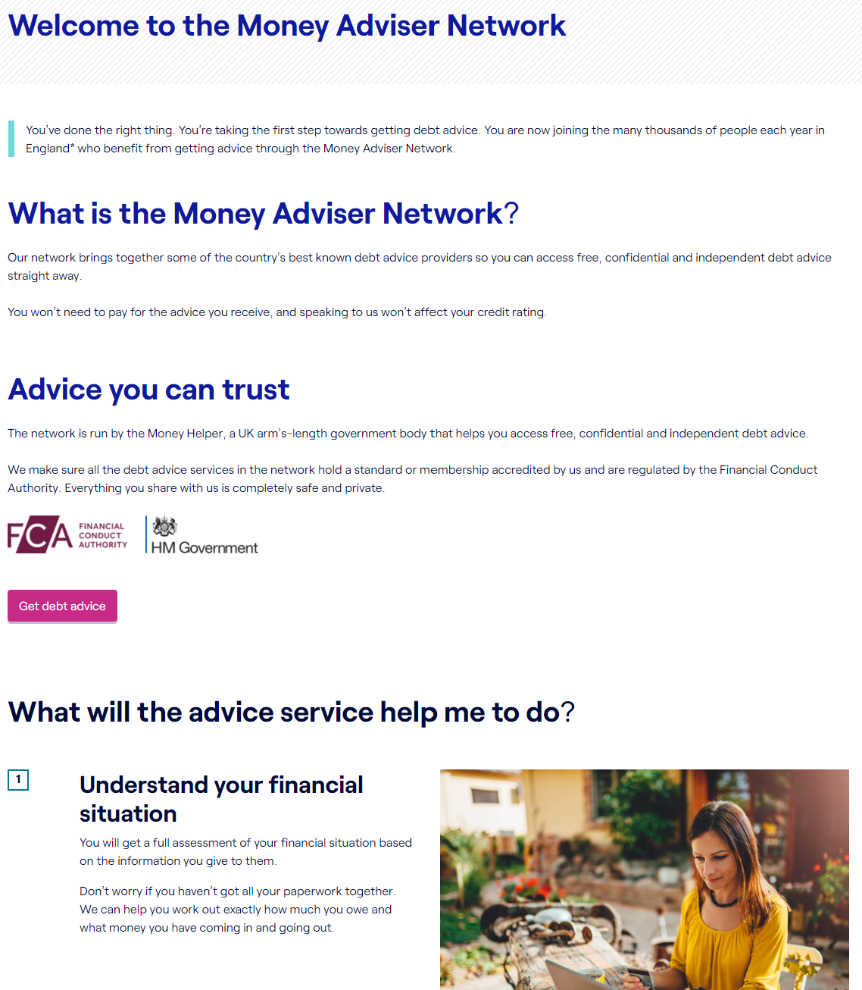
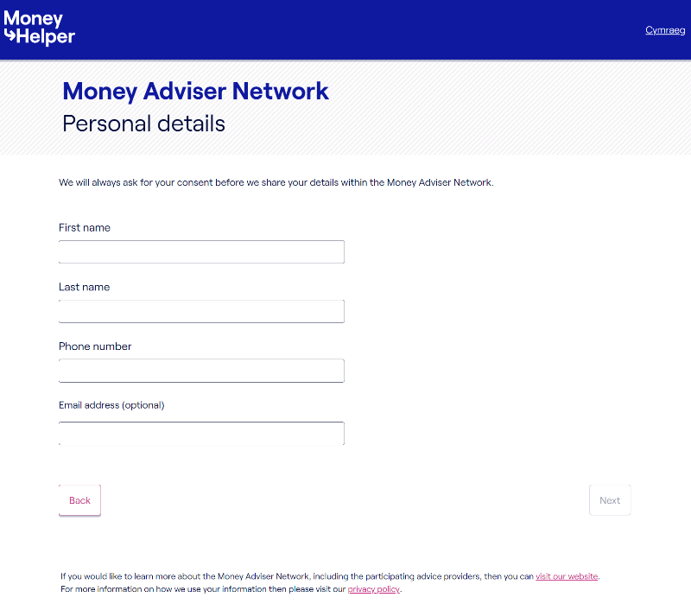
Employee self referral form
https://adviser.moneyhelper.org.uk
By completing a simple web-referral form, employees have the options to access:
Referral to online debt self-help tool
Immediate call-back from a Debt Advice Agency
Scheduled call-back from a Debt Advice Agency
The interface is accessed securely via web URL that can be placed on your intranet.

Slide 5
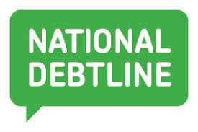
Debt Advice providers partnering on MAN
By end 2022

Slide 6
Thank you
Karleen Dowden
Regional Manager North East of England
Karleen.dowden:maps.org.uk

