Slide 1



Allied Health Professionals

Slide 2
Overview for teacher
This lesson follows a scenario about Robert (Bob). He has had a stroke.
This is a good lesson to allow students to think about careers other than the obvious ones in the NHS.
It can also be used to allow students to see how person-centred values could be seen with professionals working together for one cause.

Slide 3
Who could help me?
Think of a time when you have been poorly or have had something happen to you.
List the health professionals who helped you.

Slide 4
Aims:
To identify different roles in the NHS.
To understand how those roles support individuals.
To assess how different professionals could work together to create person centred care.

Slide 5
NHS health care professionals
When we are asked to name a health or social care professional the first two, we jump to are probably doctors or nurses.
However, there are a lot more professionals that help and support individuals to get back to ‘as close to normal’ when something goes wrong with the body or mind.
We call these allied health professionals and there are 14 different ones
Art therapists
Dietitians
Drama therapists
Music therapists
Occupational therapists
Operating department practitioners
Orthoptists
Osteopaths
Paramedics
Physiotherapists
Podiatrists
Prosthetists and orthotists
Radiographers
Speech and language therapists

Slide 6

Say hello to Robert, he prefers Bob…
Bob is 72 years old, he has a wife, 3 children and 4 grandchildren.
Bob was sat in the chair watching football with his son when suddenly, he could not lift his arm. As he tried to tell his son he could not get the words out properly. Then he remembers his son telling him his face had dropped at one side.
Bob was having a stroke.

Slide 7
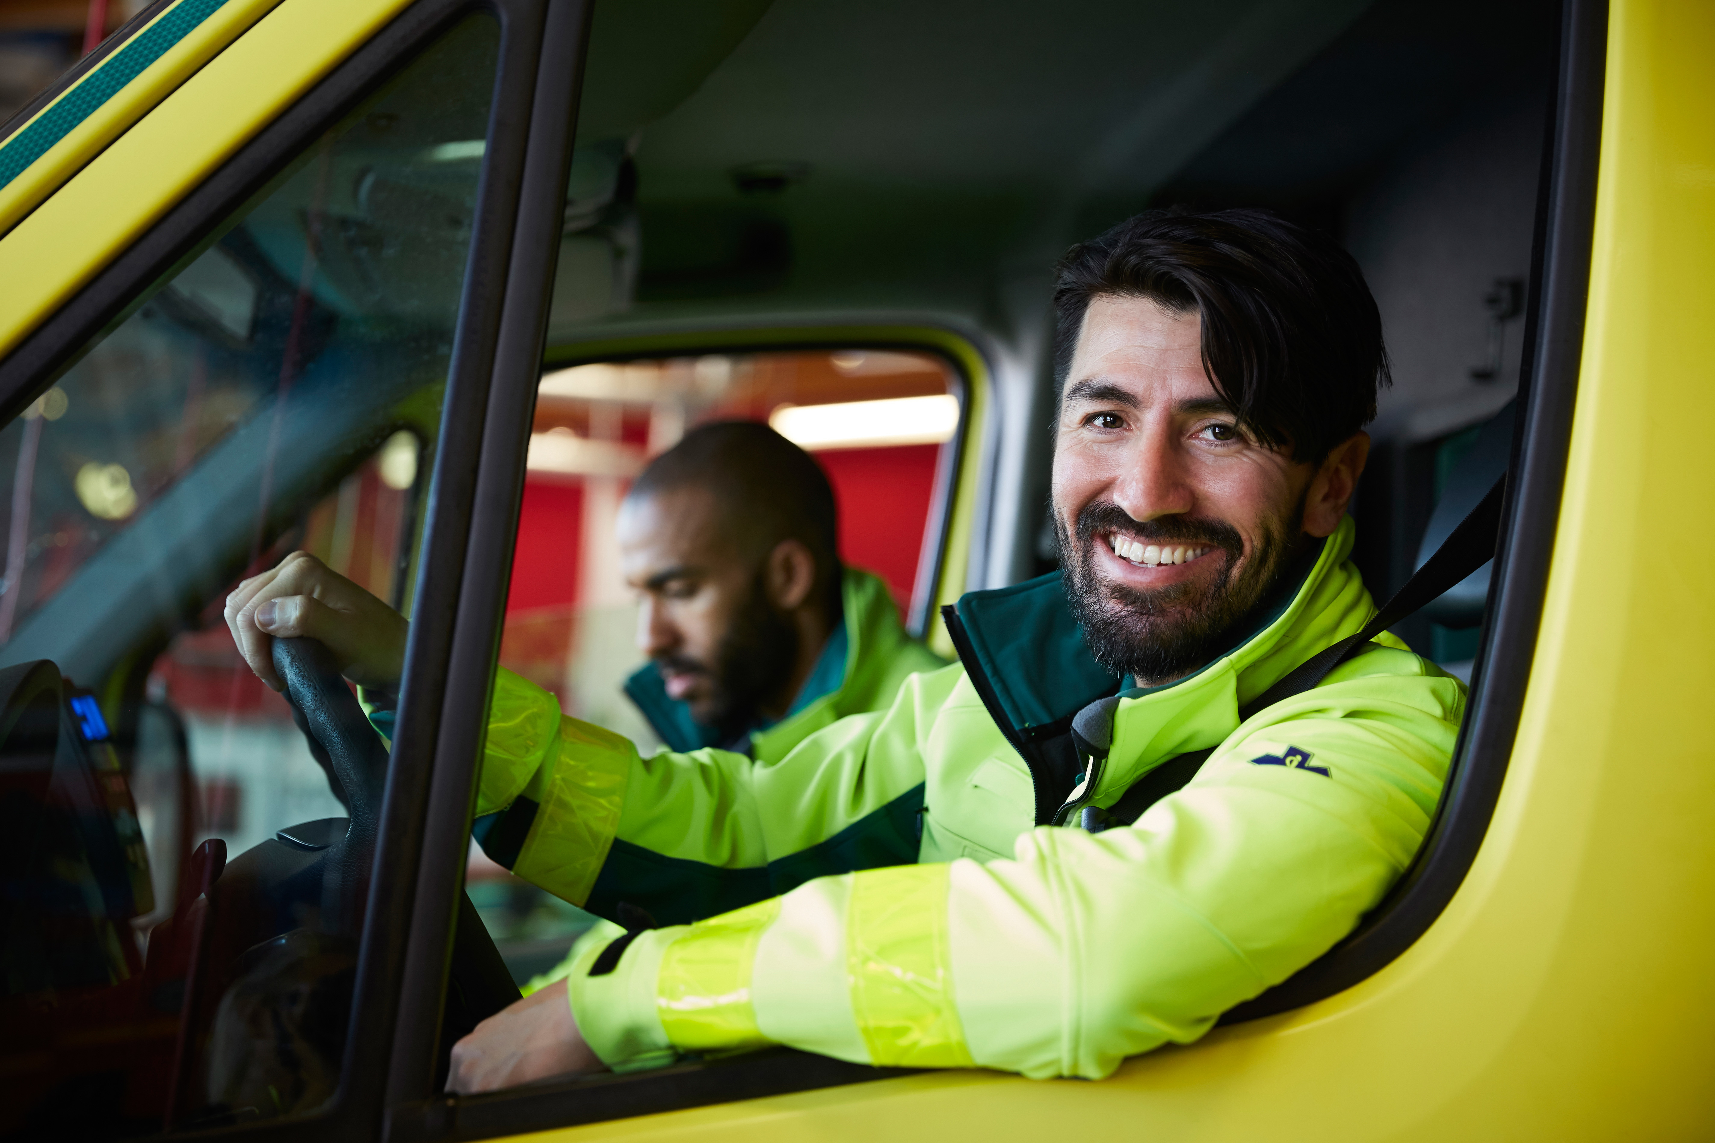
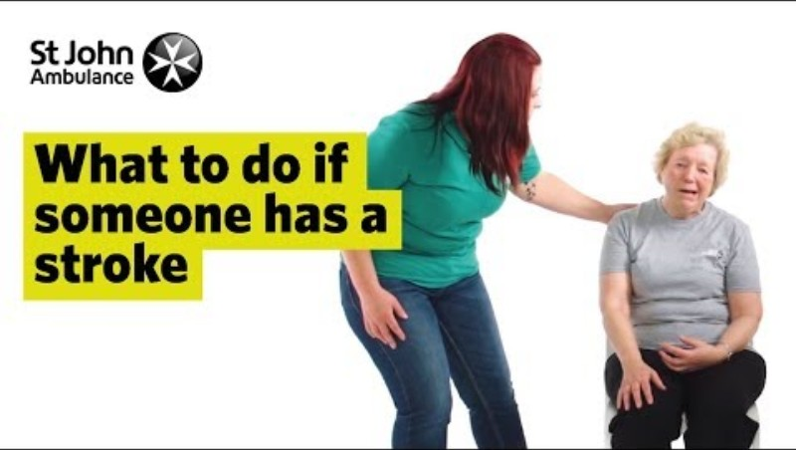
Let's follow Bobs story and identify the different allied health professionals that supported him…
When Bob’s son realised there was something wrong, he phoned 999.
The operator sent an ambulance.
Paramedic
A Paramedic would identify if the person had, had a stroke by using the FAST test. This is important as they will need to get to hospital as quickly as possible.
Watch the video to know about the fast test:

Slide 8
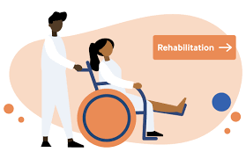
Once Bob got to hospital he was treated by doctors and then was referred to the rehabilitation team.
The team consists of:
Occupational therapist
Orthotics
Speech and language therapy
Dietician
Physiotherapist.
Rehabilitation Team
A team of people who work with an individual to help them gain as much independence as possible. Helping them get back to as near their normal as they can.

Slide 9
You are going to be given a role in Bobs care
(Groups of 5, each with a different role)
You need to research the different allied health professionals that would be involved in Bobs recovery.
Researching what is required to be qualified as that professional.
THEN:
It is your job to explain what you would do in that role for Bob and how you would help with his rehabilitation.

Slide 10
What is your job title?
How did you become a professional? (A levels/ degree?)
What is your role in patient care?
What specific care would you give Bob to help with his stroke.

Slide 11
Resources
www.stroke.org.uk/stroke/life-after/occupational-therapy
www.stroke.org.uk/stroke/life-after-stroke/physiotherapy
www.slt.co.uk/conditions/neurological-problems/stroke/
www.wuth.nhs.uk/our-departments/a-z-of-departments/nutrition-and-dietetics/stroke-specialist-dietitian-team/
www.londonorthotics.co.uk/treatment/stroke-treatment/
These are starting points for students, if you have access to IT they could also use their own research skills to find out more

Slide 12
Bring your group back together
On big paper draw Bob in the middle.
Each person take turns to add your information to the poster explaining to the others in the group what you have found out about your professional and their role in helping Bob recover from his stroke

Slide 13
Demonstrate:
Explain how the care professionals you have been learning about would show person centered values.
Give an example of how each value would be shown for Bob.
Individuality | Encouraging decision making of others | Choice
Dignity | Partnership | Independence
Rights | Privacy | Respect

Slide 14
Consolidate:
Why is it important for professionals to work together when working with Bob?
Do you think there is one professional that is needed more than another in the team?
Why do you think this?

Slide 15
Next steps…
You can look more into these professionals and the services in the Tees Valley area by looking at these websites.
Tees Valley Careers
www.teesvalley-ca.gov.uk/work/careers-hub/pathways/support-for-schools-colleges/
LMI Factsheets (Digital)
www.teesvalley-ca.gov.uk/work/wp-content/uploads/sites/6/2025/03/6-x-LMI-Tees-Valley-Posters-digital-friendly.pdf
Health & Life Sciences Sector Booklet www.teesvalley-ca.gov.uk/work/wp-content/uploads/sites/6/2025/01/Healthcare-and-Life-Sciences-digital-1.pdf
National Careers Service www.nationalcareers.service.gov.uk/explore-careers
CEC Resource Directory www.resources.careersandenterprise.co.uk/
NHS Website
www.nhs.uk
STRIVE Website
www.southtees.nhs.uk/about/strive/
Step into the NHS
www.stepintothenhs.nhs.uk/

