Slide 1




KS3 & 4 Careers in Drama & the Theatre Industry

Slide 2

Why is Drama so important in school?

Slide 3
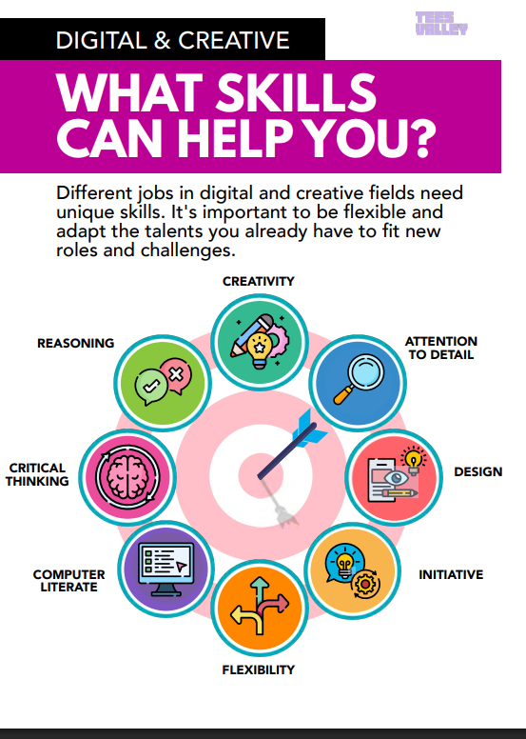
Transferrable Skills Learned in Drama:
Team Working
Verbal and written communication skills
Problem Solving
Time Management
Practical Application of IT
Research Skills
People Management
Presentation Skills
Motivation & Commitment
Ability to work independently

Slide 4

But I don’t want to be an Actor, so, how can it help me?
Some people think that the only worthwhile reason to be studying Drama is to become an actor or director. That’s NOT true. Most students don’t go onto be performers, they choose it because they enjoy it and because of the huge range of life skills you develop.
What people forget is that practical subjects like Drama allow you to develop hugely valuable skills which you will continue to use throughout your life, in and out of work.
Here is a run through of the skills you will develop and perfect throughout your Drama studies.

Slide 5
Team Work
No subject teaches you how to work well in a team quite like Drama.
In Drama you are nearly always working with a group of people of varying sizes.
You will work with people who work hard, disorganised people, bossy people and you may well be one of these characters yourself.
Drama will allow you to develop your patience, ability to compromise and communication skills.
You will need these skills in EVERY job you ever do!

Slide 6
Discipline
You will learn discipline.
Once you’ve mastered the art of keeping a straight face throughout all of a ridiculously funny performance you’re basically the master of discipline.
This skill makes you more aware of your body language and more able to adapt your behaviour for various situations.
It’s not so much about acting as being aware of your body language and how to adapt to distracting, uncomfortable or sensitive situations.

Slide 7
Improvising and Problem Solving
In Drama you will be asked to improvise on a number of occasions.
This allows you to think on your feet, develop your initiative and will encourage you to be more proactive.
It may not feel like it at the time but this will hold you in good stead when it comes to taking initiative and adapting in your personal life and in the workplace.

Slide 8
Being Creative
Drama stimulates you to be constantly creative.
Of course, nothing can actually teach creativity but it is a muscle that needs regular exercise and stretching.
Drama will force you to regularly come up with exciting, functional and convincing ideas, to a deadline and this ability will stay with you.

Slide 9
Empathy
Empathy is a really important life skill.
When you act in Drama you put yourself in to another person’s shoes and try to identify with them and their situation.
This will really test your empathy, especially when portraying a character who is experiencing things you cannot personally relate to.
This is an invaluable skill that will open your mind, improve the way you interact with people and is especially when you have to work with others in any job.

Slide 10
Critical Thinking
Analysing Drama productions and scripts allows you to develop your critical thinking skills.
This is useful for almost every jobs and is great if you are planning on taking English Literature, Media Studies, Humanities and even Maths and Science at degree level.
Also, it allows you to think more critically about the film, television and theatre that we all consume on a daily basis.

Slide 11
Confidence
You will gain in confidence. This is a really important one because Drama gives you the opportunity to push yourself to perform.
You will be able to grow in confidence, develop your performance skills and overcome the fear of making mistakes in a fun, creative and supportive environment.

Slide 12
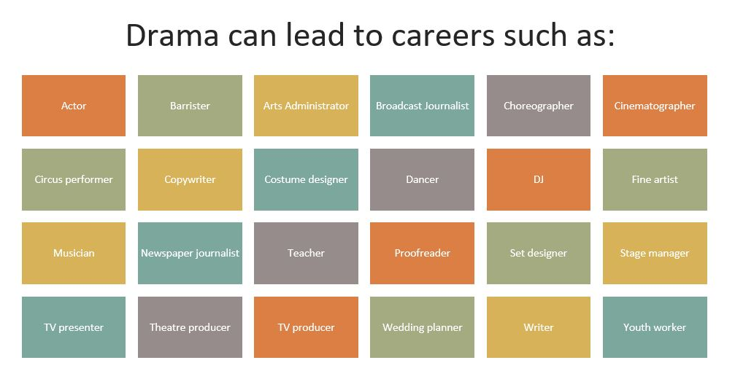

Slide 13

So, where can a career in the Theatre Industry take you? ACTIVE LISTENING

Slide 14

Get into Theatre! ACTIVE LISTENING

Slide 15

Spotlight on Stage Management – ACTIVE LISTENING

Slide 16
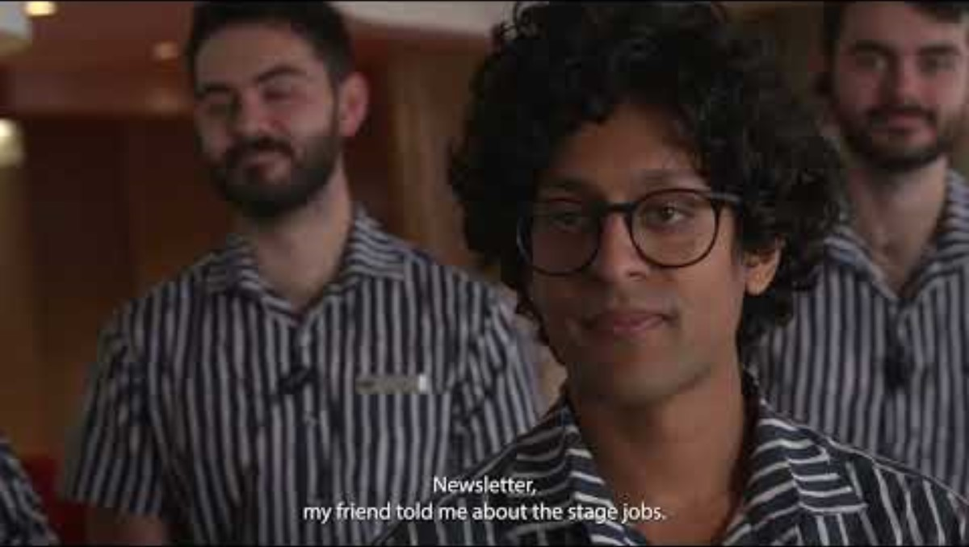
Spotlight on Front of House – ACTIVE LISTENING

Slide 17
Spotlight on Audience Development & Participation Manager (Darlington Hippodrome) – ACTIVE LISTENING
Click here to watch Chris, from Darlington Hippodrome
Click here to take a tour of Darlington Hippodrome

Slide 18
Over to you…..
Using the website, Get Into Theatre.Org - https://getintotheatre.org/ C omplete list of jobs in the theatre industry
Select 5 key roles in the Theatre Industry and create a project fact file which provides detailed information about each of the different roles.
Your project can be presented digitally or as a handwritten booklet.
You should aim to include visual images and as much detail as possible about your 5 chosen roles in the Theatre Industry.

Slide 19
You could also take a look at these links to help you with your research…
Tees Valley Careers https://teesvalley-ca.gov.uk/work/careers-hub/
Sector Workbook – https://teesvalley-ca.gov.uk/work/wp-content/uploads/sites/6/2025/01/Digital-Creative-digital-1.pdf
LMI Information – https://teesvalley-ca.gov.uk/work/wp-content/uploads/sites/6/2025/04/6-x-LMI-Tees-Valley-Posters-digital-friendly.pdf
North East Screen - https://northeastscreen.org/
National Careers Service - https://nationalcareers.service.gov.uk/

