Slide 1

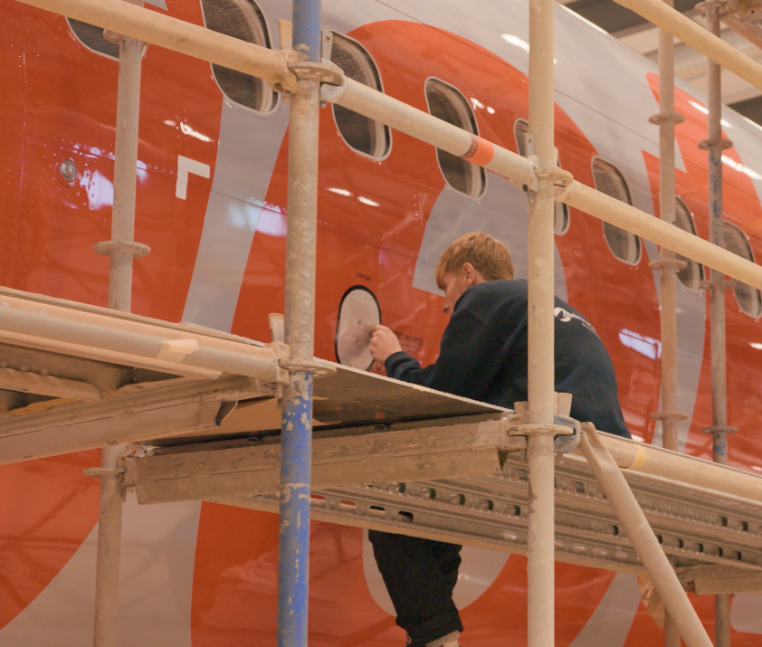


Careers in the Aerospace Sector

Slide 2




Companies across Tees Valley
Where are the most jobs?
Notes:
Introduce the top companies in the Tees Valley area – narrow in on Teesside Airport as a focus of this lesson.

Slide 3

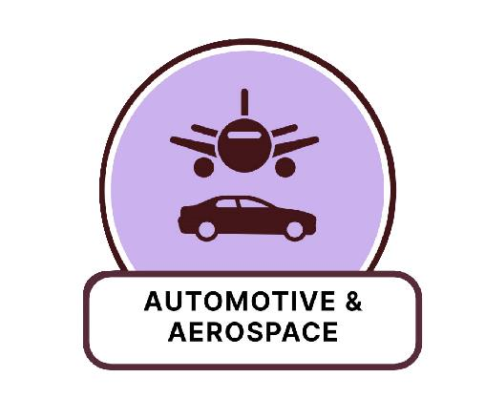

Stockton-on-Tees
Notes:
Introduce the top companies in the Stockton area – narrow in on Aerospace as a focus of this lesson.

Slide 4


How many careers can you name, linked to an airport?
Pilot
Air cabin crew
Airline food service
Baggage handler
Air traffic controller
Aircraft refueler
Flight dispatcher
Duty free retailer
Food service Mechanic
Aircraft Marshall
Security
Cleaner
Bus driver
Animal welfare staff
Ramp agent
Receptionist
Bag scanner
1 MIN
Notes:
Time students for a minute then share answers

Slide 5
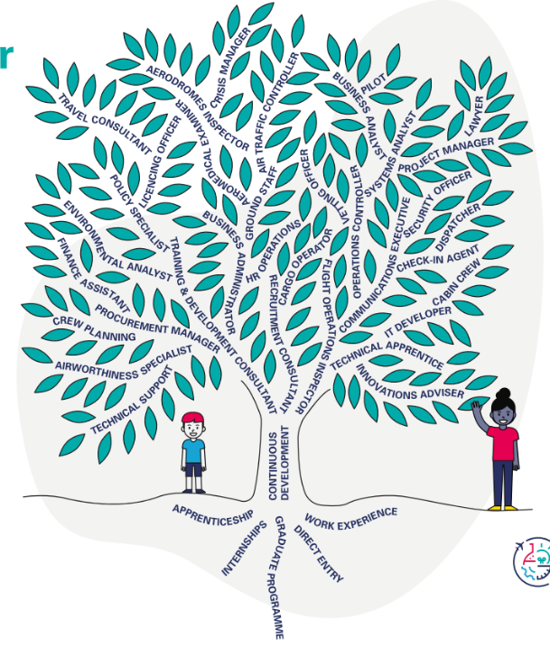
Growing your career in Aviation & Aerospace Industry
Find out more at stem.caa.co.uk

Slide 6
Career paths for different subjects in Aerospace
Construction | English & Social Sciences | Humanities | Maths and Engineering | Science and Technology
Welders Painters Aeroplane Technician Runway surface Gas engineer Electrician Quantity surveyor | Journalism Marketing Public Services Officer HR Air cabin crew | Consents Legal Policy Contracts Logistics Border control | Mechanical Engineering Civil Engineering Finance Insurance Risk Analysis Air traffic control / radar Fuel consumption | Pilot Air traffic control / radar Programmers IT support Cyber security
Notes:
STEM | Head Office – STEM
Discuss how different GCSE subjects can be linked to different areas of the airport

Slide 7
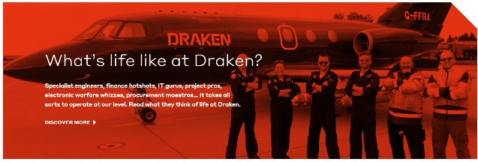
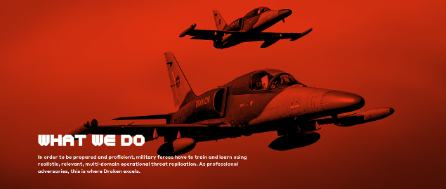

Support for STEM
We are dedicated to investing in new skills, jobs and delivering improvements where we operate, with the aim of supporting a more inclusive economy. We prioritise initiatives that address regional disparities, ensuring opportunities and resources have maximum impact.
We work hard to give guidance to underprivileged students, working with local schools, colleges and universities, to attract a range of talent, encouraging young people from all backgrounds to the importance of STEM subjects.
Collaborating with charities in the aerospace and defence sector, we promote to youngsters the benefits that a rewarding technology-focused career can deliver.
Notes:
Introduce Draken as a potential career opportunity at Teesside Airport

Slide 8
Support for STEM
Draken offers a number of routes into the aerospace and technology sectors. To the right people, we provide the opportunity to earn while you learn, working on live aircraft, guided by experienced colleagues. Our trainees have real responsibility and gain valuable qualifications.
Our four-year technical apprenticeship sees individuals work in the aircraft maintenance sector while studying for professional qualifications. Our programme graduates become fully qualified technicians, using innovative technologies and next-generation engineering skills daily.
Former apprentices are found at all levels in our organisation, with career routes varying from attaining aircraft engineering licenses to achieving degrees in aviation design or radar and electronic warfare specialisms.
Earn while you learn and kickstart a lifelong career with Draken.
Notes:
Introduce Draken as a potential career opportunity at Teesside Airport

Slide 9
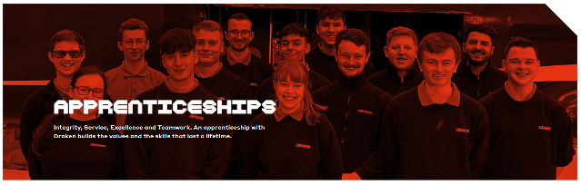
Draken
Draken offers a number of routes into the aerospace and technology sectors. To the right people, we provide the opportunity to earn while you learn, working on live aircraft, guided by experienced colleagues. Our trainees have real responsibility and gain valuable qualifications.
Our four-year technical apprenticeship sees individuals work in the aircraft maintenance sector while studying for professional qualifications. Our programme graduates become fully qualified technicians, using innovative technologies and next-generation engineering skills daily.
Former apprentices are found at all levels in our organisation, with career routes varying from attaining aircraft engineering licenses to achieving degrees in aviation design or radar and electronic warfare specialisms.
Earn while you learn and kickstart a lifelong career with Draken.
Draken is a world-leading defence aerospace specialist. To retain that position, we have to nurture our in-house talent. It’s why we invest in leaders of our own, helping them to develop and unlock their potential through our annual Leadership Talent Programme.
Notes:
Draken provide apprenticeship opportunities – application form can be found on their website.

Slide 10


Paper Airplane Flight Challenge
By Jennifer Powers
1 MIN
Notes:
Provide students with a piece of plain paper – give them 1 minute to construct a paper aeroplane. Line students up and ask them all to fly their planes. Whichever plane flies the furthest, pick it up and discuss why that design was best.
If you have time, play video clip How Do Airplanes Fly? www.youtube.com/watch?v=Gg0TXNXgz-w (link in next slide)

Slide 11
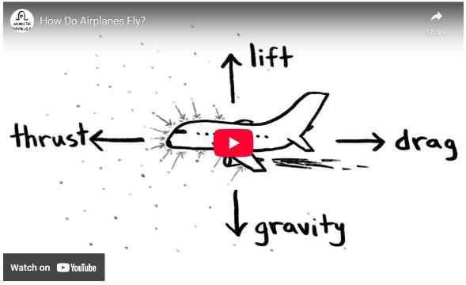
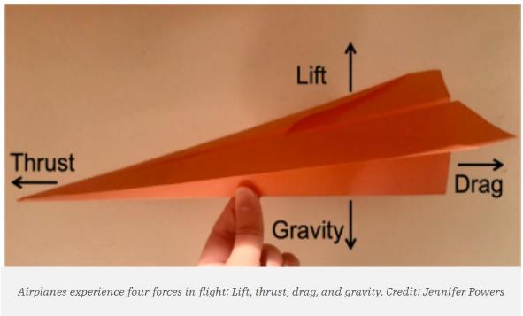
Watch the video – before making aeroplanes

Slide 12
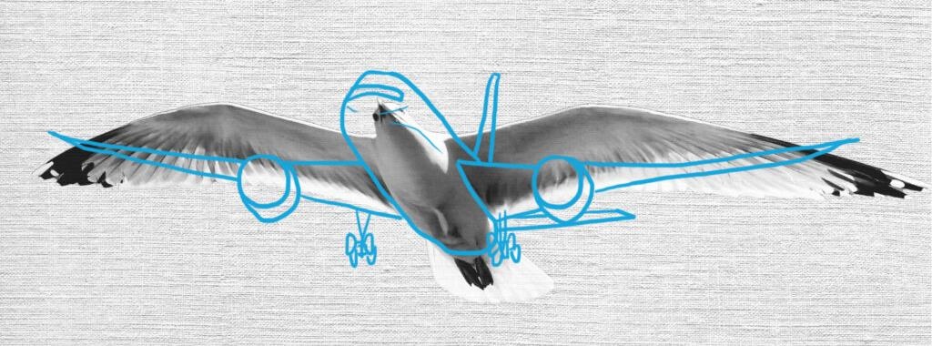
What is Biomimicry?
The design and production of materials, structures, and systems that are modelled on biological entities and processes. It is a practice that learns from and mimics the strategies used by living organisms to solve challenges comparable to the ones we face as individuals and societies.
Notes:
Link aeroplane design to biology. A lot of wing designs are based on real animals.

Slide 13
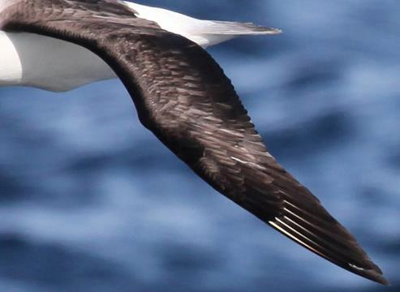
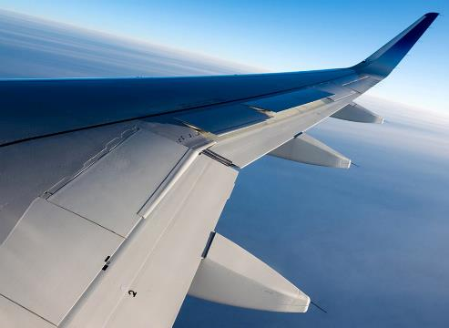
Biomimicry in Aviation
What are the ways that nature inspires breakthrough engineered designs in aerospace?
The most obvious application of biomimicry in aerospace design and engineering, is the adoption of bird-inspired wing designs. Biomimicry has helped engineers design more fuel-efficient and sustainable aircraft. Aircraft designers, for example, are inspired by the albatross bird’s long-distance, low-energy flying technique.
Notes:
Link design to global impact, fuel reduction, saving fossil fuels, global warming etc.

Slide 14
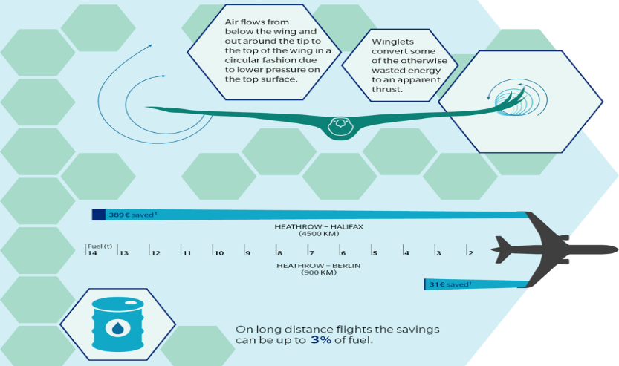
Biomimicry in Aviation (Eagle Winglets)
Notes:
Link design to global impact, fuel reduction, saving fossil fuels, global warming etc.

Slide 15
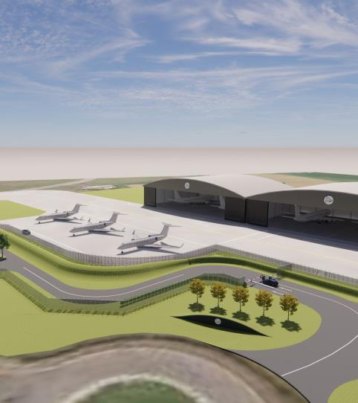
Teesside International Airport
Teesside International Airport is at the heart of the aerospace industry in Tees Valley. Business and general aviation are core activities at the airport and businesses on-site include Global aviation giant Willis Lease Finance Corporation (WLFC) and its wholly-owned subsidiary, Willis Aviation Services Limited (WASL). They are developing an up to £25million maintenance facility and a state-of-the-art Jet Centre at the airport. Draken Europe is also based at the airport, housing aircraft and supporting the critical role the firm plays in training combat pilots from the Royal Air Force, United States Air Force and other NATO member states. Serco International Fire Training Centre and Sycamore Aviation also call Teesside International home.
The airport Master Plan presents a vision for repositioning the airport and looks to secure additional investment to continue to establish a vibrant specialist airport. A key feature is the 2291 x 45 metre runway, which is capable of accepting an aircraft of any size, including the world’s largest aircraft, the Antonov.

Slide 16
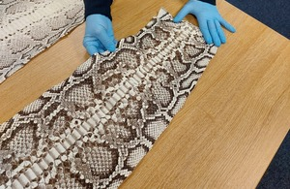
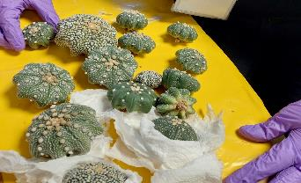

Border Force
Thousands of unlicenced and illegal wildlife products were seized by Border Force as part of Operation Thunder.
Seizures included live plants, a range of beauty products containing caviar and cactus extracts, a quantity of bear bile, and clothes and accessories containing animal skins. Border Force also detected over 400 live birds as part of the operation, including rosella parakeets, king parrots, African grey parrots and blue-fronted Amazon parrots.
Border Force Director for National Operations, Danny Hewitt said: “Wildlife crime is a serious organised crime which fuels corruption, threatens species with extinction, deprives some of the world’s poorest communities of sustainable livelihoods, and degrades ecosystems.
The part of the Home Office responsible for securing the UK border 24 hours a day, 365 days a year by enforcing immigration and customs regulations.
Notes:
Link biology / zoology to border force. Some people may choose to illegally traffic animals/produce which then needs to be intercepted and looked after until relocation can be found in zoos/wildlife facilities. Species must be well cared for an identified.

Slide 17
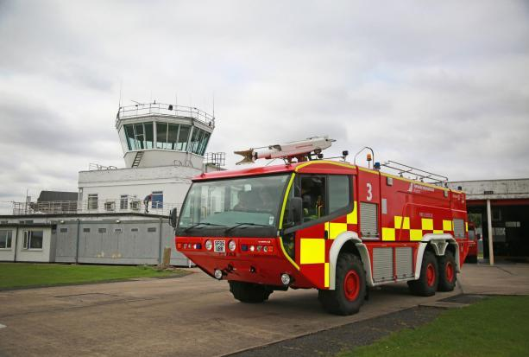
Fire & Rescue at Teesside Airport
Teesside International Airport is a regional airport seeking to develop global connectivity, along with domestic and European business routes and leisure opportunities. As well as serving passengers, the Airport is also focused on developing broader aviation related activities.
The role of firefighter is essential to our airport’s operation, ensuring compliance and business continuity around the clock. We are currently looking for 5 energetic, self-motivated and proactive individuals to join our Fire & Rescue Team.
Are you ready to be part of something extraordinary? Teesside International Airport is expanding its horizons, connecting our region to the world with ambitious domestic and global routes, and we need passionate, dedicated firefighters to keep our airport safe and secure 24/7.
About the Role: As a firefighter at Teesside Airport, you’re not just on standby – you’re a key part of our daily operations, ready to respond to emergencies, support aviation activities, and help ensure smooth airport operations. This role offers hands-on, high-impact work for energetic and proactive individuals ready to make a difference.

Slide 18
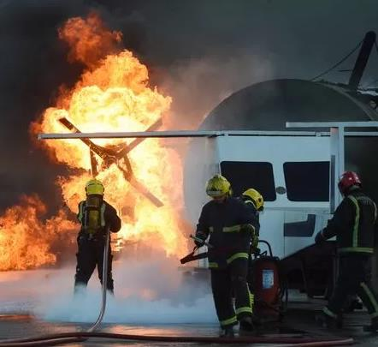
Fire & Rescue at Teesside Airport
Emergency response – react instantly to incidents, prioritizing safety and minimising risk
Medical aid – provide first aid and support emergency medical situations
Station readiness – maintain equipment, vehicles, and operational readiness
Wildlife management – help manage wildlife on airport grounds for safety
Fire prevention – conduct risk assessments and fire audits
Winter operations – keep the runway and facilities safe through snow clearing and de-icing
Support Airport Operations – engage in tasks from baggage handling to patrols, making sure every corner of the airport is safe and operational
Notes:
Talk through some of the duties involved with being a firefighter at the airport.

Slide 19

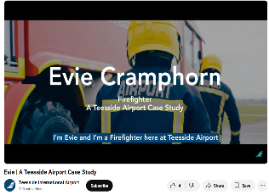
Evie Cramphorn – Firefighter
Good level of fitness / stamina
Excellent communication skills
Team player
Multi-task
Flexible working hours
Full UK driving licence
5 year background check
Evie Teesside Airport Case Study
Notes:
Evie | A Teesside Airport Case Study

Slide 20

NATS Careers
Training to be an Air Traffic Controller www.nats.aero/careers/operations/trainee-air-traffic-controllers/
Notes:
Go through the job of air traffic controller – one of the most profitable jobs at the airport and the routes in.
Click on the weblink and look at the different tabs, the students can create a poster about the different areas.

Slide 21
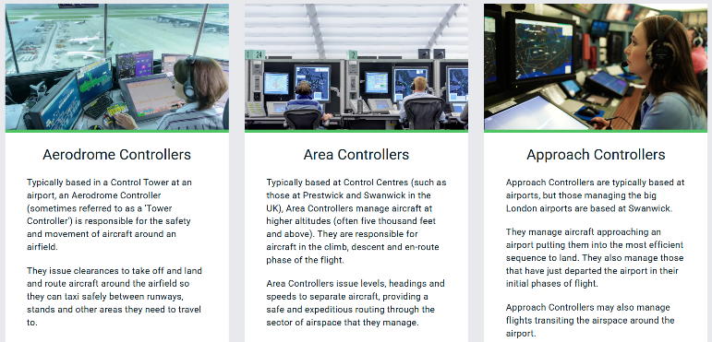
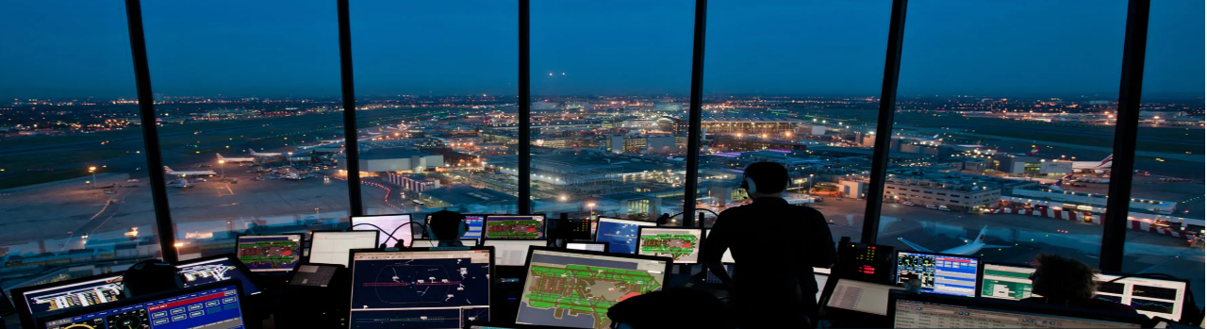
NATS Careers
Notes:
Go through the job of air traffic controller – one of the most profitable jobs at the airport and the routes in.

Slide 22
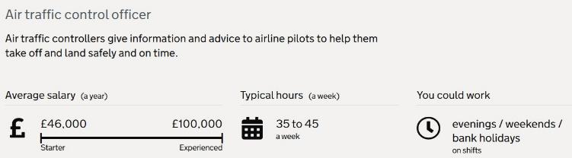
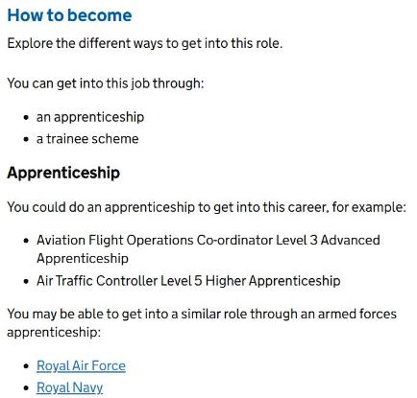
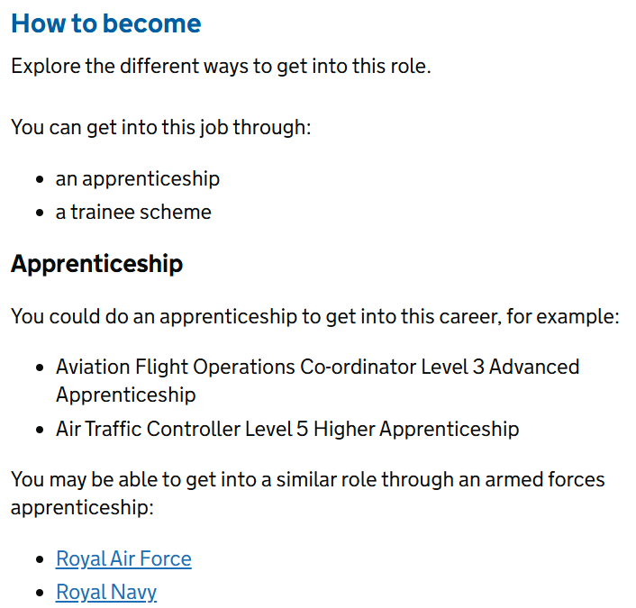
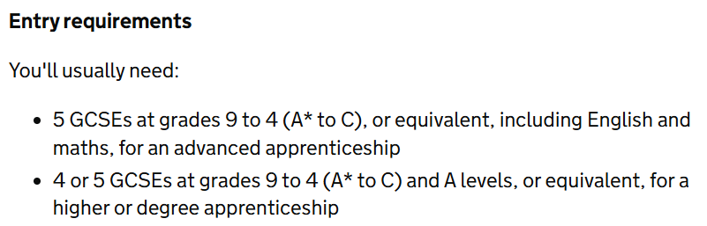
Air Traffic Controller
Notes:
Go through the job of air traffic controller – look at the qualifications, pathways, skills needed

Slide 23
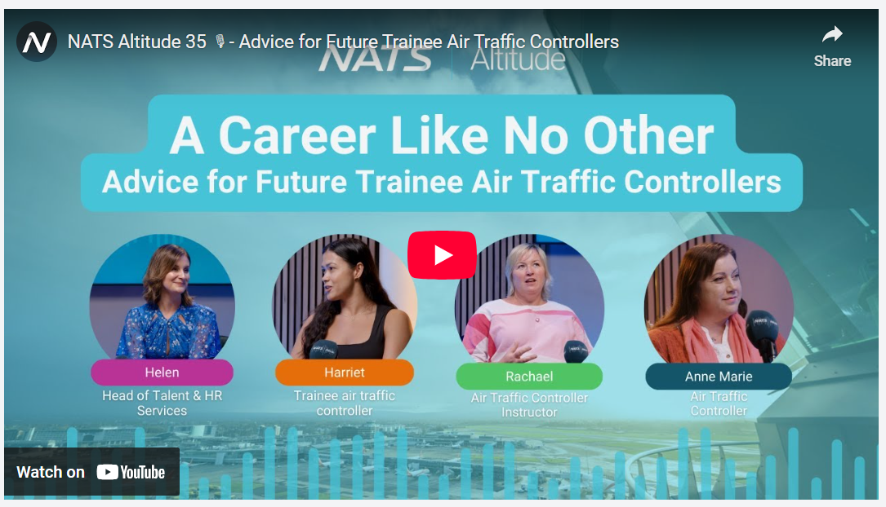
Notes:
https://youtu.be/2F9AJRxB3tM

Slide 24


Chemical Engineering
Chemical engineers design fuels / products that are used in the aerospace industry to improve efficiency and reduce environmental impact.
De-icing a runway or aircraft is very expensive for an airline / airport but flight delays would be even more costly so advances in the chemical industry are vital.

Slide 25
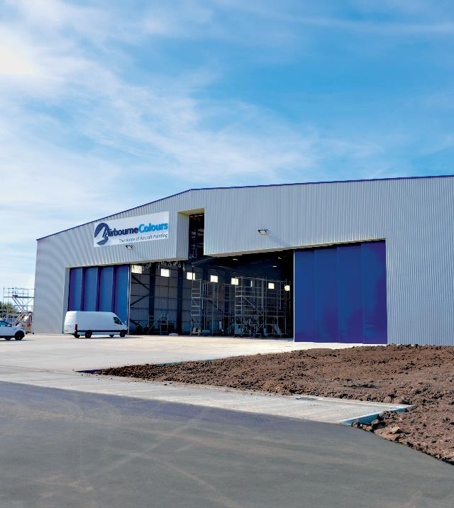
Airbourne Colours
Painting an aircraft is a very complex process that requires up to two weeks of work and, sometimes, over one thousand litres of paint. Coatings are certainly important to improve aesthetics, but their main role is actually to protect the aeroplane against corrosion while improving its aerodynamic properties.
Approximately every five to seven years, an airline has to undergo a new coating phase in order to be able to continue flying safely in the sky.
Notes:
AirbourneColours is a new company that has opened at Teesside Airport following a £6.5million investment which has created 40 new jobs. Students who have an interest / experience in spraying automobiles can transfer their skills over to aircraft.

Slide 26
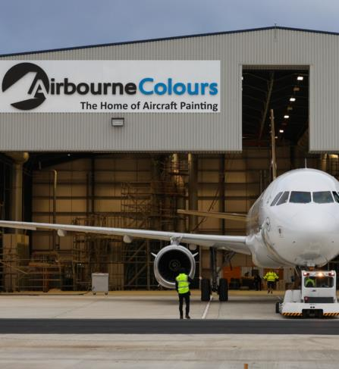
Airbourne Colours
Typical process:
Masking – protect areas that do not need to be coated, such as windows
Surface preparation
Mechanical and chemical stripping
Primer
Coating
Why are most aircrafts painted white?
Notes:
AirbourneColours is a new company that has opened at Teesside Airport following a £6.5million investment which has created 40 new jobs. Students who have an interest / experience in spraying automobiles can transfer their skills over to aircraft.

Slide 27
Airbourne Colours
Typical process:
Masking – protect areas that do not need to be coated, such as windows
Surface preparation
Mechanical and chemical stripping
Primer
Coating
Why are most aircrafts painted white?
It reflects sunlight
It fades more slowly than other colours
It is cheaper and lighter – the heavier the aircraft, the higher the fuel consumption
It makes it easier to detect damage
It reduces the risk of bird strike – white improves the visibility of the aircraft and it increases its detection by birds, thus
Notes:
AirbourneColours is a new company that has opened at Teesside Airport following a £6.5million investment which has created 40 new jobs. Students who have an interest / experience in spraying automobiles can transfer their skills over to aircraft.

Slide 28
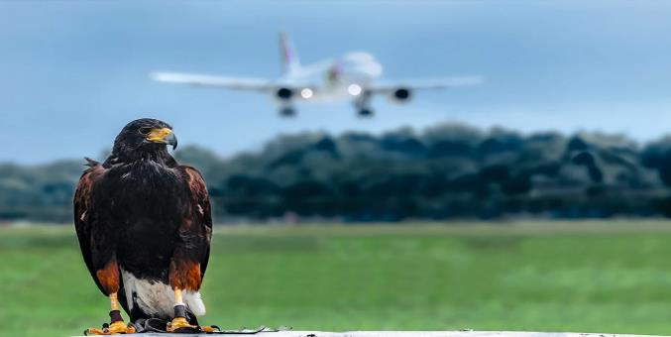
Bird Strikes
Bird strikes are a major problem for Aviation. Estimated conservative costs due to damage and delays of commercial aircraft worldwide are estimated between £1-2 billion per year. They present major problems in taking-off and landing. At Teesside Airport, there are officers that look out for wildlife and environment issues.
Suggested Strategies
Bird management – sounds, lights, pyrotechnics, radio-controlled airplanes, decoy animals, birds of prey, lasers, dogs, falcons, egg adding, nest removal, trapping.
Land planning and management – habitat choice, recycling centres/garbage removal, vegetation control
Avoidance of birds’ migratory routes
Notes:
Link this important role to biology / zoology / ecology. Knowledge of species present in local area, their breeding / migration patterns are vital to preventing bird strike which not only can cause damage/cost to the industry but put peoples lives at risk. 2009 – the miracle on the Hudson, when the captain managed to land the aircraft which had hit a flock of Canadian Geese.

Slide 29
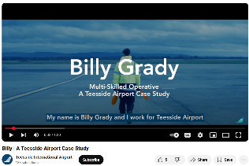
Billy Grady – Multi-Skilled Operative
The range of activities that he can be involved in from marshalling, bag handler, general aircraft jobs and terminal duties.
There is a lot of progression at Teesside Airport so employees can enter on the ground level with minimal qualifications and progress through to management.
Billy Teesside Airport Case Study
Notes:
Watch the video and discuss the job role and skills needed.

Slide 30



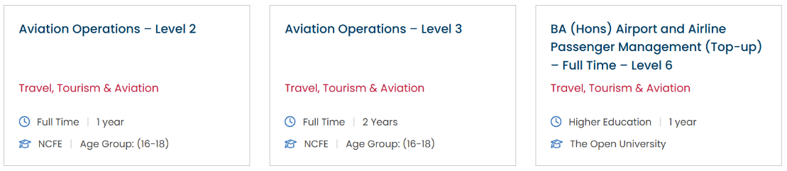
Middlesbrough College
Employers they work with:
Eden Flight Training
Teesside Airport
Virgin Atlantic
Wynyard Hall
Notes:
Slide to show some courses offered by Middlesbrough college for 16-18 year olds in the aerospace industry

Slide 31

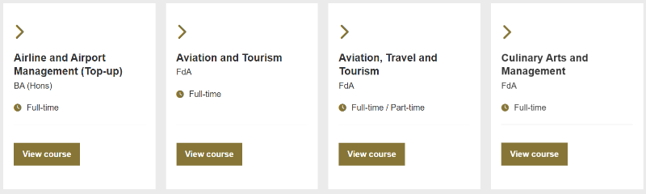

Teesside University
“As international tourism returns to pre-pandemic levels, there is a need for resilience in this popular industry. The aviation and tourism sectors form one of the most dynamic and rapidly expanding industries worldwide. Our courses provide you with the knowledge, skills and real-world experiences you need to become a successful leader in this thriving sector.”
Notes:
Slide to show some courses offered by Teesside University in the aerospace industry

Slide 32
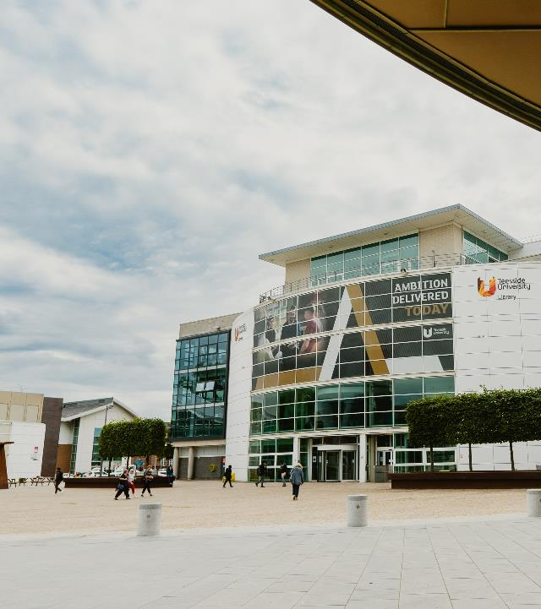
Teesside University
A crucial part of Tees Valley’s infrastructure, Teesside University supports nearly 3,000 jobs and contributes £125million to the economy. Over £270million has been invested in the university, with a further £300million planned over the next ten years.
Teesside University and Tees Valley Combined Authority share an ambition to drive economic growth by supporting local businesses. The Teesside University Partnership, signed in January 2018, formalises the relationship between the two organisations who have worked together for years to deliver joint projects and initiatives that help residents and businesses. It is a unique agreement that will enable the creation of the high level skills that local businesses need to thrive, by attracting and retaining more graduates. It will also help increase the scale-up potential for local businesses and increase innovation capacity, giving businesses here a competitive edge over other regions.
Teesside University also offers specialist training and international expertise in aeronautical engineering and aerospace training. Its Aviation Skills Academy is a collaboration between the Aviation Skills Partnership, local education providers and industry. Currently Teesside University's BEng (Hons) Aerospace Engineering course includes a range of fundamental topics in mechanical engineering, electrical and electronic engineering, materials engineering and design, as well as specialist aerospace and aeronautical topics.

