Slide 1




Where can Geography take you?
An insight into careers within the aviation sector

Slide 2
Outcomes
Identify various careers available within the airport sector.
Understand the different entry routes into the airport industry.
Appreciate the range of skills required for different airport jobs.

Slide 3
Discussion
Who works at Teesside Airport?
What kinds of jobs do they think are necessary for an airport to run smoothly?
What do you know about Teesside Airport?
Notes:
Explain that Teesside airport is actually a large, complex organization with many different careers. Today, you will explore these jobs and learn about different career paths available in the sector.

Slide 4

Overview of jobs
Notes:
Provide a brief overview of the different departments and the jobs within them:
Operations:
Air Traffic Controllers: Manage the flow of air traffic and ensure safe takeoffs, landings, and routing of planes.
Ground Staff: Handle the movement of baggage, oversee aircraft loading/unloading, and ensure that the planes are ready for takeoff.
Customer Service:
Check-In Staff: Help passengers check in, provide boarding passes, and answer general queries.
Ticket Agents: Assist with bookings, ticket purchases, and customer concerns.
Airport Information Officers: Provide assistance and directions to passengers throughout the airport.
Security:
Security Personnel: Ensure the safety of the airport by screening passengers, luggage, and cargo.
Airport Fire service: Respond to emergencies, ensure public safety.
Technical and Maintenance:
Aircraft Engineers and Technicians: Inspect, repair, and maintain aircraft to ensure they are fit for flight.
Facility Maintenance Staff: Handle repairs and general upkeep of airport infrastructure.
Management and Administration:
Airport Manager: Oversees the entire operation of the airport, ensuring smooth functioning and safety.
Operations Manager: Manages daily operational activities at the airport.
Marketing and PR Staff: Handle the airport's image, promotions, and customer relations.
Other Roles
Retail and Hospitality: Run shops, restaurants, and lounges within the airport.
Baggage Handlers: Ensure the safe and efficient transport of baggage from check-in to the plane and vice versa.
Catering Staff: Provide food and beverages to passengers onboard flights and within the airport

Slide 5
Career exploration.
Airline and customer service
eg. Check-in agents, Cabin Crew.
You'll need:
customer service skills
excellent verbal communication skills
patience and the ability to remain calm in stressful situations
to enjoy working with other people
knowledge of public safety and security
sensitivity and understanding
the ability to work well with others
the ability to accept criticism and work well under pressure
to be able to use a computer and the main software packages competently
Operations and Logistics
eg. Baggage handlers, Air traffic control.
You'll need:
customer service skills
physical skills like movement, coordination, dexterity and grace
the ability to work well with others
patience and the ability to remain calm in stressful situations
knowledge of public safety and security
physical fitness and endurance
excellent verbal communication skills
concentration skills
to be able to carry out basic tasks on a computer or hand-held device

Slide 6
Career exploration.
Security and safety
e.g airport police, fire and rescue
You'll need:
knowledge of public safety and security
patience and the ability to remain calm in stressful situations
excellent verbal communication skills
to be thorough and pay attention to detail
sensitivity and understanding
the ability to work well with others
physical fitness and endurance
knowledge of teaching and the ability to design courses
to be able to carry out basic tasks on a computer or hand-held device
Engineering and maintence
eg. Aircraft engineers, ground support technicians.
You'll need:
knowledge of engineering science and technology
maths skills
to be thorough and pay attention to detail
the ability to work well with your hands
the ability to use, repair and maintain machines and tools
the ability to work well with others
the ability to think clearly using logic and reasoning
the ability to analyse quality or performance
to be able to use a computer and the main software packages confidently

Slide 7
Pathways.
There are many different routes into the aviation sector such as:
Applying directly
College courses
Apprenticeships
University courses
https://teesvalley-ca.gov.uk/work/careers-hub/pathways/

Slide 8
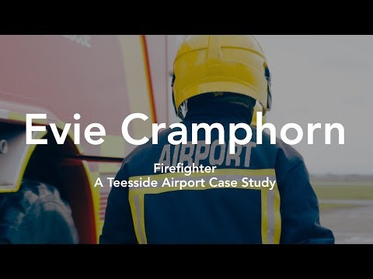
Pathways

Slide 9
Plenary
Which career interests you most and why?
Using the weblinks below research your career interests further:
Tees Valley Key Priority Sectors – httpshttps://teesvalley-ca.gov.uk/business/automotive-and-aerospace/
Tees Valley LMI Factsheet (Darlington) – https://teesvalley-ca.gov.uk/work/wp-content/uploads/sites/6/2025/01/Darlington-LMI-Tees-Valley-Poster.pdf
Aerospace Sector Workbook – https://teesvalley-ca.gov.uk/work/wp-content/uploads/sites/6/2025/01/Automotive-Aerospace-digital.pdf
National Careers Service – https://nationalcareers.service.gov.uk/explore-careers

