Slide 1

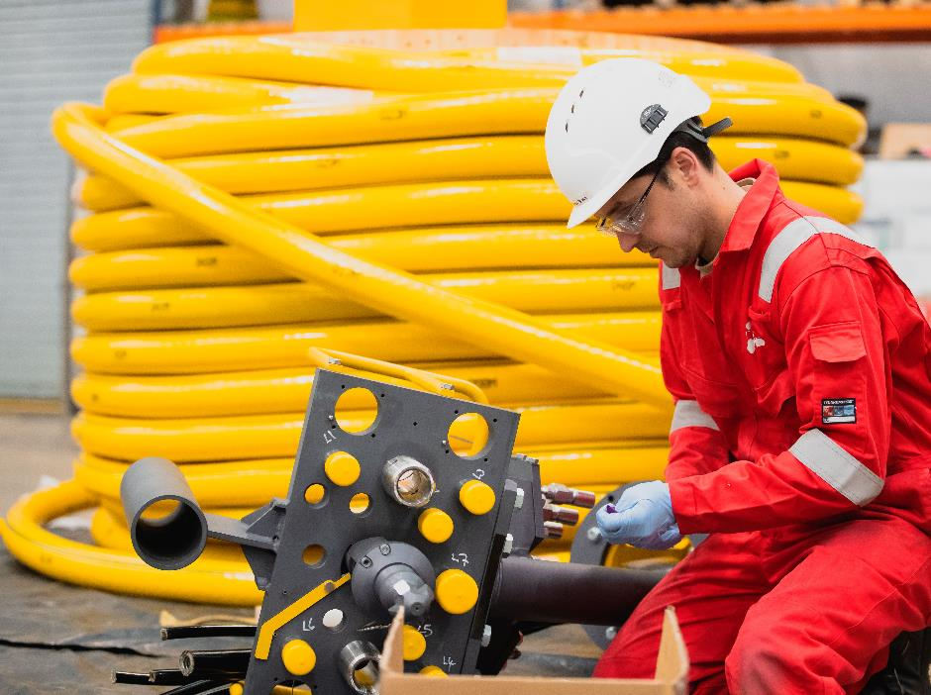


Careers in Engineering
Spotlight on Balfour Beatty

Slide 2
Who are Balfour Beatty?
Watch video here.
Notes:
Redefining what's possible - YouTube

Slide 3
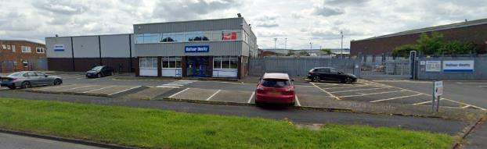
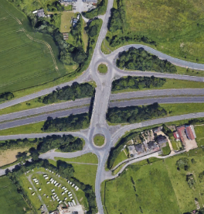
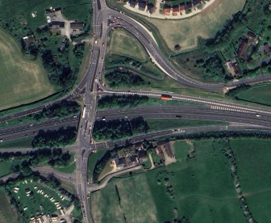
Who are Balfour Beatty?
A leading international infrastructure group
Launched in 1909
Operating in the UK, USA and Hong Kong
13,000 employees in the UK
Design, engineer and maintain major projects across the country on roads, rail and the electricity network
Large office and engineering site in Middlesbrough
Most recently, they did all the work for the Elton Interchange with the A66 – just up the road from school!

Slide 4
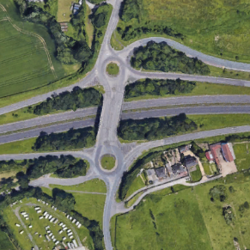
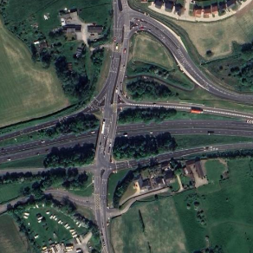
Who did that?
BEFORE (2022)
In the last slide, we talked about the Elton Interchange which was completed by Balfour Beatty in 2024.
How many job roles can you name which could be involved in this work?
What skills or qualifications do you think are needed for some of these roles?
AFTER (2024)
Notes:
Job roles suggested may include:
Project Manager
Site Manager / Construction Manager
Civil Engineer
Surveyor / Land Surveyor
Urban Planner
Environmental Engineer
Health and Safety Officer
Geotechnical Engineer
Structural Engineer
Traffic Engineer
CAD Technician / Draftsperson
Quantity Surveyor
Excavator Operator
Bulldozer Operator
Grader Operator
Asphalt / Bitumen Worker
Concrete Worker / Finisher
Paving Machine Operator
Truck Driver
General Labourer
Flagger / Traffic Controller
Pipe Layer / Drainage Worker
Electrician
Utility Coordinator
Sign Installer
Quality Control Inspector
Inspector / Clerk of Works
Environmental Monitor

Slide 5
Engineering task
Design Engineer This person designs the structure to be built in line with the clients wishes. They are responsible for overseeing the construction and adjusting the design when problems are identified | Quantity Surveyor This person is responsible for working out how much of each construction material is required and identifying the cost of the design
Marketing Officer This person responsible for selling the strengths of the design and showing the benefits of the final bridge. | Construction Engineer These people build the structure following instructions from the designer and project manager.
Quality Assurance This person is responsible for checking that the structure is functional and safe. | Health & Safety Officer This person is responsible for keeping everyone sale while at work
Project Manager This person oversees the whole project keeping an eye on the budget to avoid unnecessary spending and monitor how well the client's requitements are being met. They are also responsible for making sure the project meets deadlines.
Design and construct a bridge to hold as much weight as possible
You will work in teams of six, each taking on one of the roles (everyone will take the role of construction engineers)
You will have the following time:
5 mins to approve a design
5 mins to cost your design and order materials
30 mins to construct
Your materials budget is £1million
Construction Materials Cost
Material | Specification | Cost per unit
Road surface | Cardboard, 100mm by 400mm | £200,000
Short beam | Wood dowel, 50mm | £25,000
Medium beam | Wood dowel, 100mm | £45,000
Long beam | Wood dowel, 200mm | £95,000
Cable | String, per 100mm | £10,000

Slide 6
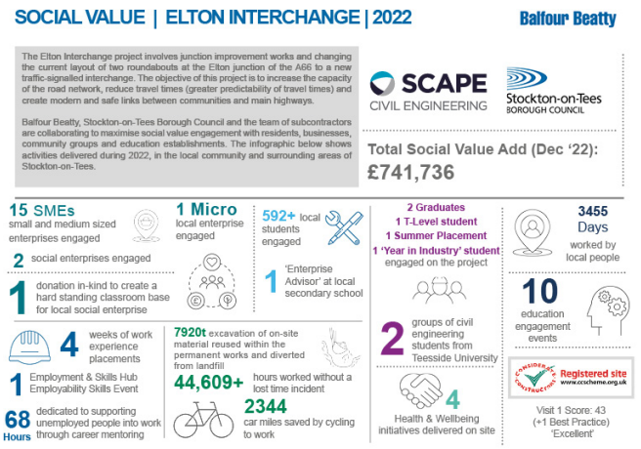

Why is engineering a good choice?

Slide 7
Why is engineering a good choice?
Hear from the professionals:
Ben – Engineer
Watch here.
Clare – Senior Social Impact Manager
Watch here.

Slide 8

Where can you find out more about Balfour Beatty?
Balfour Beatty website www.balfourbeatty.com
Balfour Beatty Early Careers www.balfourbeatty.com/careers/early-careers/explore-early-careers
Balfour Beatty Live Vacancies www.balfourbeatty.com/careers/job-search
Balfour Beatty Academy Consider joining using the link in the image

Slide 9
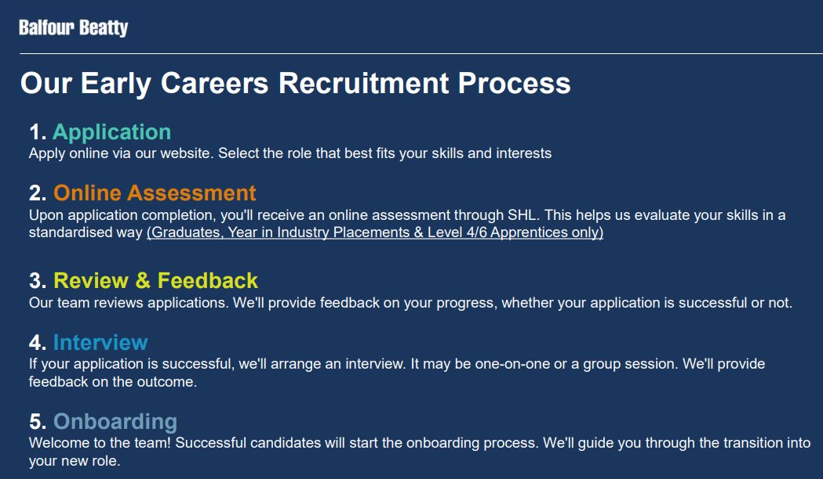
What is the Recruitment Process at Balfour Beatty?

Slide 10



Next steps in your engineering career path
Think about your GCSE courses:
Grade 5s in English, Maths and Science
DT, Engineering, Electronics
Post-16:
A-levels in Science, Maths, Technology
T-levels in Engineering
Apprenticeships with Balfour Beatty and others
Post-18:
Foundation & Degree level apprenticeships
University (Science or Engineering courses)
Factsheets & Workbooks
Key Growth Sectors
Careers at Balfour Beatty

