Slide 1

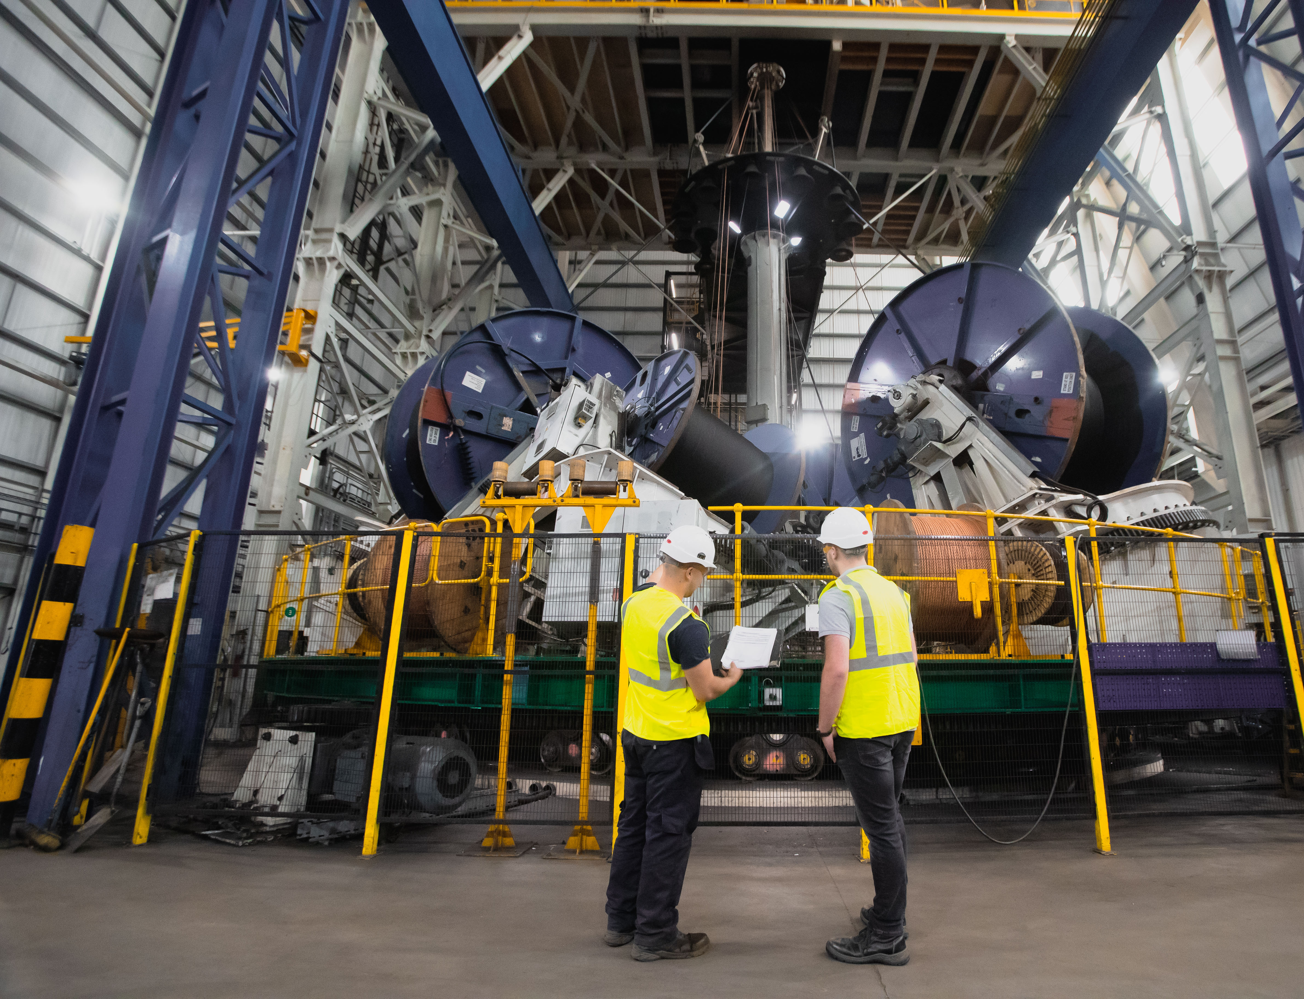


Geography & Engineering: Building the World Around Us
Exploring careers and real-world impact with Balfour Beatty

Slide 2
Lesson Objectives:
Understand how geography is used in engineering projects.
1
Explore real-world examples from Balfour Beatty.
2
Learn about careers in engineering that link to geography.
3
Identify pathways into engineering roles.
4

Slide 3
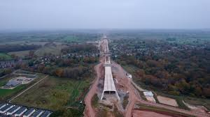

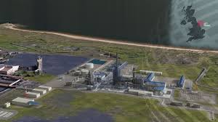
Daily Review: Think-Pair-Share
How do engineers use geography to plan major infrastructure projects?
Instructions:
Think individually for 1 minute.
Pair up and discuss for 2 minutes.
Share answers with the class.
Some thinking points – what challenges does nature present for social engineering? What geographical information would an engineer need?

Slide 4

Geography & Engineering Connections
Engineers use geography to:
Plan routes using topography
Design sustainably with environmental studies
Choose materials with weather/climate data
Use population density for infrastructure planning

Slide 5


Case Study: Balfour Beatty
Balfour Beatty is a UK based infrastructure company.
They design, manage, and implement engineering and infrastructure projects world-wide.
Local projects have included: roads, utilities, flood defences.
How geography played a role:
Avoid flood zones
Protecting wildlife habitats
Supporting urban development

Slide 6
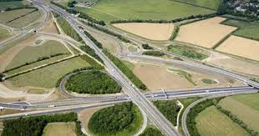

More Balfour Beatty Projects
A14 Cambridge to Huntington Improvement Scheme:
One of the UK’s biggest road projects.
Used advanced geotechnical surveys to avoid flood zones and preserve archaeological sites.
Over 900,000 trees planted and wildlife crossings built for species like otters and badgers.
Hinkley Point C Nuclear Power Station:
Major engineering project using coastal and seismic geography for design.
Use of modular construction: prefabricated parts are assembled on-site to speed up work.
Integration of digital engineering, including BIM (Building Information Modelling) and GIS data for design and logistics.

Slide 7
Careers & Entry Routes
Geography-related roles at Balfour Beatty:
Civil Engineering
Environmental Consultant
Project Planner
Geospatial Analyst
Qauntity Surveyor
Health and Safety Advisor
Site Engineer
Planner
Entry Routes:
Apprenticeships (Post-16, Post-18)
T Levels in Construction or Engineering
University degrees (Engineering, Geography, Geology,Maths)

Slide 8
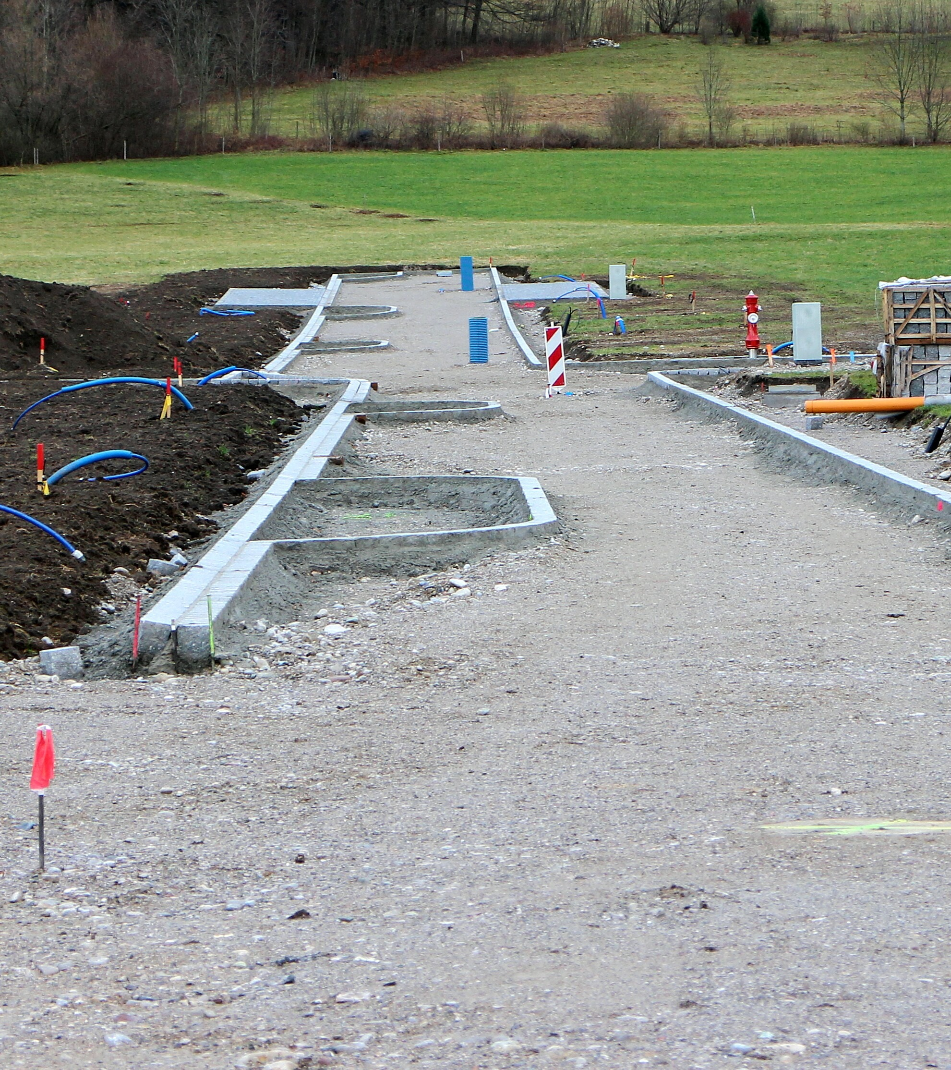
Activity: You’re the Engineer
Task: Design a road connecting two towns across a river and farmland.
Use a simplified map provided
Choose a route avoiding natural obstacles
Justify your choices using geography-based reasoning
Present your design to the class
Bonus: Compare your design with a real Balfour Beatty example.

Slide 9

Group Activity: Environmental Impact Report
Scenario: You are planning a new bridge for a growing town.
Task: Create an Environmental Impact Report (EIR) that addresses:
What habitats and landscapes would be affected?
How could pollution or traffic be managed?
What geographical data would you need to make decisions?
How could you reduce the projects impact?

Slide 10
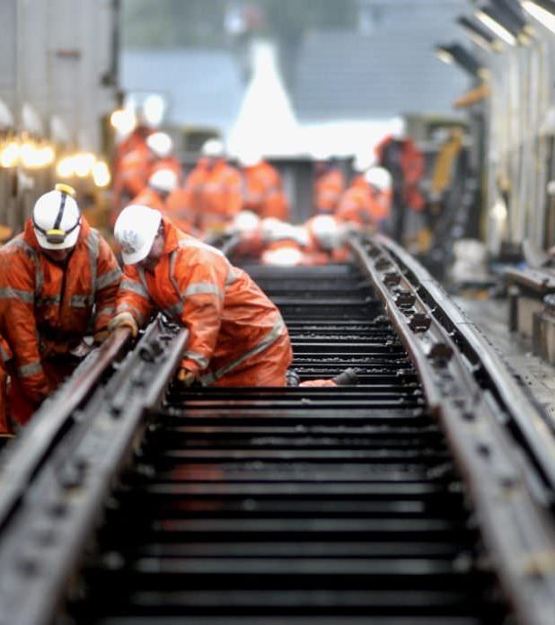
Plenary
Complete the following sentences before leaving:
One new thing I learned about engineering and geography is…
One job I found interesting and why…
Homework:
Research a local engineering project.
Find out how geography influenced its design or location.
Prepare a short presentation or written report.
This Photo by Unknown Author is licensed under CC BY-NC-ND

Slide 11
Useful Resources
Balfour Beatty Careers: https://www.balfourbeatty.com
Tees Valley Labour Market info: https://teesvalley-ca.gov.uk/work/wp-content/uploads/sites/6/2024/12/6-x-LMI-Tees-Valley-Posters-digital-friendly-NEW.pdf
Engineering Sector Workbook: https://teesvalley-ca.gov.uk/work/wp-content/uploads/sites/6/2025/01/Advanced-Manufacturing-Engineering-Digital-2.pdf

