Slide 1

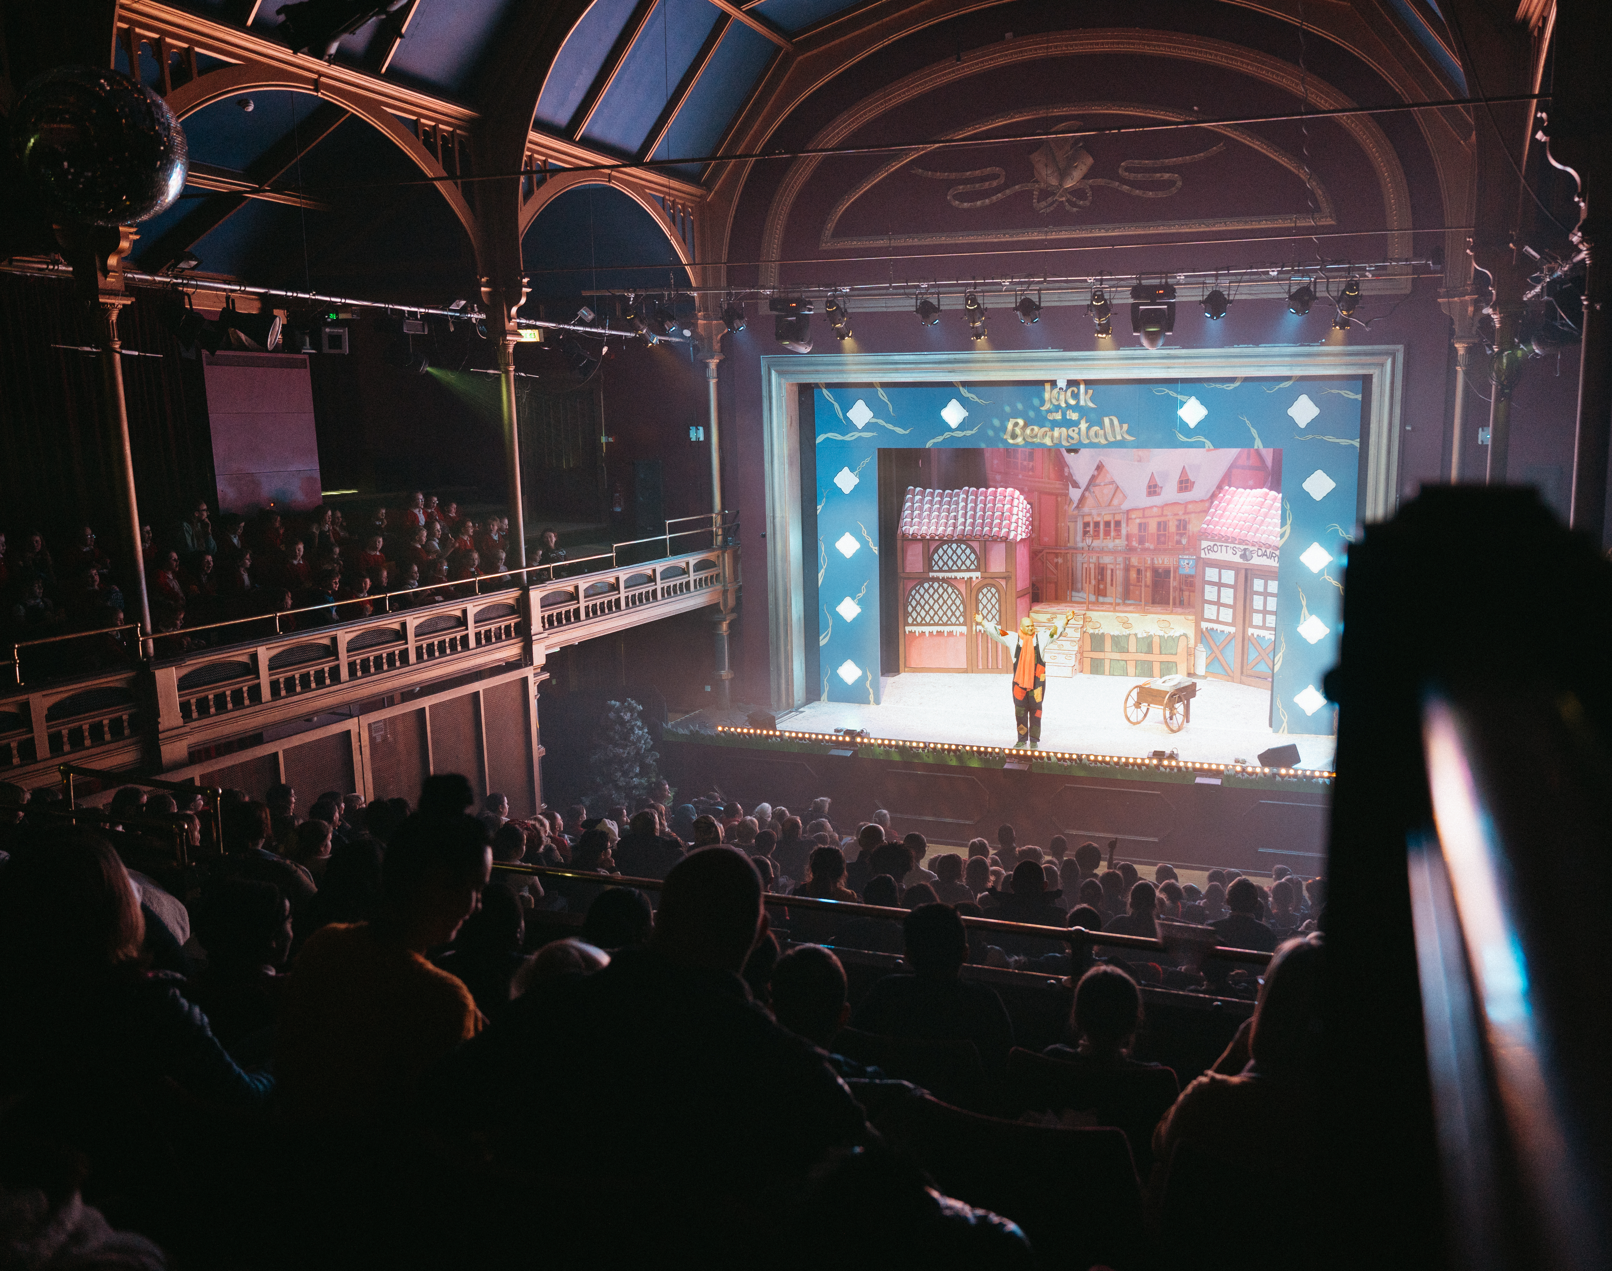


Careers in Theatre Darlington Hippodrome
Understanding the roles of below-the-line staff in theatre production.

Slide 2
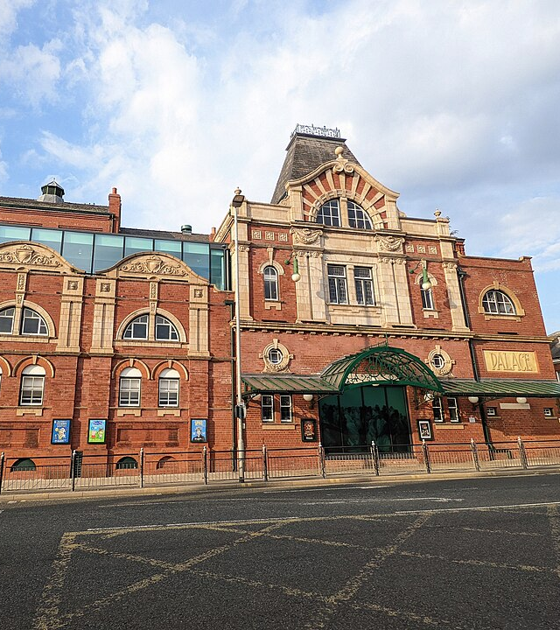
Learning Objectives:
By the end of the lesson, students will:
Understand what "below-the-line" roles are in theatre.
Identify key backstage roles and their responsibilities.
Appreciate the importance of below-the-line staff in a production.
Engage in a practical activity related to backstage work.
Notes:
What are Below-the-Line Roles?
Explanation: In theatre, "below-the-line" roles refer to the behind-the-scenes positions that help make a production possible. These roles are crucial to the functioning of a theatre production but are not usually in the spotlight. They deal with the technical, organisational, and logistical aspects of the performance.
Contrast with "Above-the-Line" Roles:
"Above-the-line" roles include the director, playwright, lead actors, etc. These are often the more visible, creative positions.
"Below-the-line" roles involve technical and production staff, such as stage managers, lighting technicians, sound engineers, etc.
Why are these roles important?
Explain the importance of below-the-line roles: Without these key players, the show cannot go on! These roles ensure that the performance runs smoothly, from set design to costume changes and sound management.

Slide 3
Starter Activity (10 minutes) – Discussion & Introduction
"What happens behind the scenes to make a theatre show work?"
Notes:
1. Starter Activity (10 minutes) – Discussion & Introduction
Engage: Ask students, "What happens behind the scenes to make a theatre show work?"
Introduce Key Concept: Explain "below-the-line" roles—those working behind the scenes rather than performing (e.g., stage management, lighting, sound, and costume, props, set design).
Darlington Hippodrome Context: Show images or brief clips of productions at Darlington Hippodrome and discuss the backstage elements.

Slide 4
Notes:
The term “above-the-line” comes from the production budget, where the key creative roles are budgeted separately from other stages of the production process. The three key creative roles are screenwriter, director and producer, and these roles vary in each type and size of productions.

Slide 5
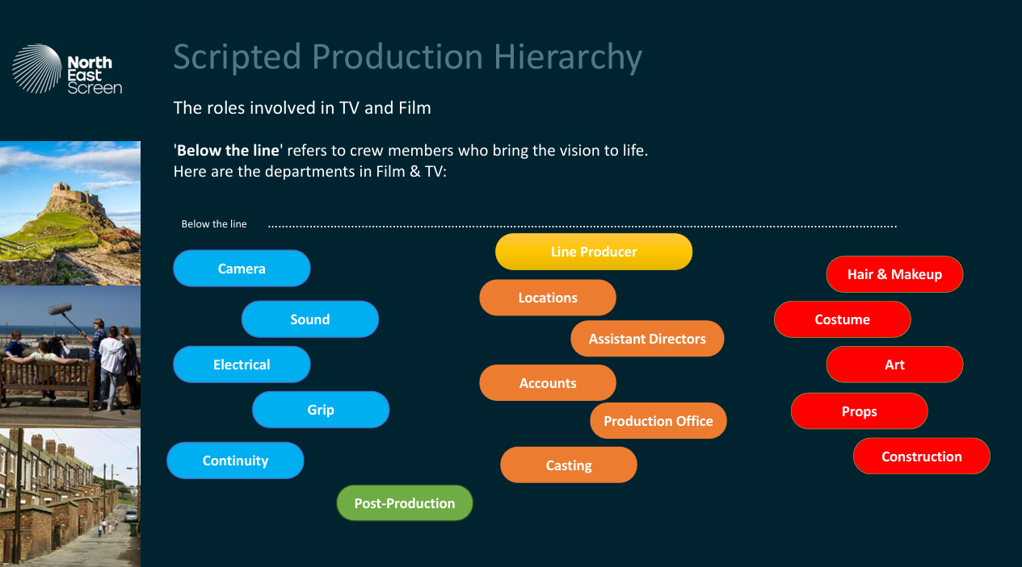
Notes:
Below the Line: Those who are responsible for the day-to-day filmmaking involved in pre-production, production, and post-production. Departments such as Camera, Electrical, Grip, Production Design, Costume and Makeup.

Slide 6
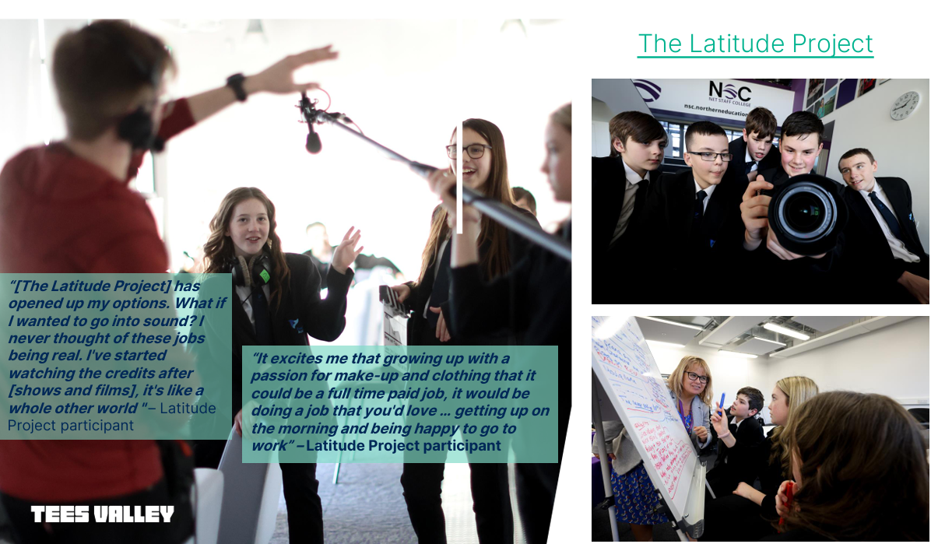
https://www.youtube.com/watch?v=wnqMTQ1vTqE
Notes:
The Latitude Project is a radical new education and training programme that helps create pathways for young people into TV and Film Production.

Slide 7
Main Activity (30 minutes) – Exploring Theatre Roles
Role Exploration (15 minutes)
Stage Manager – Group 1.
Lighting Technician – Group 2.
Sound Engineer – Group 3.
Set Designer – Group 4.
Costume & Prop Crew – Group 5.
Notes:
Divide students into small groups. Assign each group a key below-the-line role:
Stage Manager – Coordinates the production.
Lighting Technician – Controls lighting design and cues.
Sound Engineer – Manages sound effects and microphones.
Set Designer – Designs the stage setting.
Costume & Prop Crew – Prepares and maintains costumes/props.
Each group researches their role (you can provide fact sheets).
They create a short "day in the life" script explaining their job.

Slide 8
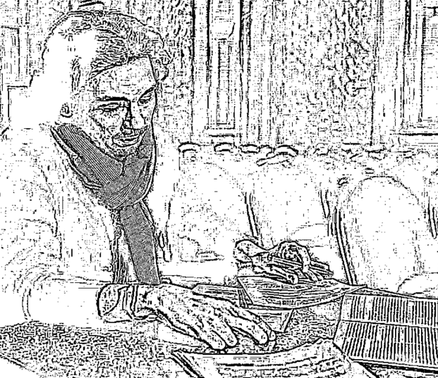
Stage Manager – Coordinates the production.
Notes:
Students can use this space to annotate during presentation on interactive whiteboard or these sheets can be printed out (A3) to add notes to as part of paper-based presentation.
Each group researches their role (you can provide fact sheets).
They create a short "day in the life" script explaining their job.

Slide 9
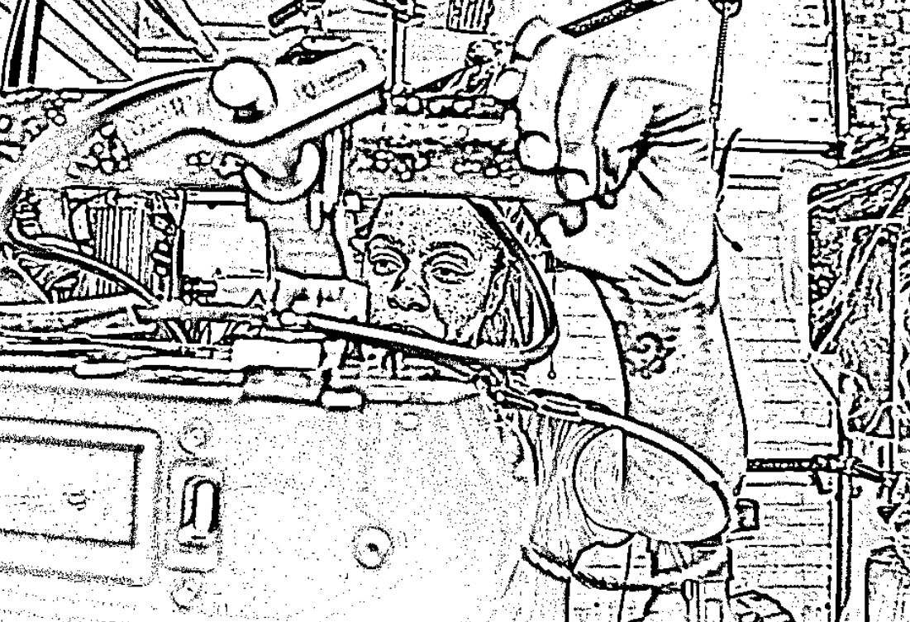
Lighting Technician – Controls lighting design and cues.
Notes:
Students can use this space to annotate during presentation on interactive whiteboard or these sheets can be printed out (A3) to add notes to as part of paper-based presentation.
Each group researches their role (you can provide fact sheets).
They create a short "day in the life" script explaining their job.

Slide 10
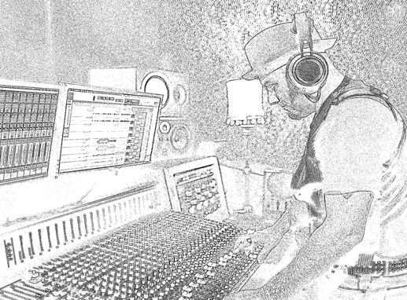
Sound Engineer – Manages sound effects and microphones.
Notes:
Students can use this space to annotate during presentation on interactive whiteboard or these sheets can be printed out (A3) to add notes to as part of paper-based presentation.
Each group researches their role (you can provide fact sheets).
They create a short "day in the life" script explaining their job.

Slide 11
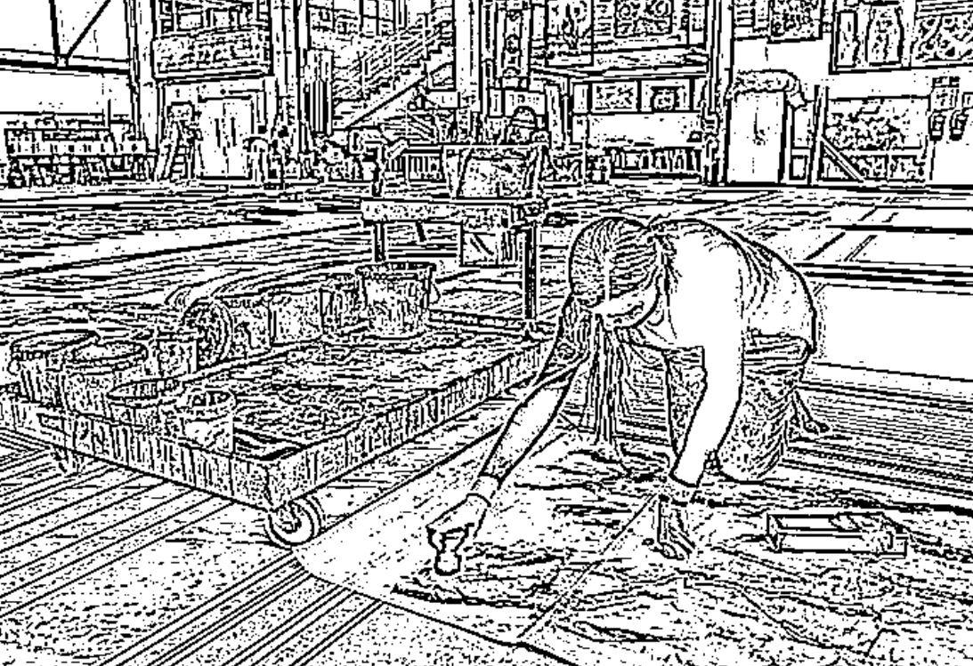
Set Designer – Designs the stage setting.
Notes:
Students can use this space to annotate during presentation on interactive whiteboard or these sheets can be printed out (A3) to add notes to as part of paper-based presentation.
Each group researches their role (you can provide fact sheets).
They create a short "day in the life" script explaining their job.

Slide 12
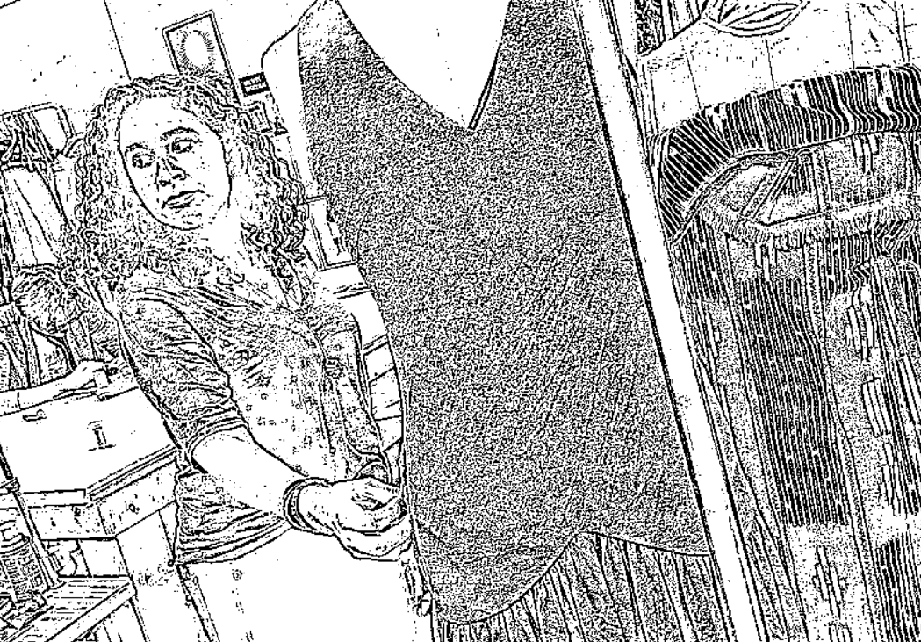
Costume & Prop Crew – Prepares and maintains costumes/props.
Notes:
Students can use this space to annotate during presentation on interactive whiteboard or these sheets can be printed out (A3) to add notes to as part of paper-based presentation.
Each group researches their role (you can provide fact sheets).
They create a short "day in the life" script explaining their job.

Slide 13
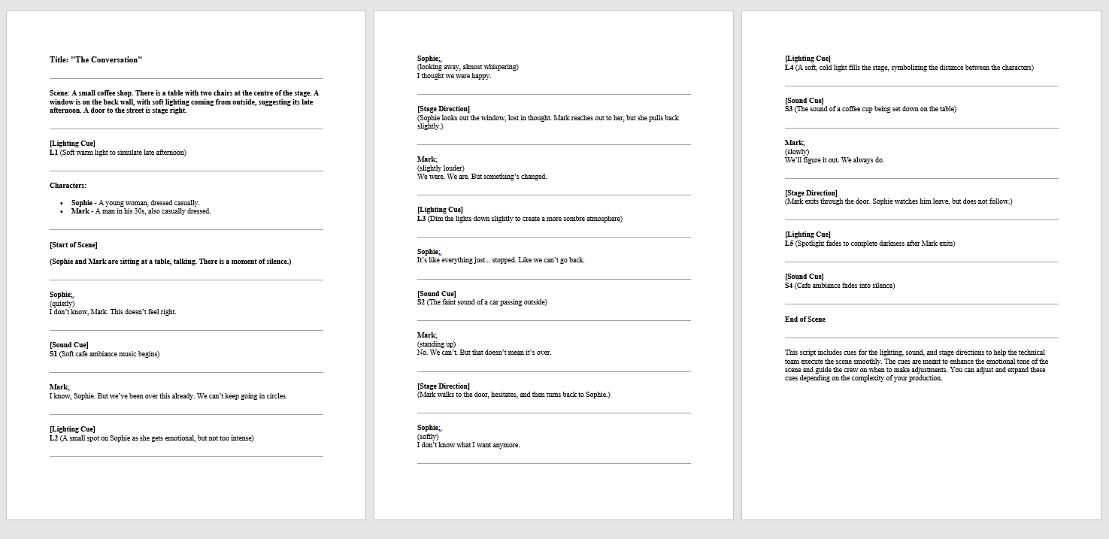
Practical Task (15 minutes)
Set up a small mock stage area with a script extract.
Each group must "perform" their backstage role:
Lighting group adjusts a basic light cue.
Sound team plays/mimes sound effects.
Stage management team coordinates the scene.
Set/costume team prepares a quick scene change.
Notes:
Set up a small mock stage area with a script extract.
Each group must "perform" their backstage role:
Lighting group adjusts a basic light cue.
Sound team plays/mimes sound effects.
Stage management team coordinates the scene.
Set/costume team prepares a quick scene change.

Slide 14
Plenary (20 minutes) – Reflection & Q&A
Each group presents what they learned about their role.
Discuss: "How would a theatre production be affected if these roles didn’t exist?"
Final Q&A: Invite students to ask about backstage roles at Darlington Hippodrome - Video Links to be added.
Video Links…
Notes:
Each group presents what they learned about their role.
Discuss: "How would a theatre production be affected if these roles didn’t exist?"
Final Q&A: Invite students to ask about backstage roles at Darlington Hippodrome - Video Links to be added.

Slide 15
Darlington Hippodrome – Video & Tour
Click here to watch Chris, from Darlington Hippodrome
Click here to take a tour of Darlington Hippodrome

Slide 16
Assessment & Differentiation:
Assessment:
Observation of group work, participation in practical tasks, and responses during discussion.
Differentiation:
Offer printed role descriptions for support.
Challenge high-ability students by asking them to suggest how different roles collaborate.

Slide 17
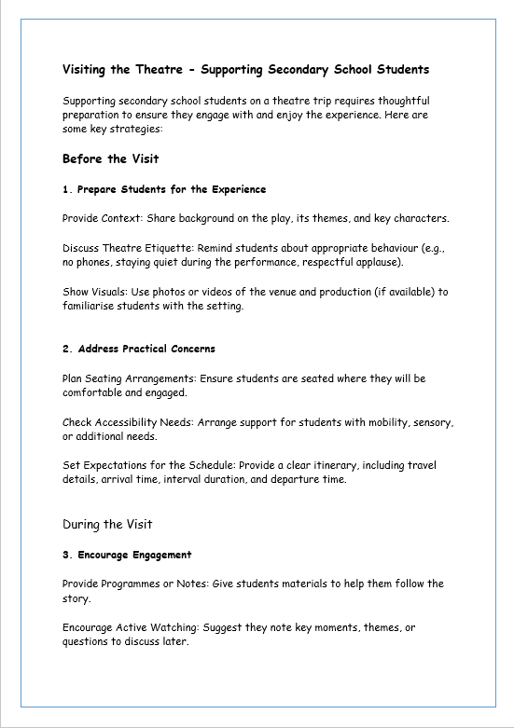
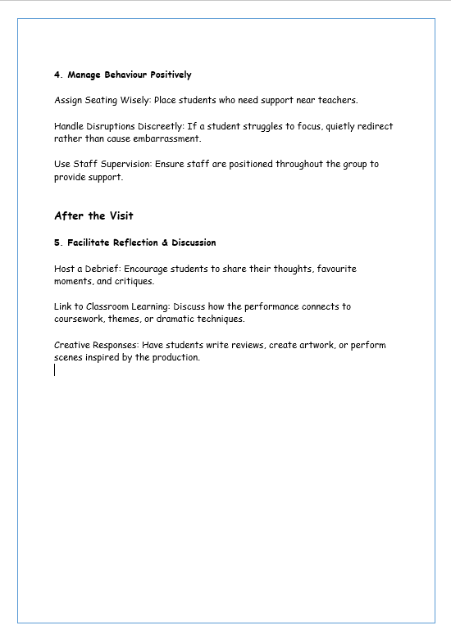
Secondary School Guide to Visiting the Theatre
Notes:
Visiting the Theatre - Supporting Secondary School Students
Supporting secondary school students on a theatre trip requires thoughtful preparation to ensure they engage with and enjoy the experience. Here are some key strategies:
Before the Visit
1. Prepare Students for the Experience
Provide Context: Share background on the play, its themes, and key characters.
Discuss Theatre Etiquette: Remind students about appropriate behaviour (e.g., no phones, staying quiet during the performance, respectful applause).
Show Visuals: Use photos or videos of the venue and production (if available) to familiarise students with the setting.
2. Address Practical Concerns
Plan Seating Arrangements: Ensure students are seated where they will be comfortable and engaged.
Check Accessibility Needs: Arrange support for students with mobility, sensory, or additional needs.
Set Expectations for the Schedule: Provide a clear itinerary, including travel details, arrival time, interval duration, and departure time.
During the Visit
3. Encourage Engagement
Provide Programmes or Notes: Give students materials to help them follow the story.
Encourage Active Watching: Suggest they note key moments, themes, or questions to discuss later.
4. Manage Behaviour Positively
Assign Seating Wisely: Place students who need support near teachers.
Handle Disruptions Discreetly: If a student struggles to focus, quietly redirect rather than cause embarrassment.
Use Staff Supervision: Ensure staff are positioned throughout the group to provide support.
After the Visit
5. Facilitate Reflection & Discussion
Host a Debrief: Encourage students to share their thoughts, favourite moments, and critiques.
Link to Classroom Learning: Discuss how the performance connects to coursework, themes, or dramatic techniques.
Creative Responses: Have students write reviews, create artwork, or perform scenes inspired by the production.

Slide 18
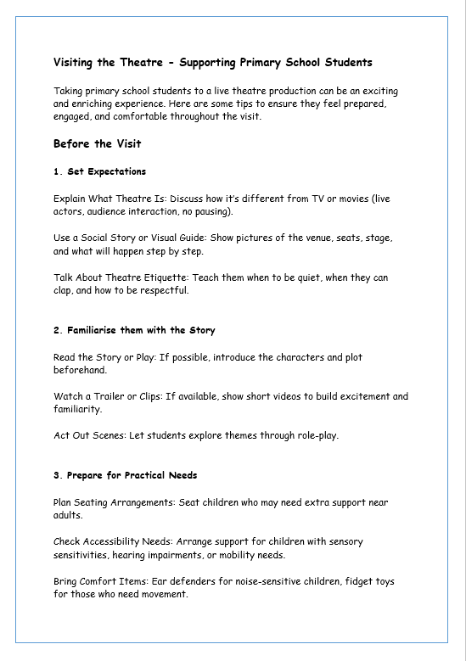
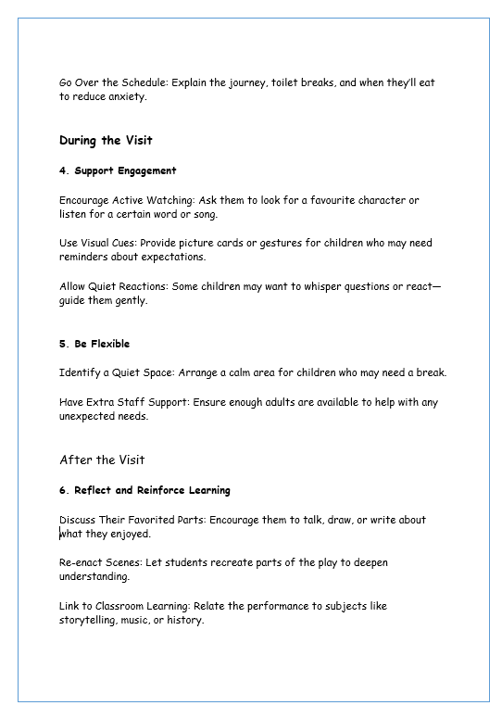
Primary School Guide to Visiting the Theatre
Notes:
Visiting the Theatre - Supporting Primary School Students
Taking primary school students to a live theatre production can be an exciting and enriching experience. Here are some tips to ensure they feel prepared, engaged, and comfortable throughout the visit.
Before the Visit
1. Set Expectations
Explain What Theatre Is: Discuss how it’s different from TV or movies (live actors, audience interaction, no pausing).
Use a Social Story or Visual Guide: Show pictures of the venue, seats, stage, and what will happen step by step.
Talk About Theatre Etiquette: Teach them when to be quiet, when they can clap, and how to be respectful.
2. Familiarise them with the Story
Read the Story or Play: If possible, introduce the characters and plot beforehand.
Watch a Trailer or Clips: If available, show short videos to build excitement and familiarity.
Act Out Scenes: Let students explore themes through role-play.
3. Prepare for Practical Needs
Plan Seating Arrangements: Seat children who may need extra support near adults.
Check Accessibility Needs: Arrange support for children with sensory sensitivities, hearing impairments, or mobility needs.
Bring Comfort Items: Ear defenders for noise-sensitive children, fidget toys for those who need movement.
Go Over the Schedule: Explain the journey, toilet breaks, and when they’ll eat to reduce anxiety.
During the Visit
4. Support Engagement
Encourage Active Watching: Ask them to look for a favourite character or listen for a certain word or song.
Use Visual Cues: Provide picture cards or gestures for children who may need reminders about expectations.
Allow Quiet Reactions: Some children may want to whisper questions or react—guide them gently.
5. Be Flexible
Identify a Quiet Space: Arrange a calm area for children who may need a break.
Have Extra Staff Support: Ensure enough adults are available to help with any unexpected needs.
After the Visit
6. Reflect and Reinforce Learning
Discuss Their Favorited Parts: Encourage them to talk, draw, or write about what they enjoyed.
Re-enact Scenes: Let students recreate parts of the play to deepen understanding.
Link to Classroom Learning: Relate the performance to subjects like storytelling, music, or history.

Slide 19
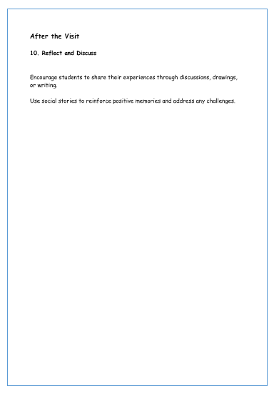
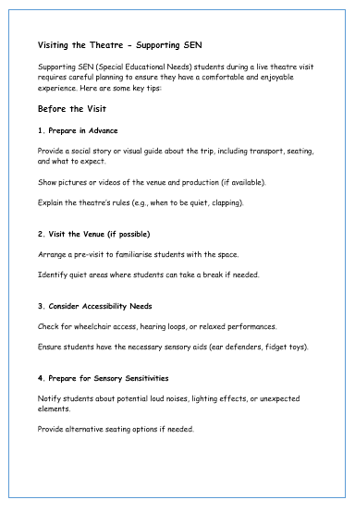
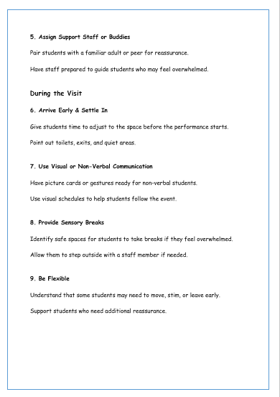
SEN Guide to Visiting the Theatre
Notes:
Visiting the Theatre - Supporting SEN
Supporting SEN (Special Educational Needs) students during a live theatre visit requires careful planning to ensure they have a comfortable and enjoyable experience. Here are some key tips:
Before the Visit
1. Prepare in Advance
Provide a social story or visual guide about the trip, including transport, seating, and what to expect.
Show pictures or videos of the venue and production (if available).
Explain the theatre’s rules (e.g., when to be quiet, clapping).
2. Visit the Venue (if possible)
Arrange a pre-visit to familiarise students with the space.
Identify quiet areas where students can take a break if needed.
3. Consider Accessibility Needs
Check for wheelchair access, hearing loops, or relaxed performances.
Ensure students have the necessary sensory aids (ear defenders, fidget toys).
4. Prepare for Sensory Sensitivities
Notify students about potential loud noises, lighting effects, or unexpected elements.
Provide alternative seating options if needed.
5. Assign Support Staff or Buddies
Pair students with a familiar adult or peer for reassurance.
Have staff prepared to guide students who may feel overwhelmed.
During the Visit
6. Arrive Early & Settle In
Give students time to adjust to the space before the performance starts.
Point out toilets, exits, and quiet areas.
7. Use Visual or Non-Verbal Communication
Have picture cards or gestures ready for non-verbal students.
Use visual schedules to help students follow the event.
8. Provide Sensory Breaks
Identify safe spaces for students to take breaks if they feel overwhelmed.
Allow them to step outside with a staff member if needed.
9. Be Flexible
Understand that some students may need to move, stim, or leave early.
Support students who need additional reassurance.
After the Visit
10. Reflect and Discuss
Encourage students to share their experiences through discussions, drawings, or writing.
Use social stories to reinforce positive memories and address any challenges.

Slide 20
Useful Links
Tees Valley Careers https://teesvalley-ca.gov.uk/work/careers-hub/
Key Priority Sectors https://teesvalley-ca.gov.uk/business/invest/key-sectors/
LMI Factsheets & Sector Booklets https://teesvalley-ca.gov.uk/work/education-employment-and-skills/labour-market-intelligence-factsheets/
Darlington Hippodrome https://www.darlingtonhippodrome.co.uk/
Schools/Colleges https://www.darlingtonhippodrome.co.uk/about-us/take-part/schools/
Tees Valley Creative https://teesvalley-ca.gov.uk/visit/ https://teesvalley-ca.gov.uk/business/creative-and-visitor-economy-growth-programme/
North East Screen https://northeastscreen.org/
National Careers Service https://nationalcareers.service.gov.uk/explore-careers

