Slide 1

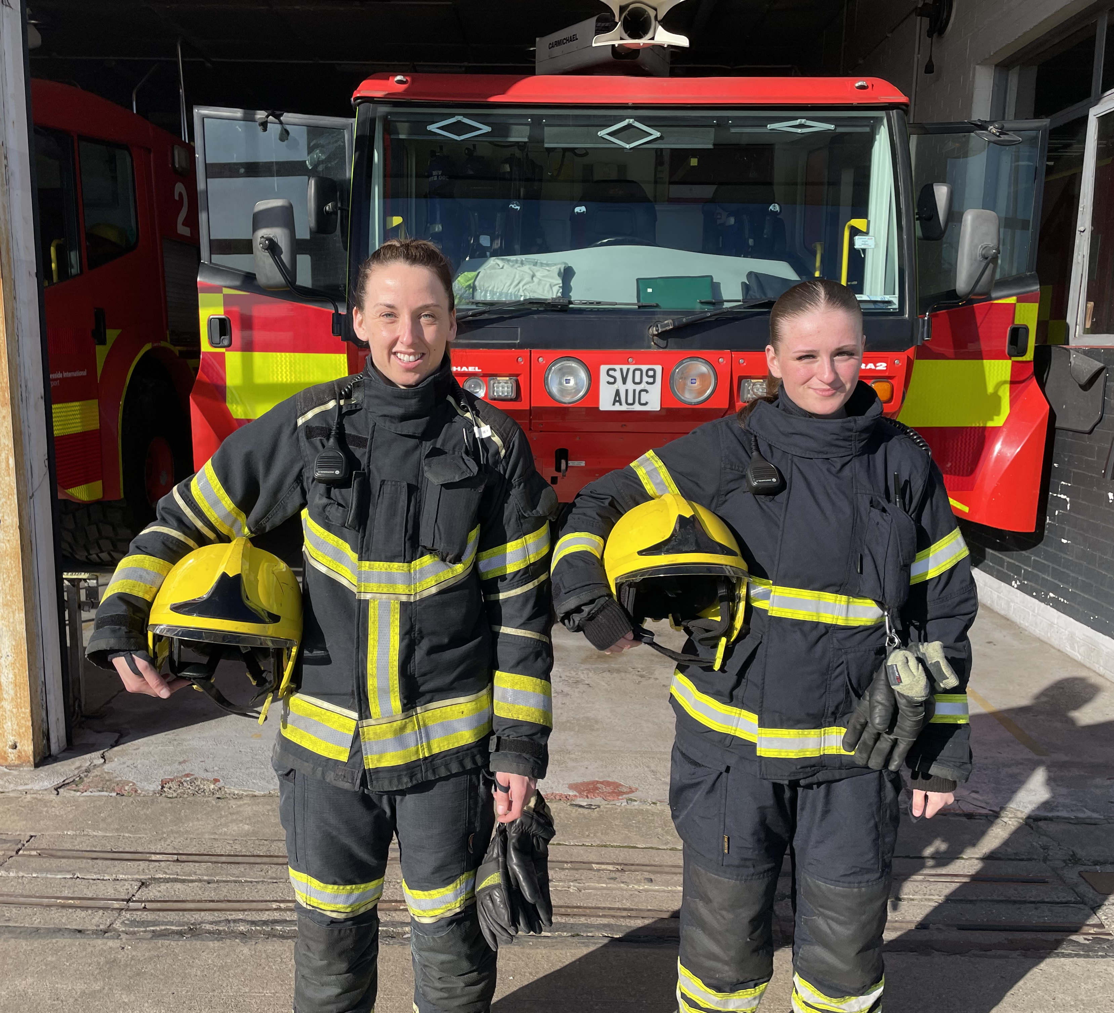


Careers in The Aviation Industry
More than cockpits and cabin crew!
Notes:
In 1961, RAF Middleton St. George became the site of the first commercial flights in the history of Teesside Airport. The legacy of the MOD can still be seen in the aerial images of the site but the airport has moved on considerably since then. Although there have been significant highs and lows in the airport’s history since the first commercial flights to Manchester, it is a great example of the variety and number of different career pathways which exist in the aerospace industry.

Slide 2
Careers in Aviation – A Realistic Goal?
86.5 million jobs globally, 1.56 million UK jobs
11.6 million direct jobs in airlines and air navigation
4 million in aerospace manufacture
1.7 million in manufacture of systems, frames and engines
5.9 million in airport positions
20.4 million in purchasing goods and services from air transport industry
37.3 million in aviation generated tourism
17.2 million ‘induced’ jobs through spending by employees
Careers exist across;
Airports
Airlines and
Ancillary Services
Teesside Airport provides jobs across all sectors associated with the aviation industry, providing support to some of the 144 million domestic passengers in the UK. In 2023 there were 35.3 million commercial flights worldwide.
Notes:
The Aviation industry provides employment and progression for over 1.5 million people in the UK and although some of these are in roles with Airports, Airlines and the Ancillary sectors, this are the tip of the iceberg, with many more job sectors being dependent on the Aviation industry, including tourism, manufacturing, imports and exports. Locally, Teesside Airport is securing contracts with airlines and companies who use air transport and increasing passenger numbers each year. This supports the local workforce and provides opportunities for lifelong careers in the sector.

Slide 3
Airports – run by private or public operators.
Airport roles in:
Customer service – luggage checking, gate, advice
Check-in
Dispatch – getting aircraft ready for flight (flight deck) ie; cleaning, fueling, checking for damage
Ground Handling Operators also have roles in HR, Health and Safety, Finance, Admin, Finance, Marketing
Air Traffic Control
Concessions – (Newsagents, McDonald's, Costa etc.)
Agencies – customs, transport police etc. (6 years residency in the UK)
Border Force – checking shipments and freight.
Fire and Rescue Services – often MSO as multiple teams
Freight & Cargo – FedEx at Teesside
Logistics
Groundworks - ensuring safety of runways, barriers, lights etc. animal control, vegetation management
The Local Landscape
Teesside Airport is publicly owned and operated by the Tees Valley Combined Authority meaning that there is greater local interest in making it successful.
Airlines flying from Teesside use the Airport staff for ‘Air-service’. At larger airports, this may be provided by a 3rd party company
Jobs at the airport are advertised on the airport website - https://www.teessideinternational.com/careers/ and Tees Valley Jobs https://teesvalley.jobs/
There is a VERY strong vetting requirement for 5 years of history for all airport roles.
Seasonal work is an excellent entry point and there is a demand for multi-skilled operatives (MSO) – those who will be flexible and step-in to fulfill the need across the airport– this is an excellent way to progress and become indispensable to the team. There is a long history at Teesside Airport of employees ‘working their way up’ from entry roles to the most senior positions. The current Airfield Operations Manager (most senior position) started as a baggage handler!
Notes:
Airports can be privately owned by operators or, in the case of Teesside Airport, publicly owned. There are benefits to both. Privately owned airports will be keen to be profitable and will therefore invest heavily in expansion, whereas privately owned airports will generally be able to operate with a smaller profit margin and will have slower expansion due to the reduced financing. At larger airports, the day to day operations may well be done by third party companies and airlines may also staff check-in desks, customer service roles and ground handling. At Teesside, these roles are offered by the airport themselves, providing lots of opportunities for employees to work across multiple roles and find new career opportunities. There are some great seasonal roles which are appropriate for students or those who wish to build work experience in the Aviation industry.

Slide 4
Airlines – often supported by 3rd party Air Service Providers
Airlines actually have some of the lowest profit margins of all other sectors within Aviation – only 2% net profit – but they employ 60% of the staff
Airline roles within airports are sometimes filled through 3rd party companies – known as Air Service – and airlines will only recruit Cabin Services and Pilots.
Usual requirements for Cabin Crew are 5 GCSEs and 2 A levels (or equivalents) There are apprenticeship routes and additional languages can be a major advantage – Sign Language is considered a strength
Fully funded training for pilots is rare and very competitive. Several charities work specifically with young people to overcome funding barriers and provide information and support.
For support to get flight hours and experience; https://airleague.co.uk/
For women: https://elevateheraviation.co.uk/home
The Local Landscape
Airlines currently flying from Teesside Airport:
Ryanair
TUI
Loganair
KLM
There are entry level roles and apprenticeships with all these airlines.
Notes:
Airlines are the companies who use the facilities and services at airports to provide their transport services. Some airlines are global operators who have larger planes, longer routes and who require larger airports. Teesside provide European flights, with seasonal routes offered by Tui. KLM offer global connectivity by flights to Amsterdam, from where it is possible to fly anywhere in the world. Airlines will be responsible for recruitment of their Cabin staff and pilots. At larger airports, they may also have customer service roles, baggage handling and flight-deck opportunities, as well as the professional services opportunities such as HR, Finance and Technical roles. Airlines also offer holiday services and provide opportunities for reps and sales through the selling and provision of holiday packages. Airlines provide the greatest number of jobs within the Aviation industry.

Slide 5
Ancillary – employers who work with the Aviation industry
Ancillary roles can be found with private companies who may offer:
Catering
Fuel production – Demand for SAF (sustainable aviation fuel)
Aerospace and aeronautical engineering – ie Airbus
Private/chartered flights and experiences
Concessions – food/shops/travel agents within airport
Freight handlers
Department for Transport – Border Force etc.
Civil Aviation Authority – promoting careers through Aviation Ambassadors and https://stem.caa.co.uk/careers-in-aviation-and-aerospace
The Local Landscape
The number and variety of Ancillary employers are increasing at Teesside. There are excellent entry level roles and apprenticeships available with most employers.
Draken Europe– defence contractors for MoD training/repairs on fighter jets. https://careers.draken.aero/ careers in Engineering - Apprenticeship route
Willis Aviation Services Ltd. And Willis Jet Centre. Aircraft Maintenance, storage, VIP and commercial
Fedex – planning expansion
Airbourne Colours – New local company. spraying/branding. Now offering training roles to 19+, second hangar being built
Airport expansion brings opportunities across all industries; construction, plumbing, electricians, civil engineering. Professional services such as HR, Finance, Legal, HSE, also increase
Notes:
In order for Airlines to be able to access the services of an Airport and operate, it is necessary for a huge number of other agencies and services to be involved. Starting with the design and manufacture of aircraft, there are roles in Aerospace and Aeronautical engineering – designing more efficient planes and currently pursuing technologies which will reduce the reliance on traditional fuels, by developing Sustainable Aviation Fuels or SAFs. The Aviation industry is the primary mode of transport for a large number of manufacturers and exporters. As a result there are roles in logistics, freight and the checking of the imports and exports handled by airports through Customs and Border Force employees. There are also those who work in regulatory bodies such as the Civil Aviation Authority and government roles within the Department for Transport, constantly reviewing the role which the Aviation industry plays in our wider infrastructure. More broadly, there are those who service planes and maintain them, providing a wealth of transferable jobs such as mechanic roles and sprayers. Planning for airport expansion and the actual building of runways and hangars provides contract work for construction companies and, in the case of Teesside Airport, the Tees Valley Combined Authority employ a large number of professional career pathways who are involved with the operation of the airport.

Slide 6
The Future – You CAN Stay Local and Go Far!
6,500 jobs will be needed in Chemical Engineering to develop Sustainable Aviation Fuels. 2024 saw 1.3billion litres of SAF used for commercial flights. Aim is for net-zero by 2050
Development of lighter, stronger, smart manufacturing technologies to reduce fuel consumption
AI and Drones increasing in use for assessing damage, security checks – even whilst planes are mid-air.
Design and innovation being pushed by the likes of Airbus, requiring new skills from designers and engineers. Airbus Concept
The Local Landscape
Teesside Airport recruits locally and promotes internally, making it a fantastic place to grow your career. Current employees are building on their Foundation degrees at local FE colleges such as Hartlepool and Stockton Riverside, topping-up to degrees and Masters Degrees from Teesside University. Graduates are now progressing their careers in Air Traffic Control, TVCA roles and other management positions, sufficiently skilled to move to other UK and international airports if desired.
The airport is expanding capacity across all 3 key areas of Airport, Airline and Ancillary operations. A new business park and additional capacity in hangars will attract new business, strengthening resilience to global fluctuations in the travel industry and securing the future of the airport.
Career progression and development is possible across all key areas and entry level and graduate roles attract local talent.
Notes:
As with many other industries, Aviation is evolving to embrace new technology in order to improve the operation of its planes and services and to protect the environment as we move to net-zero. Creative solutions can only be implemented by people invested in working within the sector. Locally, Teesside Airport is well-placed to respond to the challenges of the future. Its location in a historically industrial area means there is expertise and a passion for manufacturing and advancements in chemical, material and technological elements. There are some excellent educational opportunities to develop a work-force locally and Teesside University has very strong links with the airport, ensuring its students gain extremely valuable experiences and insights. Progression from their courses has seen many people start and develop their careers at the airport. In terms of pursuing a career in Aviation, you really can stay local and go far.

Slide 7
Helpful links to explore:
Civil Aviation Authority https://stem.caa.co.uk/about/
Airlines UK https://airlinesuk.org/
Talentview – jobs in Aviation https://talentview.org/aviation
Tees Valley Jobs https://teesvalley.jobs/job-type/teesside-airport/
Teesside International Airport https://www.teessideinternational.com/
Air Traffic Control https://www.nats.aero/careers/early-careers/
https://www.nats.aero/about-us/research/n/project-bluebird/
Teesside University Courses https://www.tees.ac.uk/undergraduate_courses/aviation_&_tourism/index.cfm#courses
Sunderland University https://www.sunderland.ac.uk/study/tourism-hospitality-and-events/undergraduate-tourism-aviation-management/
Airbus https://www.airbus.com/en/careers/students-and-graduates/apprentices/apprenticeships-in-the-united-kingdom
Notes:
Here are just a few links to support you to explore the opportunities available in the Aviation industry.

