Slide 1

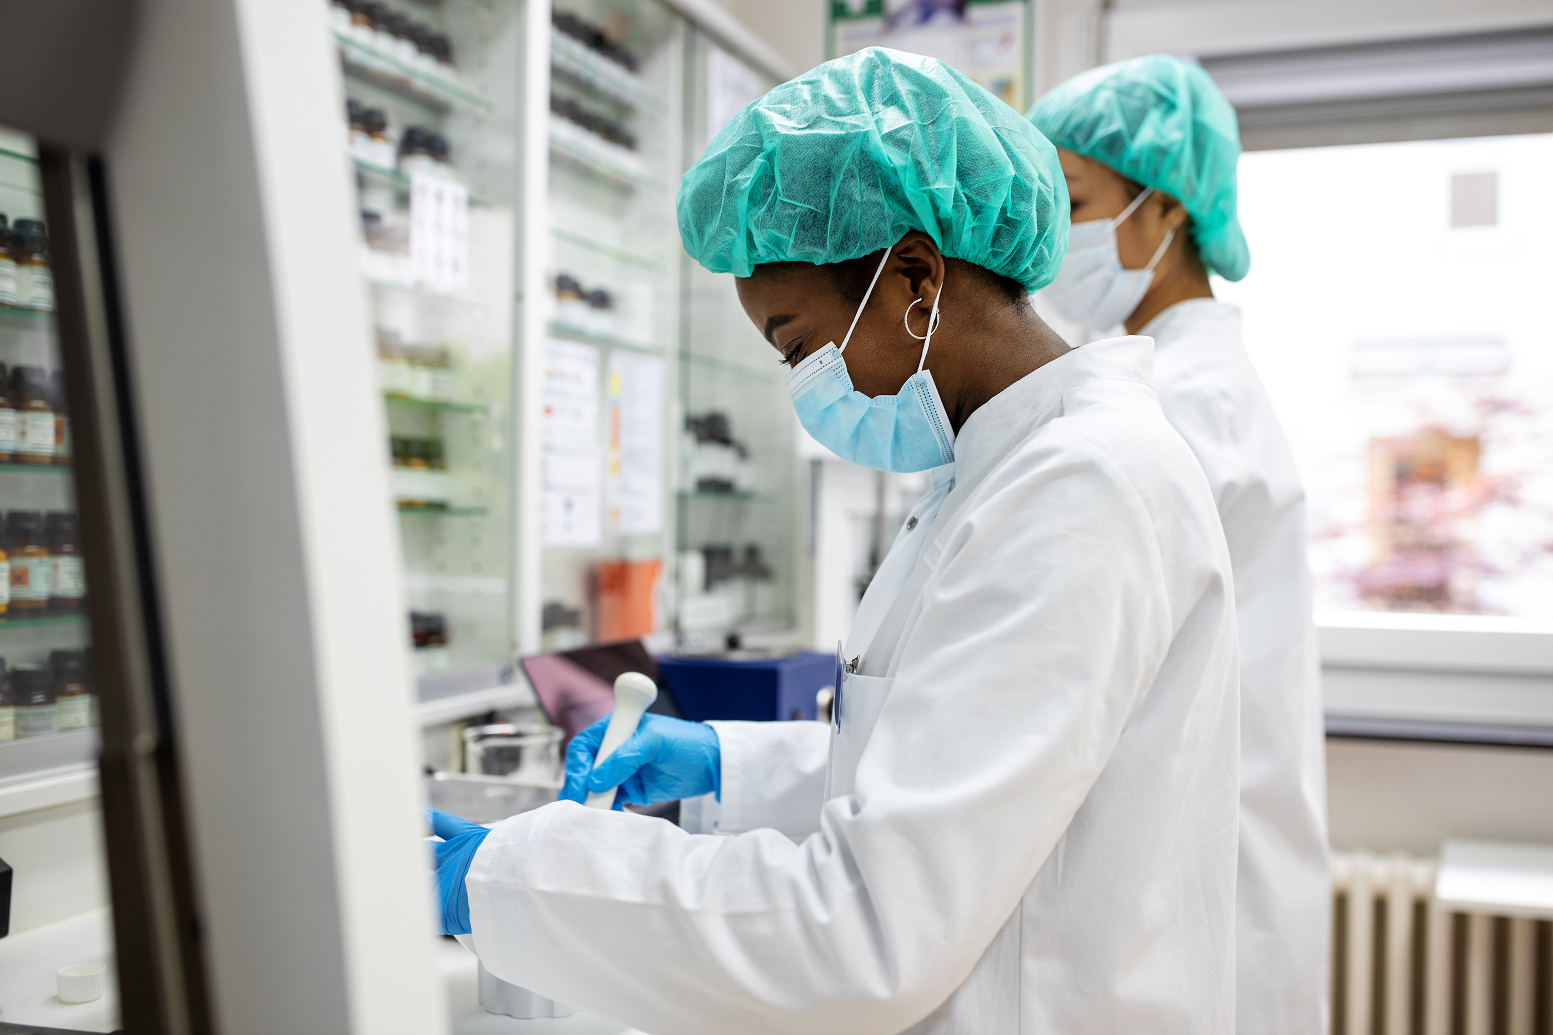

How are Drug trials conducted in the NHS?

Slide 2
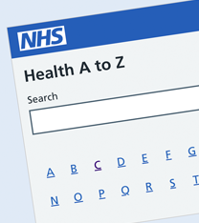
Starter Activity
For each of the letter's A-Z:
Name any types of medicine, treatments, medical conditions or careers associated with the NHS

Slide 3
Learning Aims
Describe the stages in a clinical trial of a new drug
Describe the placebo effect and suggest suitable placebos to use in clinical trials.
Explain open-label, blind and double-blind clinical trials and explain the benefits of double-blind trials.

Slide 4
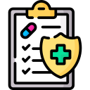

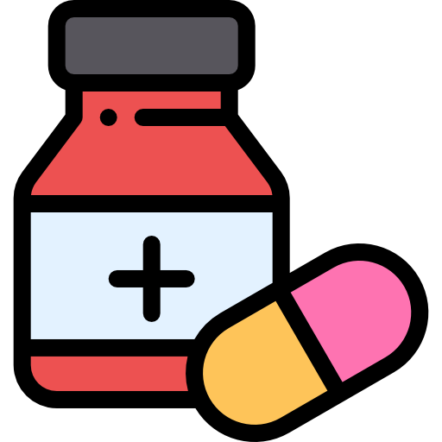
Why do we test new drug?
Safety
Dosage
Efficacy

Slide 5
What are the stages of drug trials?
Preclinical Drug Trials
The drugs are tested using computer models and skin cells grown using human stem cells in the laboratory. This allows the efficacy and possible side effects to be tested. Many trials stop at this stage due to not working or damage to healthy cells can be seen.
Animal Testing
Drugs that pass the first stage are tested on animals. In the UK, new medicines have to undergo these tests.. A typical test involves giving a known amount of the substance to the animals, then monitoring them carefully for any side effects.
Human Clinical Trials
Drugs that have passed animal tests are used in human clinical trials. They are tested on healthy volunteers to check that they are safe. The substances are then tested on people with the illness to ensure that they are safe and that they work. Low doses of the drug are used initially, and if this is safe the dosage increases until the optimum dosage is identified.

Slide 6
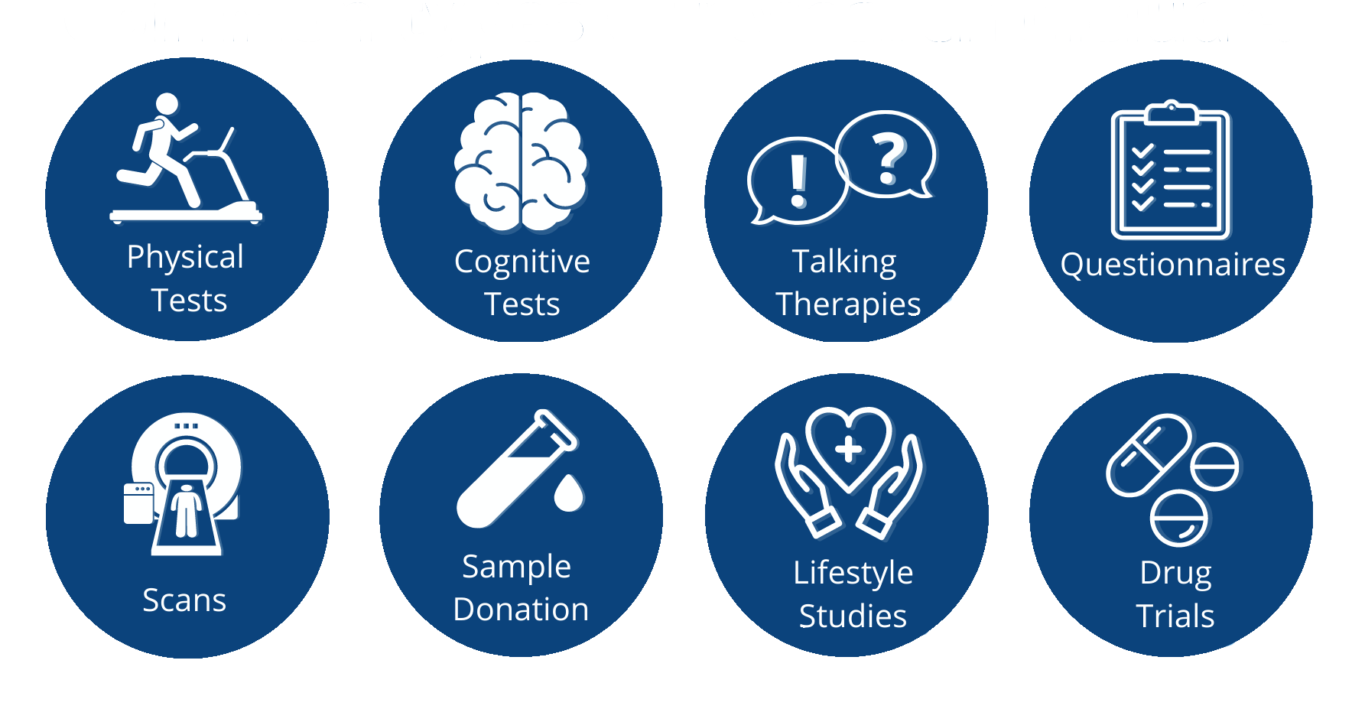

Not all clinical trials involve drugs
Clinical trials may not always involve drugs.
Trials can be to test new types of surgery or event new equipment.
Scientists are not always involved in these trials. They can be run by nurses and consultants!

Slide 7
Summary Task
In your books, write the reason for each stage:
Tested in animals so that…
Tested in healthy volunteers…
Tested in people with the disease…
Large-scale trial

Slide 8
What is the placebo effect?
An inactive substance made to resemble a drug for researchers to use as a control. It should be like the real drug as possible, but not contain the active ingredient.
Why might we not use a placebo?
A placebo is not used in the case of a patient being terminally ill as this would be unethical.

Slide 9
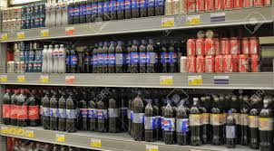
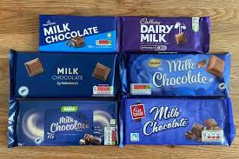
Placebo effect
Challenge:
Design a placebo trial testing out branded vs non branded chocolate or can you tell Pepsi, Coca-Cola or supermarket cola

Slide 10
Task – suggest a suitable placebo for these trials
Do sports drinks with caffeine help you run faster?
Does a massage with special essential oils help arthritis?
Does a new headache pill help you get better faster?
Do steroid injections help body builders gain more muscle?

Slide 11
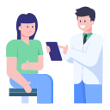
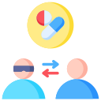
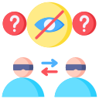
Types of trials
Open Label | Blind | Double Blind
Both the patient and doctor know the drug which has been given | In blind trials only, the doctor knows which patients have been given the drug and which have been given the placebo until the end of the trial | In double blind trials, neither the doctor nor the patient knows who has been given the drug or placebo until the end of the trial

Slide 12
Why are double blind trials used?
They makes sure that the results are more reliable as neither the patient or healthcare professional will be influenced by expectations.
How is the trial designed?
The researchers conducting the trial must draw up a plan or protocol which will include information such as:
who and how many will take part in the trial
what question does the trial aim to answer
what treatments will be compared
how the results will be collected
The protocol then undergoes an independent scientific review and must also be approved by an ethics committee before the trial can go ahead. These checks are to ensure that the trial design is accurate and that the research will respect the rights, dignity, safety and wellbeing of the participants.

Slide 13
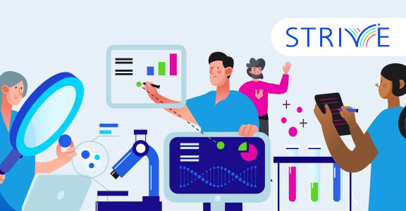
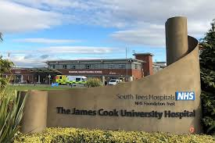
STRIVE Academic Centre at James Cook University Hospital
South Tees Research Innovation and Education (STRIVE) Centre is based at James Cook University Hospital which is part of the Tees Valley Research Alliance.
6,614 participants recruited into research studies in 2022/23
178 trials open across 23 specialties
121 investigators leading the delivery of trials

Slide 14
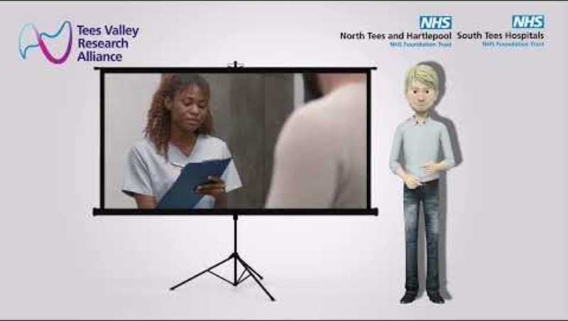
An introduction to the STRIVE Centre

Slide 15
What has been researched in the Tees Valley?
Anaesthetics
Perioperative
Medicine And Pain
Cancer
Cardiovascular Disease
Childrens (Paediatrics And Neonates)
Dementia And Neurodegenerative Disorders
Dermatology
Diabetes
Ent
Gastroenterology
Genetic
Health Services Research
Hepatology
Infection
Musculoskeletal Disorders
Neurological Disorders
Ophthalmology
Renal Disorders
Reproductive Health
Stroke
Surgery
Trauma
Orthopaedics.

Slide 16
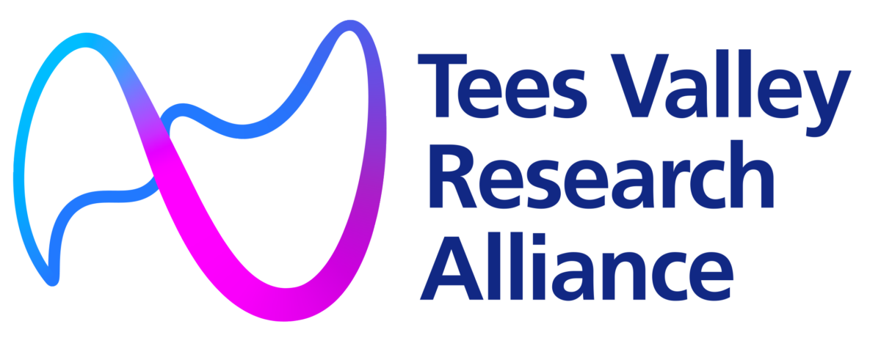
COVID-19 Trials on Teesside
We were successful in being selected as a site for the NOVAVAX COVID-19 vaccine trial. Without collaboration of the trusts this would not have been possible.
We successfully over recruited to this trial. 532 participants were recruited against a target of 350.
The vaccine is now authorised for use across the world.
Interested in a career in health care science? Click on the link below:
How to become a healthcare science professional | Health Careers

Slide 17
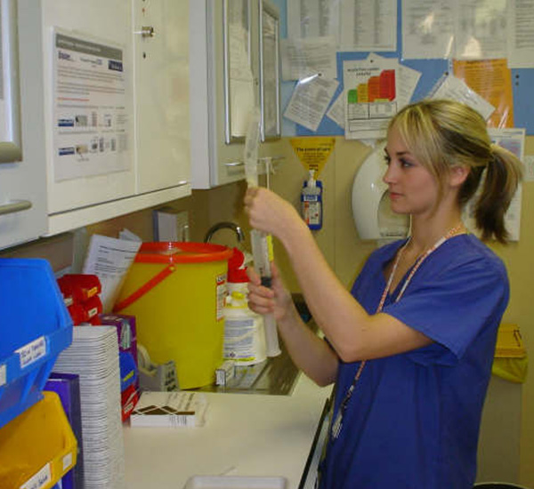
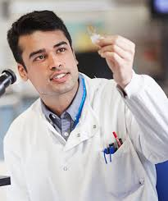
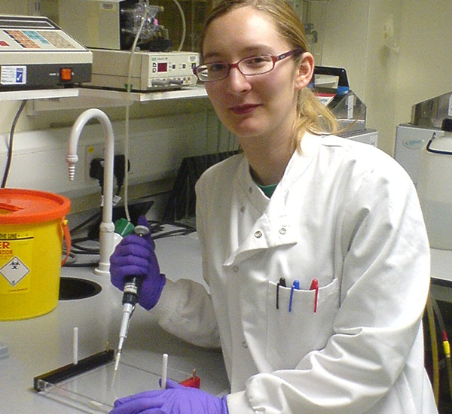
Job Roles & Pathways in the NHS linked to research
Want to find out more about over 350 careers then visit this website:
www.stepintothenhs.nhs.uk
Research Nurse
Biomedical Scientist
Pharmacist
Healthcare Science Support Worker
Medical Engineer Technician

Slide 18
Plenary – True or False
All clinical trials contain drug trials
A placebo contains the same ingredient as the real drug
In a blind trial both the patient and healthcare professional do not know if a placebo has been given
You need to be a scientist to run a clinical trial
Clinical trials happen in Teesside

Slide 19
Plenary – True or False
All clinical trials contain drug trials – False they can be surgical, equipment based or treatment led.
A placebo contains the same ingredient as the real drug – False it looks similar but doesn’t have an active ingredient
In a blind trial both the patient and healthcare professional do not know if a placebo has been given – False this is a double-blind trial
You need to be a scientist to run a clinical trial – False nurses and other healthcare professionals can run clinical trials
Clinical trials happen in Teesside – True, just look at all the amazing work happening right now at the Tees Valley research alliance

Slide 20
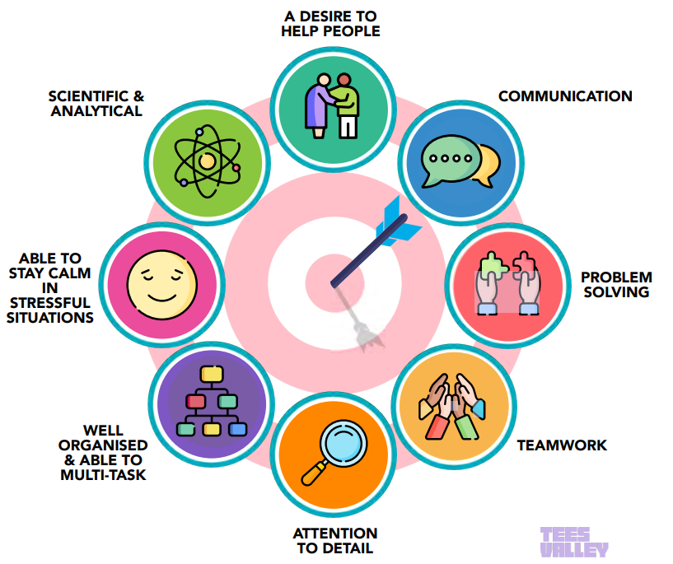
What Next
By 2030, 55,000 people are expected to be employed in healthcare and life science jobs across Tees Valley.
To work in this sector these are the key skills you will need to develop.

Slide 21
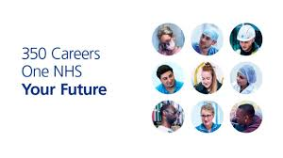
Where can I find more information
Tees Valley Careers
www.teesvalley-ca.gov.uk/work/careers-hub/
Labour Market Information
www.teesvalley-ca.gov.uk/work/wp-content/uploads/sites/6/2025/04/6-x-LMI-Tees-Valley-Posters-digital-friendly.pdf
Health & Life Science Workbook
www.teesvalley-ca.gov.uk/work/wp-content/uploads/sites/6/2025/01/Healthcare-and-Life-Sciences-digital-1.pdf
National Careers Service
www.nationalcareers.service.gov.uk
Tees Valley Jobs
www.teesvalley.jobs
Teesside University
www.tees.ac.uk

