Slide 1

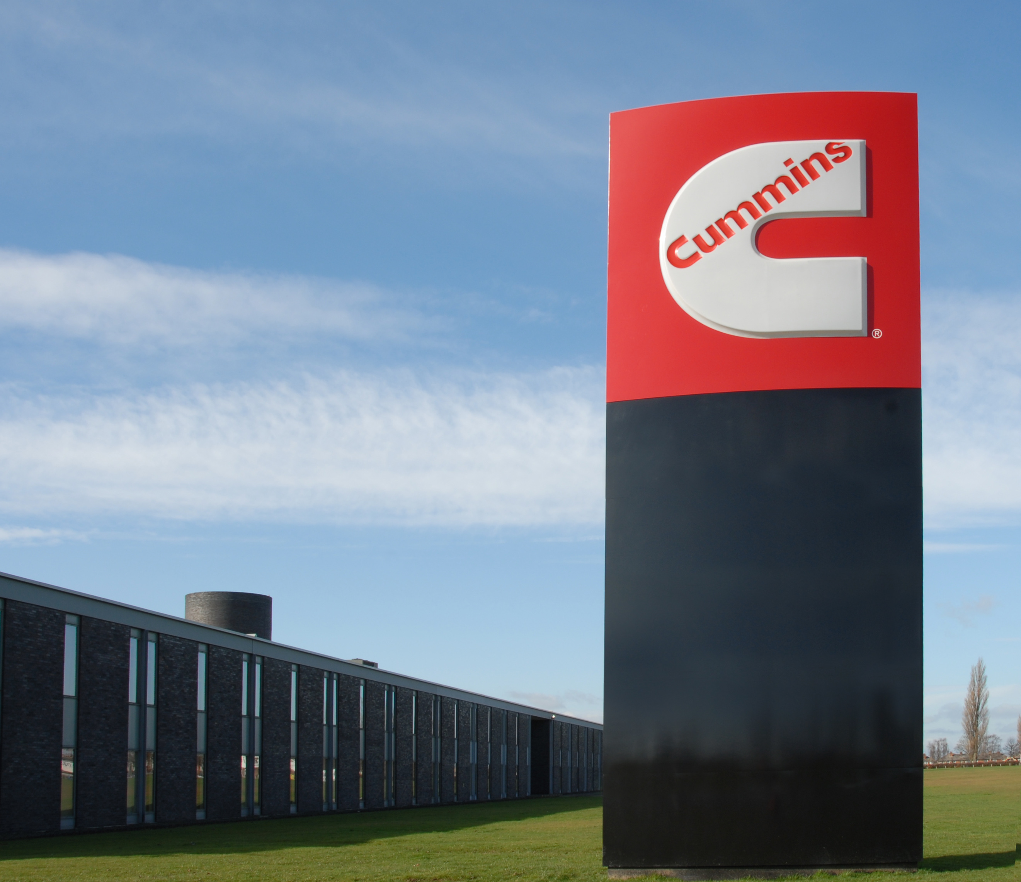




Cummins Engineering careers

Slide 2
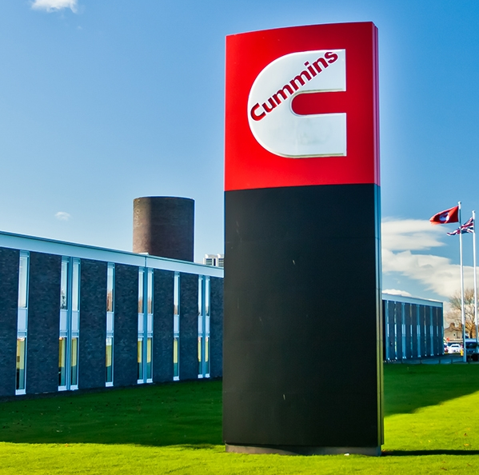

Relevance of Cummins:
There are various job roles within the Cummins factory in Darlington, with jobs in finance, HR, Engineering and many more.
Engineering
The role that we’re going to look at today is that of an Engineer. Above all else an Engineer is a problem solver; someone who can design something to make things easier, more efficient, and generally improved, for people, the environment and the world in general.
We are going to take a look at some potential challenges budding Engineers might face when coming into the Engineering Industry in the Teesside area. Take a look at the video on the next slide:

Slide 3
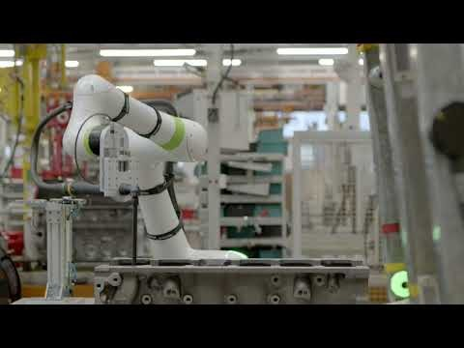

Slide 4









Engineering jobs:
Here are a sample of some of the Engineering job roles that are most required in the Automotive (Cummins) and Aerospace sectors.
Below are some of the skills and traits of people who make excellent Engineers.
TECHNICAL SKILLS
SAFETY AWARENESS
PROBLEM SOLVING
Electric Vehicle Manufacturing
Automation & Robotics
Automotive Engineering
Research & Development
TIME MANAGEMENT
TEAMWORK
ATTENTION TO DETAIL
Maintenance & Repair
Software
Integration
Environmental Compliance
Logistics & Supply Chain
COMMUNICATION
ADAPTABILITY

Slide 5


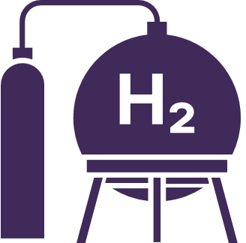






Energy & Low Carbon jobs:
Here are a sample of some of the job roles that are most required in the Energy & Low Carbon (Net Zero) industry.
Below are some of the skills and traits of people who are excellent at their job roles in this industry.
UNDERSTANDING RENEWABLE ENERGY
TEAMWORK
SUSTAINABILITY AWARENESS
Renewable Energy
Hydrogen Production
Carbon Capture & Storage
Energy Efficiency
PROJECT PLANNING
PROBLEM SOLVING
DATA MANGEMENT
Research & Development
Project Management
Environmental Consultancy
Grid Integration & Management
COMMUNICATION
TECHNICAL SKILLS

Slide 6
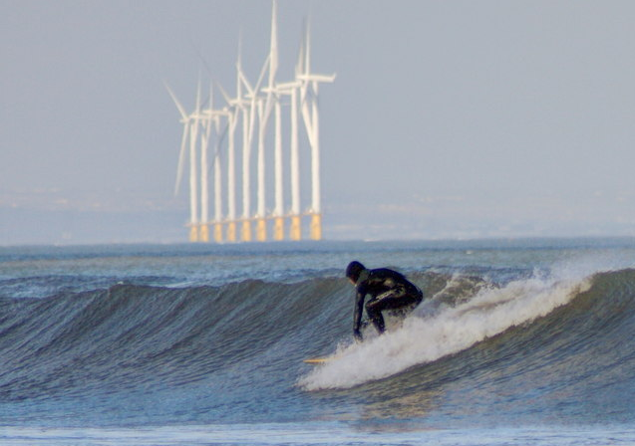
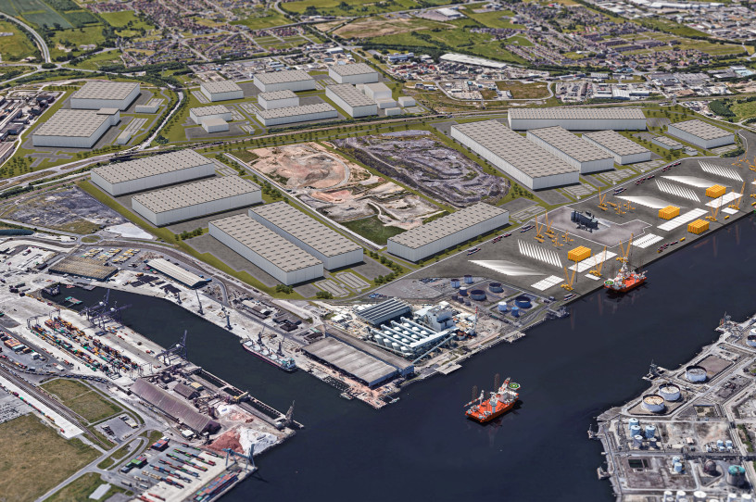
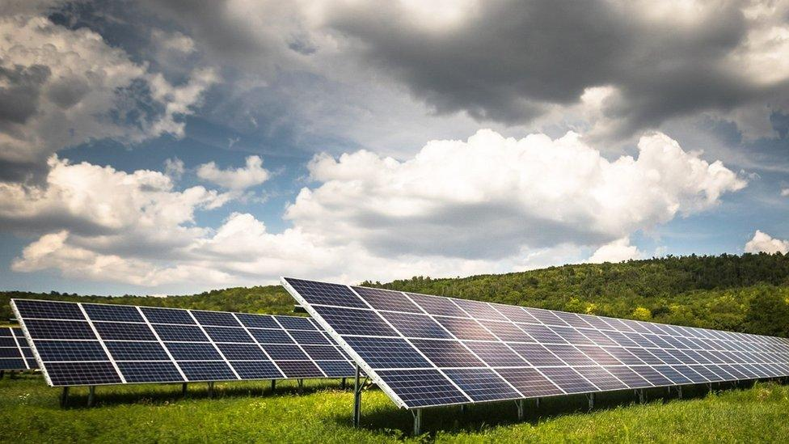
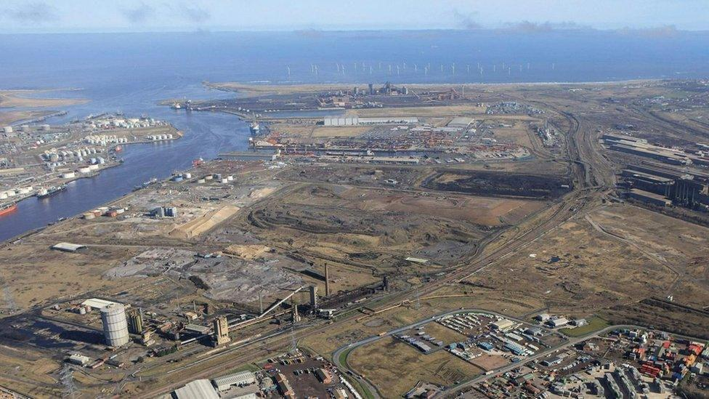
The Teesside Area & Engineering
Today there is a massive push on sustainability and the industry in Teesside has a huge part to play in making a difference.
You might have heard a lot about the Teesworks Freeport which has ambitions to become the first UK Net Zero Carbon industrial cluster.
Whilst enjoying a lemon top you might have noticed wind farms out in the sea.
When travelling along the A19 you might happen to see a solar farm to the side of the road
Notes:
Click through the images whilst reading the prompts

Slide 7

Sustainability
The dictionary definition:
noun
the ability to be maintained at a certain rate or level.
"the sustainability of economic growth"
avoidance of the depletion of natural resources in order to maintain an ecological balance.
"the pursuit of global environmental sustainability"
So this is the one we’re talking about. A key way to avoid the depletion of natural resources is to harness renewable energy sources.

Slide 8
Match the renewable energy sources to the explanation…
Solar
Harnessing the natural ebb and flow of the ocean’s tides, a variety of instruments are used to capture the energy produced by the moving water.
Similar to the way we capture wind power, in this case power is produced by building turbines in moving water.
Organic material that comes from living organisms, typically plants is usually burned to produce heat. However, this organic material can also be allowed to decompose, which creates methane gas. This gas can then be captured and used for fuel.
By using photovoltaic cells to capture and convert the sun’s rays into electricity, solar panels transform light into usable energy.
Large turbines in traditionally windy areas, energy produced by air movement can be converted into useful electricity.
When the Earth cooled billions of years ago, a large amount of heat was trapped beneath the Earth’s crust. By digging tunnels into the ground, we can use this heat on a controlled scale to turn water into steam, which in turn can provide heat or power a turbine to generate electricity.
Wind
Hydroelectric
Wave
Geothermal
Biomass
Notes:
Create hand out for this so that students can draw a line between the matching explanation and type of energy source

Slide 9
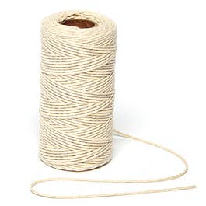
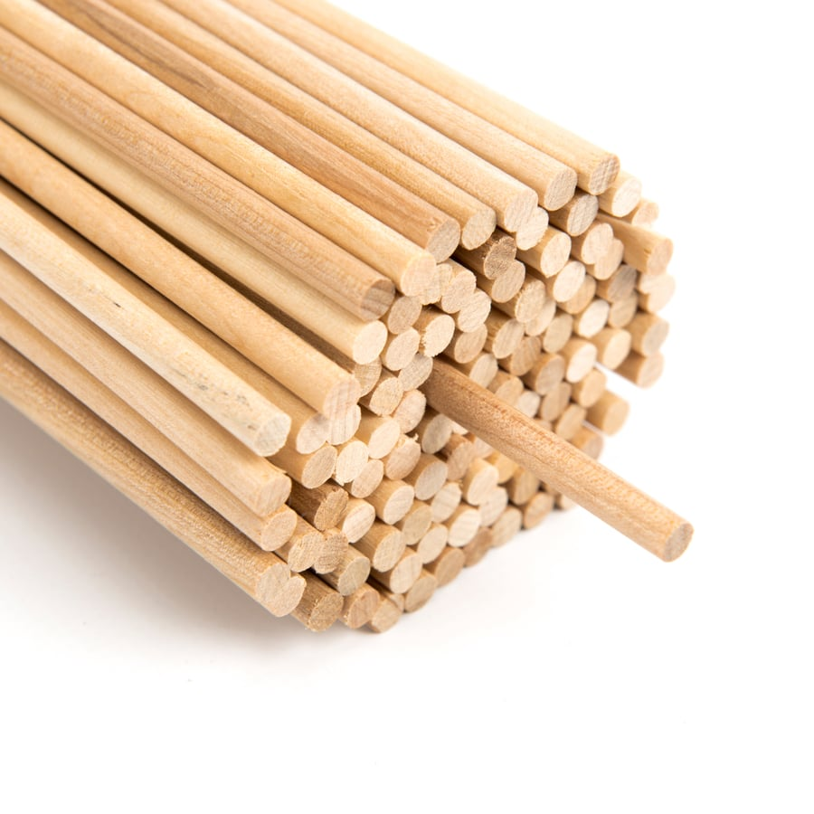

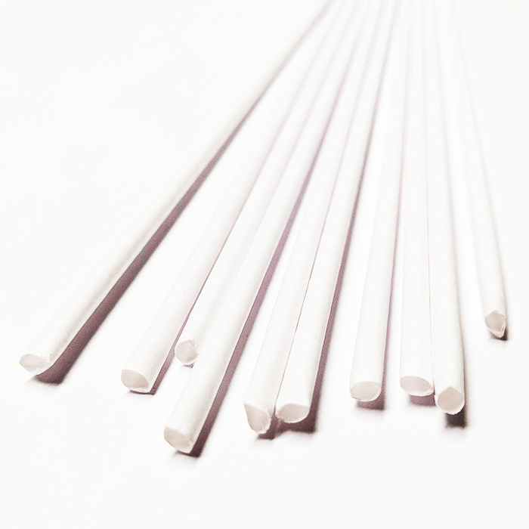
So with sustainability in mind…
Your challenge today is to produce a working model of a machine that can lift a weight from the floor to table height but only using a renewable energy source.
The energy source you have to work with is the wind (we’ll generate this using an electric fan).
The resources you have access to are listed below:
Dowel | Corrugated cardboard | String | Art Straws
Hot glue gun | Scissors | Stanley Knife | Masking tape
Electric fan

Slide 10
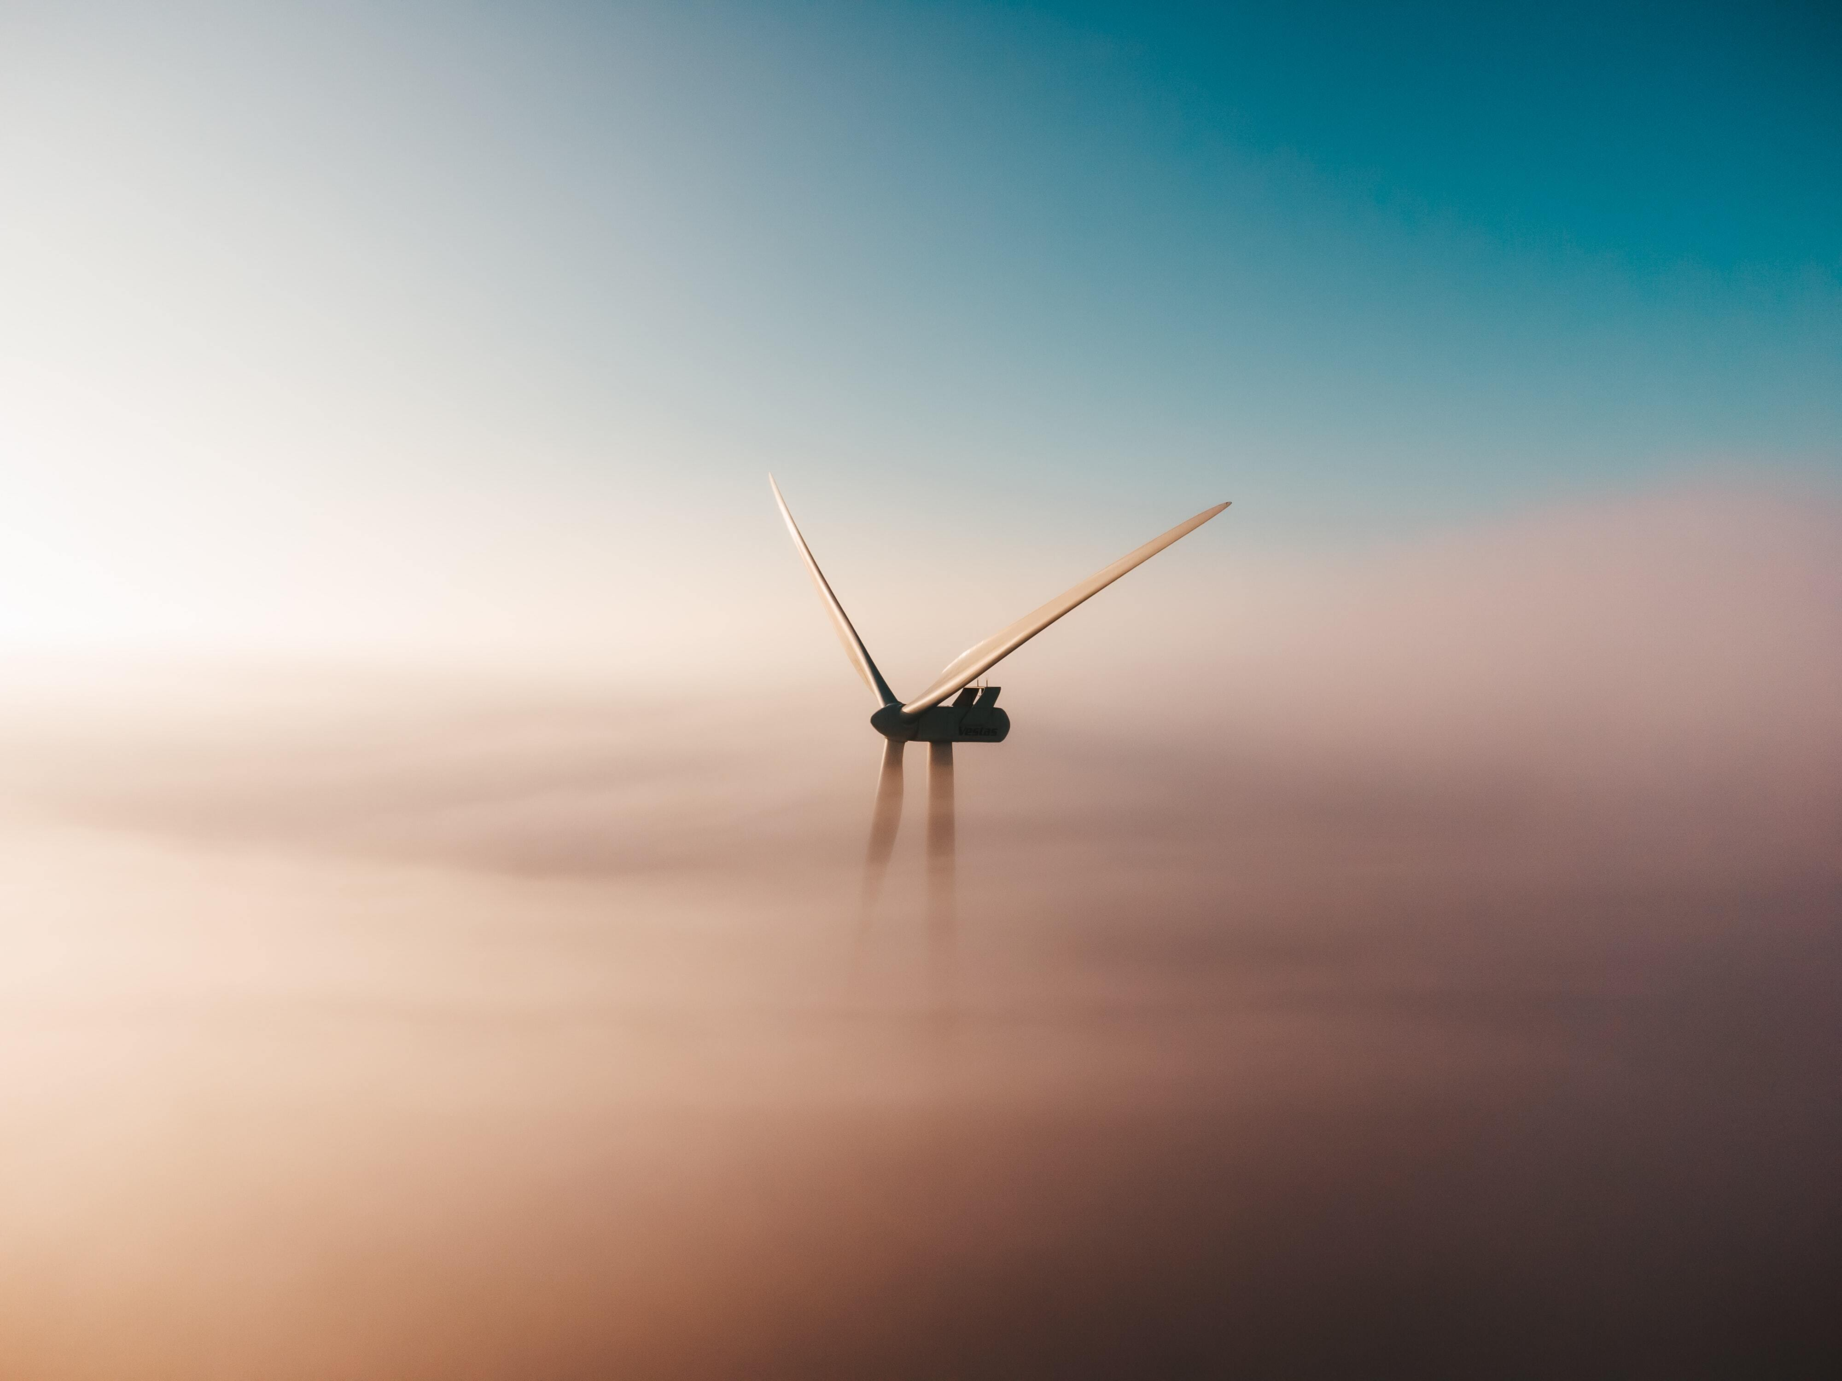
Wind Powered Lift – The Challenge…
Your lift must carry a weight from the floor to desk height without you touching it or manually operating it. It can be secured to the desk using tape.
You must:
Be in a group of 3/4 | Use the internet for research
Draw a full page of ideas | Model your final idea accurately
Use the equipment carefully | Test your final model
You could:
Research wind powered machines to help you with the design of your lift. Maybe have a look at windmill sails.

Slide 11
Wind Powered Lift – Tips…
Dowel will fit inside the art straws
You will need to make a container for the weight to be carried in
You could make one sail and then use it as a template for the others
How can you make sure the string will not slip from the shaft?
Allow enough height for the sails to go around by building a tower
When testing; the wind will blow directly towards the front of your model.
It is worth looking at the direction the sails need to be in order to harness the wind.
Test as you go so you can alter it before the final test
Triangles are great shapes to provide support

Slide 12
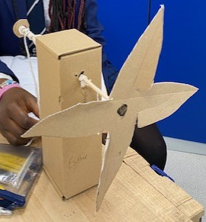
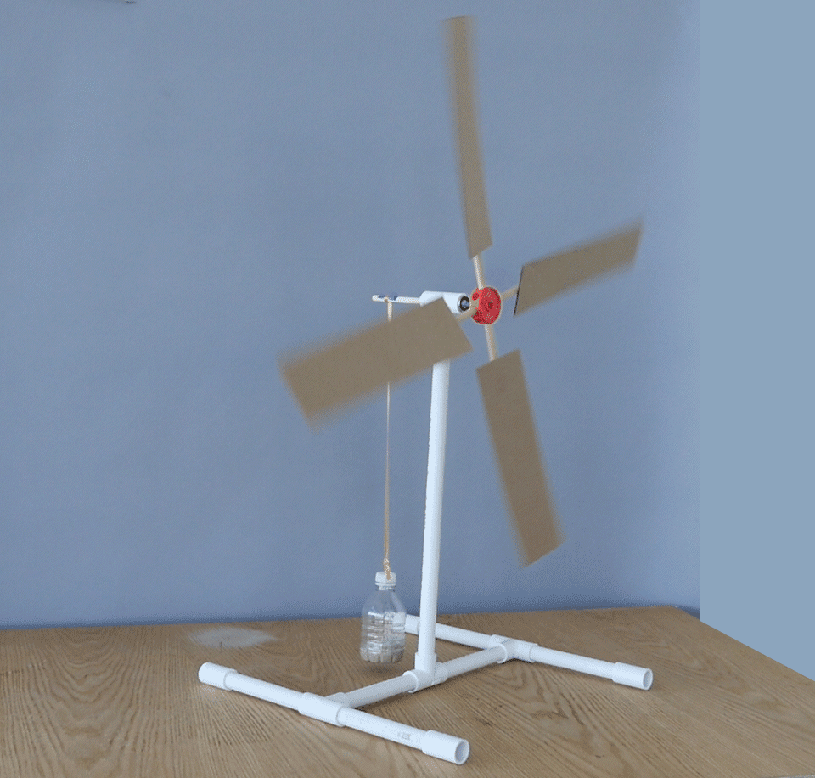
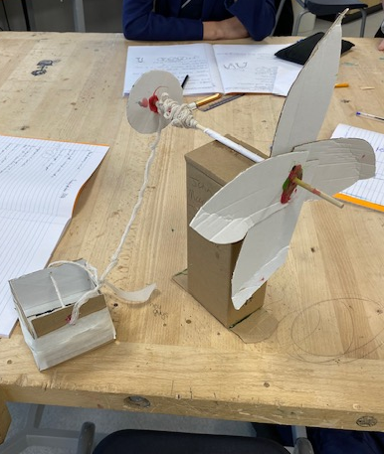
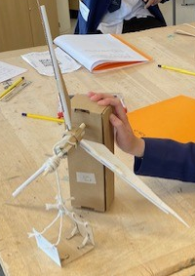
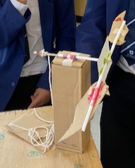
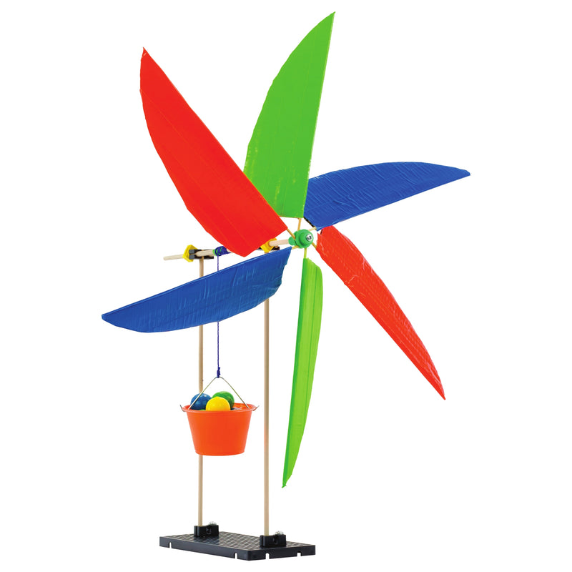
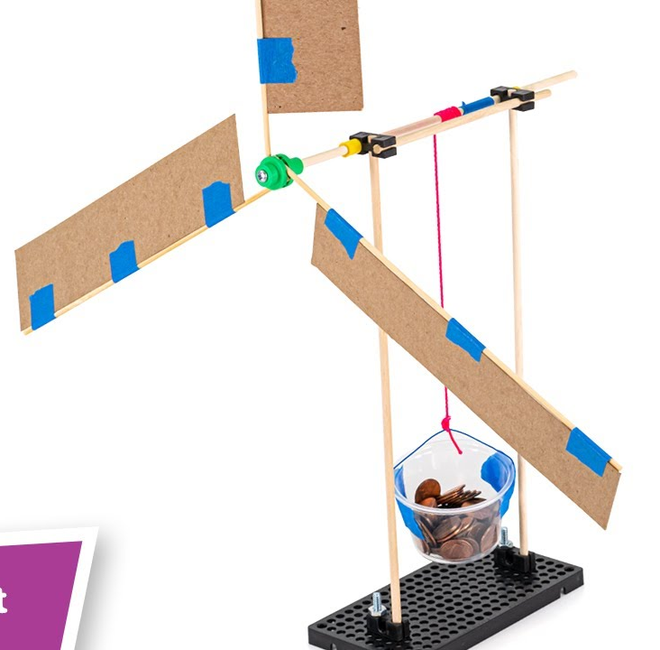
Previous examples
Notes:
Show these if needed

Slide 13
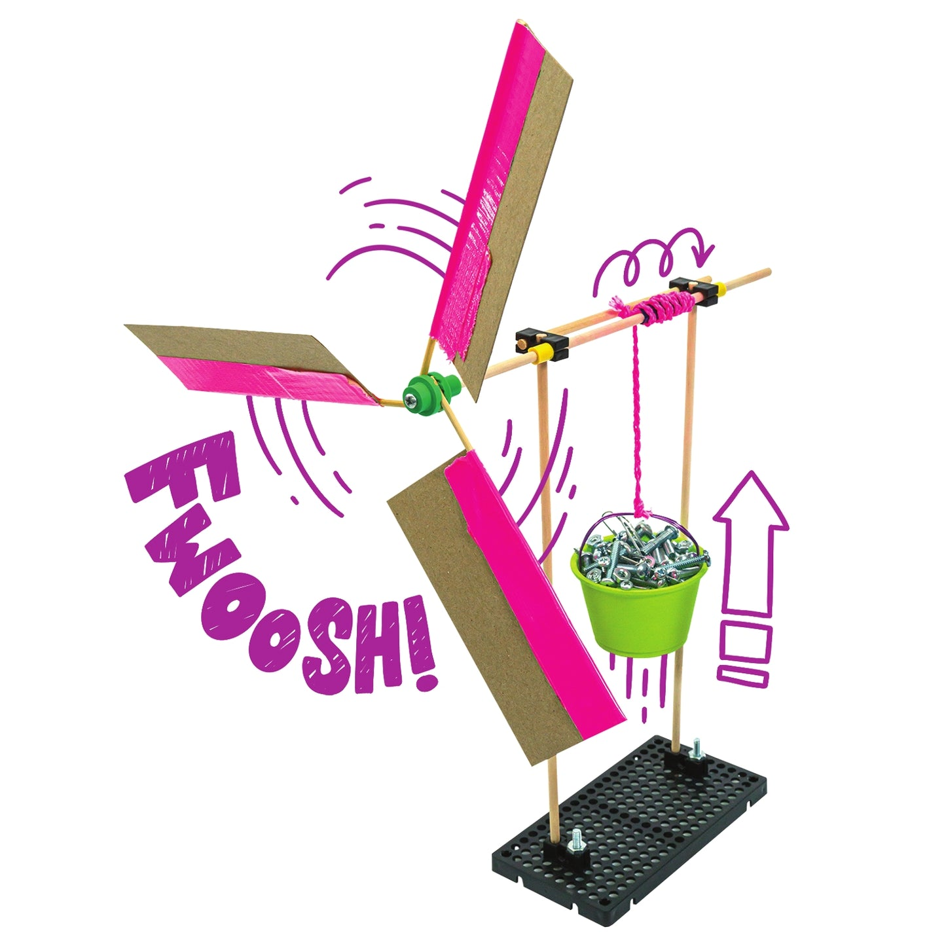
Wind Powered Lift – Testing…
Fix your wind powered lift to the desk
Load the weight into the basket/bucket
Stand back
Turn the fan on directly in front of your model
Test:
Did it raise the weight?
How quickly and safely did it raise the weight?
How could you improve the lift?
Is there another way you could make a wind powered lift?
Notes:
Could print questions and put into a booklet with space for a picture of the final model to be glued. Encourage students to write in full sentences when answering.

Slide 14
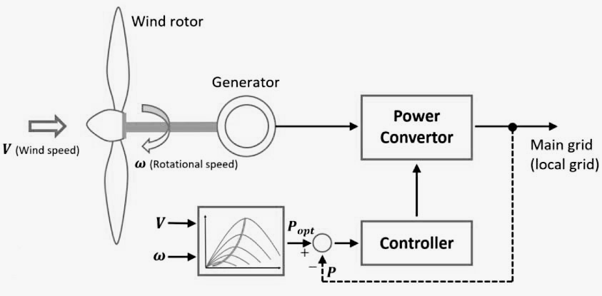
What you have just done…
You have, in essence, constructed a turbine.
A turbine takes the kinetic energy of a moving fluid, air in this case, and converts it to a rotary motion.
As wind moves past the blades of a wind turbine, it moves or rotates the blades.
In this case your blades movement caused the axel to move and wrap the string around it, lifting the weight.
On an actual turbine these blades turn a generator which produces electricity.
Notes:
Round up notes to explain how they have converted wind energy into mechanical energy and how this would work in real life.

Slide 15

What next… Take a look at these useful links:
Cummins
Tees Valley Careers
Tees Valley Key Priority Sectors
Tees Valley Labour Market Factsheets
Teesworks
National Careers Service

Slide 16
Any questions?

