Slide 1

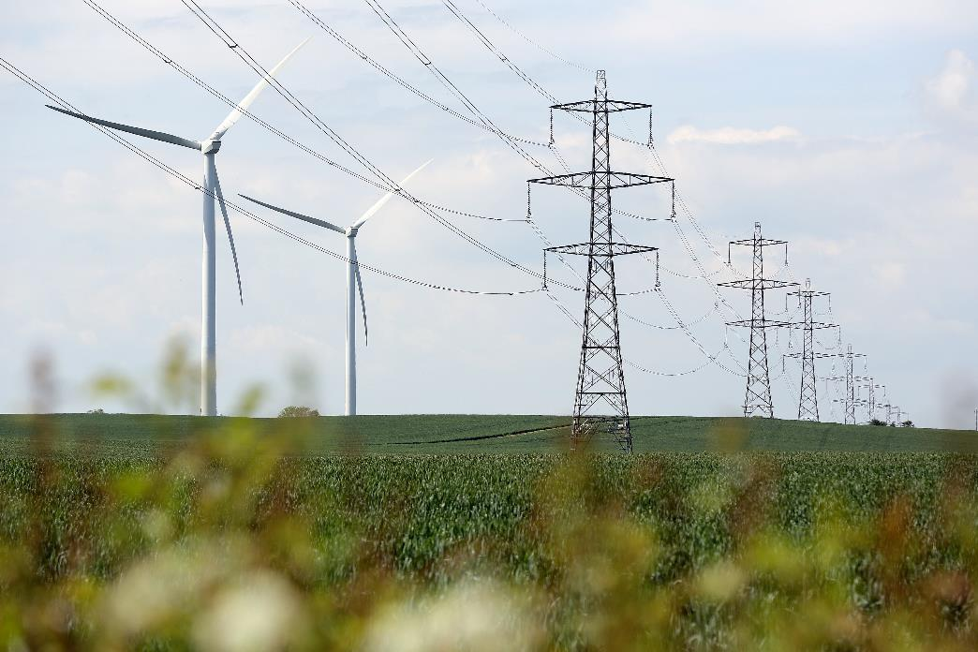


Ecological Footprints
Stay Local, Go Far!

Slide 2

Aims
To know what an ‘ecological footprint’ shows.
To identify what resources make up the components of an ecological footprint.
To explain why different places have larger ecological footprints than others.

Slide 3
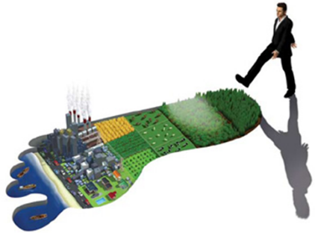
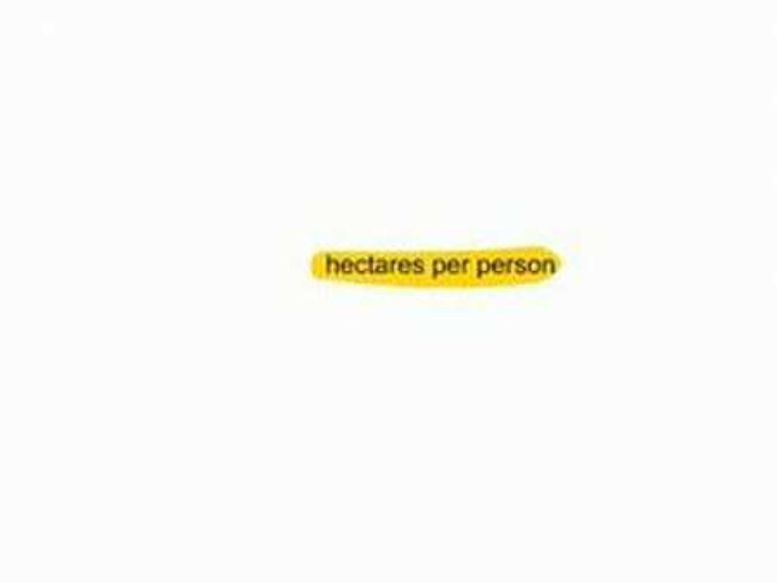
Ecological Footprints
Connect Task: Discuss in pairs, in what ways do we leave a ‘footprint’ on our planet? What is an ‘ecological footprint’?
Then, watch the clip below:
Notes:
http://www.youtube.com/watch?v=DhwBvnQdLWI&feature=related

Slide 4
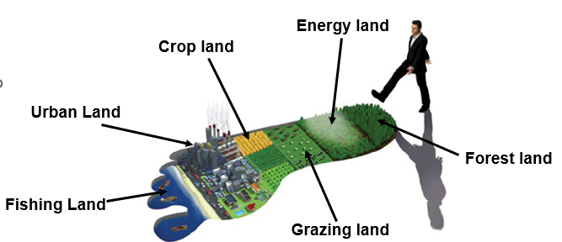
Ecological Footprints - Input
An ecological footprint is a measure of human demand on the Earth’s ecosystems (land, water and resources).

Slide 5
The BIG Picture
Look at how the Earth’s resources, such as food, metals and oil are under strain due to the high demands of the human population.
Food supply has kept pace with population growth:
World cereal production has doubled since 1970
Meat production has tripled since 1961
The demand and use of resources varies from person to person, city to city, country to country.
Many of these ‘footprints’ suggest that if everyone on the planet lived in this way that we would need the resources of more than one planet to support us.

Slide 6
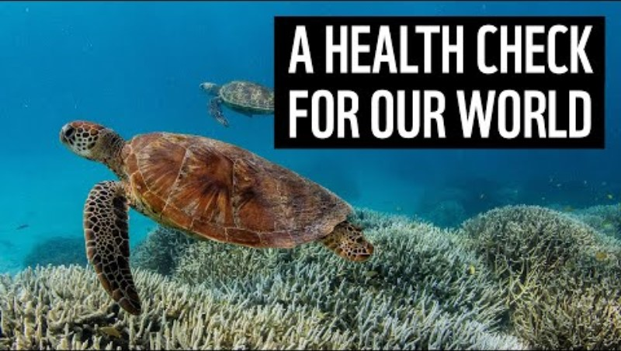
Ecology and Biodiversity
Describe the message of this WWF film:
Notes:
https://www.youtube.com/watch?v=5kXS8Yz4bgQ

Slide 7
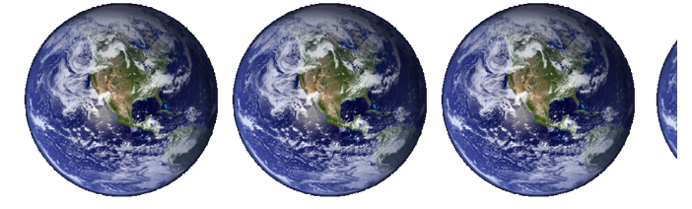
Ecological Footprints – United Kingdom
3.1 planets
Notes:
This is the share of the Earth’s resources which we use in the UK every year – if everyone on the plant lived the same lifestyle as us in the UK, we would need 3.1 planet Earth’s to meet that demand. In other words, we are living beyond the means of the planet we depend on.
What resources do we use so wastefully?

Slide 8
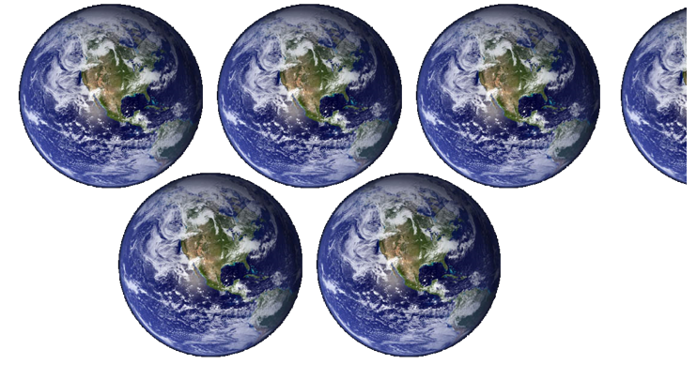
Ecological Footprints – United States of America
5.3 planets
Notes:
The US is one of the worst. It’s people use more than a fair share. Why is that?

Slide 9
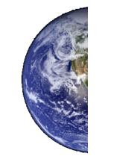
Ecological Footprints – India
0.4 planets
Notes:
Why does India, with the World’s largest population only use such a small share of the planet’s resources?

Slide 10
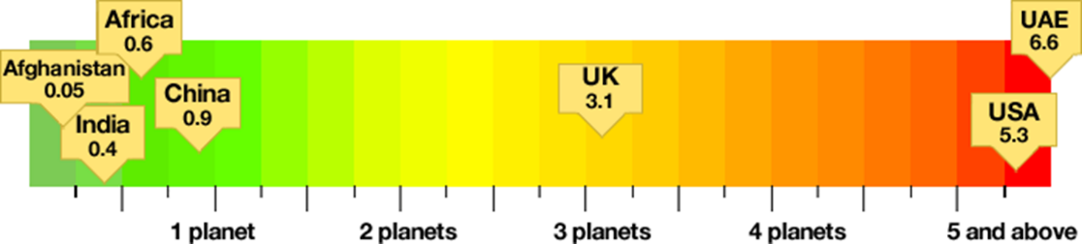
Ecological Footprints – How many planets?
Explain why some countries use more, or less, of the planet’s resources than others.

Slide 11
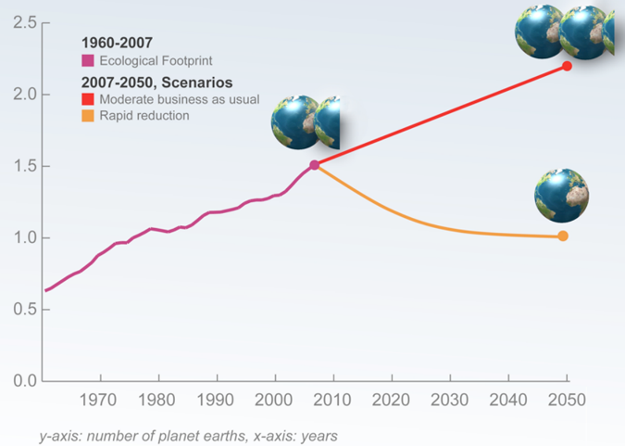
Ecological Footprints – The Future?
What might change over time to affect these predictions?

Slide 12
What does an ecological footprint show?

Slide 13
Ecological Footprints - Input
An ecological footprint is a measure of human demand on the Earth’s ecosystems (land, water and resources).

Slide 14

What’s your eco-footprint?
Our world is in crisis - from climate change to the pollution in our oceans and devastation of our forests. It's up to all of us to fix it.
Complete the questionnaire:
https://footprint.wwf.org.uk/
Notes:
Students complete the questionnaire on iPads, or teacher can demonstrate on board using themselves as the example.

Slide 15
Components of an Eco-Footprint
Which types of places on the planet will have higher ecological footprints?
Eco-footprint Component | Resources Used | What things would increase the footprint?
Food you eat | Land, crops, animals, machinery, chemicals | Importing food from abroad, heavy use of pesticides and fertilisers, irrigation
Transport you use
Housing
Businesses
Consumer goods (things we buy other than food)
Infrastructure

Slide 16
Understand your eco-footprint?
Describe how an eco-footprint is calculated.
Explain how to reduce the size of an eco-footprint (what can people do to live more sustainably).
Assess why most cities, especially in HIC’s, are not sustainable.

Slide 17
Aims – Recap
To know what an ‘ecological footprint’ shows.
To identify what resources make up the components of an ecological footprint.
To explain why different places have larger ecological footprints than others.

Slide 18
Ecological Footprints for UK Cities
This shows how many planets would be needed to support us if everyone in the world lived like people in these cities.
Rank | City | Planets Consumed
1 = | Newport | 2.78
1 = | Plymouth | 2.78
3 = | Salisbury | 2.79
3 = | Kingston upon Hull | 2.79
3 = | Stoke on Trent | 2.79
6= | Gloucester | 2.81
6 = | Wakefield | 2.81
8 | Sunderland | 2.83
9 = | Truro | 2.84
9= | Wolverhampton | 2.84
Rank | City | Planets Consumed
51 | Portsmouth | 3.21
52 | Cambridge | 3.22
53 | Durham | 3.24
54 | Southampton | 3.27
55 = | Oxford | 3.4
55 = | Canterbury | 3.4
57 | Brighton and Hove | 3.47
58 | Chichester | 3.49
59 | St Albans | 3.51
60 | Winchester | 3.52
Middlesbrough?
=2.85

Slide 19
Ecological Footprints – Exam Practice
Using examples, explain how and why cities have different eco-footprints (4 marks)
Write two P.E.E. chains in your answer
PYT: In what ways could a city reduce it’s eco-footprint?

Slide 20


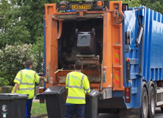


Why do footprints vary between places?
Salisbury has the second smallest eco-footprint (5.01 hectares) and Winchester the largest (6.52 hectares).
Higher House Values/ Older Houses
Many Jobs Require Commuting
Waste/Recycling Schemes
High Employment
Good Income/Wages

Slide 21


Who has the bigger eco-footprint?
A – Family of 4
B – Childless Couple
WHY?

Slide 22
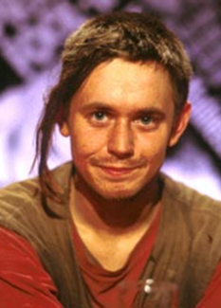

Who has the bigger eco-footprint?
A – Eco-warrior
B – Jeremy Clarkson
WHY?

Slide 23


Who has the bigger eco-footprint?
A – United Arab Emirates
B - Somalia
WHY?

Slide 24
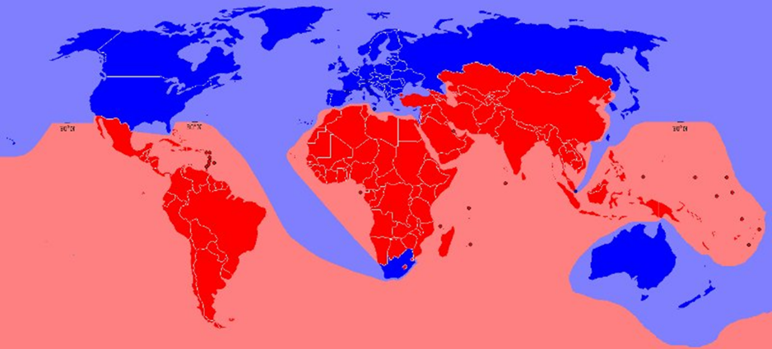
Who has the bigger eco-footprint?
A – HIC
B – LIC/NEE
WHY?

Slide 25


Who has the bigger eco-footprint?
A – Airline Pilot
B – Teacher
WHY?

Slide 26


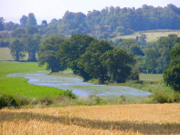







Ecological Footprints – Smallest to Largest
YOU
Notes:
Students write out each in a line to show who has the bigger eco-footprint and explains why.

Slide 27
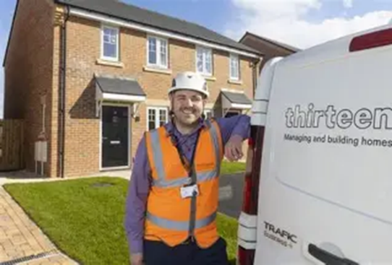

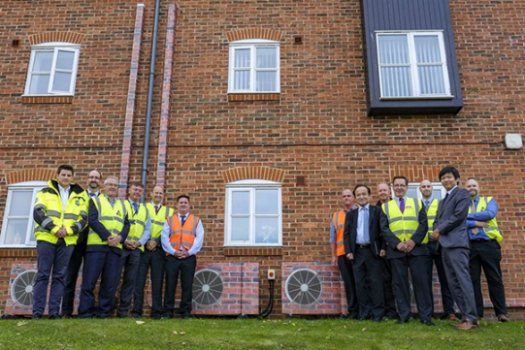
Ecological Footprints – Local Example (Thirteen)
40,000 Homes
100,000 Tenants – almost 40,000 in Tees Valley
https://www.thirteengroup.co.uk/page/about-thirteen

Slide 28
Reducing the eco-footprint of new houses at Thirteen
Thirteen homes are built with:
A renewable energy source.
Energy efficiency.
Future climate-proof features e.g. insulation.
Access to nature.
Waste management

Slide 29
Career Opportunities with Thirteen
Environmental Impact Advisor
Housing Officer
Net Zero Engagement Officer
Net Zero Technical Officer
Energy Manager
Emerging Talent Coordinator
Case Worker
Training Officer
Legal
Maintenance / Engineering
Customer Services
Recycling Officer
Environmental Specialist
Policy and Research Leader
Urban Rangers
Grounds Keeper
Waste Officer
Essential Skills:
Communication
IT
Adaptability
Ability to learn new things
Problem solving
Decision making
Public Speaking
Critical analysis / data analysis
People skills

Slide 30
Thirteen – Job Profiles

Slide 31

Mark McGahern
Job Title: Net Zero Engagement Coordinator
Key Responsibilities:
Advising tenants on how to manage their energy usage
Installation and monitoring of smart energy/metering in homes
Advising tenants how to get the best from their solar panels
Reporting on efficiency measures in our offices and rental properties
Managing repairs for solar panel systems
Advising tenants on upgrades to their homes and how to use these to be more energy efficient
Research and implementation of new technologies to effectively report and monitor our carbon footprint
Key skills needed:
Communication
IT skills
Adaptability
The ability to learn new things

Slide 32

Sammie Bradley
Job Title: Environmental Impacts Advisor
Key Responsibilities:
Calculate Thirteen’s carbon footprint; examining data on our staff travel, our fleet vehicles and all our gas and electric spending
Research and monitor environmental risks to properties such as flooding, overheating, subsidence and extreme weather
Lead environmental training, teaching others about climate science and what we need to do
Develop new ways to measure and record green space so planners can include the environment impacts in their decisions
Helping community team tackle problems like littering, fly tipping and destroying of newly planted trees
Key skills needed:
Data analytics
Problem solving
Public speaking
Critical analysis

Slide 33
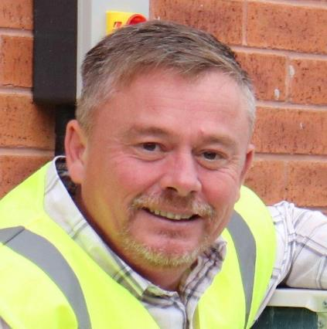
Wes McGeeney
Job Title: Net Zero Technical Manager
Key Responsibilities:
All things relating to our Net Zero Aspirations
Understanding low carbon technologies and their impacts
Business Cases relating to installation of technologies and measurable outcomes
Applying for funding streams in relation to Net Zero
Consultancy on New Build and 30-year investment plans
Seeking out new initiatives and R&D
Key skills needed:
Project management
Technical knowledge
Understanding building physics
Communication

Slide 34
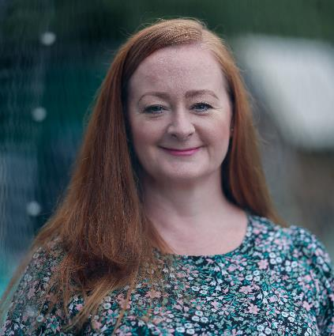
Sam Granger
Job Title: Head of Environmental Sustainability
Key Responsibilities:
Development and delivery of Thirteens approach to reaching net zero and reducing environmental impacts of all business activity.
Leadership of the environmental sustainability team.
Primary contact to board members and senior decision makers
Key skills needed:
Leadership
Communication
Negotiation
Project management

Slide 35
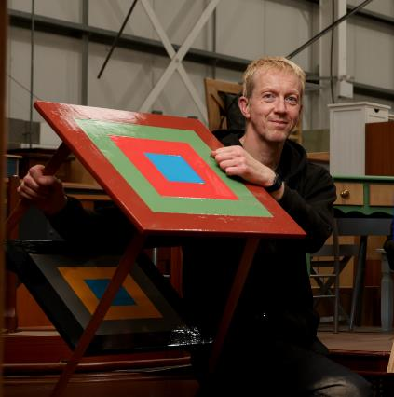
Rhys Baker
Job Title: Upcycling and Reuse Project Co-ordinator
Key Responsibilities:
Strive to divert furniture waste from landfill
Identify and breathe life back into furniture pieces
Creating furniture packs to give a helping hand to customers who need it most
Educating others about furniture poverty
Hosting school groups
Key skills needed:
Creativity
Patience
Practical making skills
Good with people

Slide 36
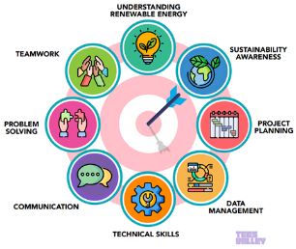

What Next? Research Exercise
Tees Valley Careers www.teesvalley-ca.gov.uk/work/careers-hub/
Tees Valley Sector Workbook www.teesvalley-ca.gov.uk/work/wp-content/uploads/sites/6/2025/01/Energy-and-Low-Carbon-digital-1.pdf
National Careers Service www.nationalcareers.service.gov.uk/explore-careers
Thirteen www.thirteengroup.co.uk/page/jobs
WWF Footprint Calculator www.footprint.wwf.org.uk
Jobs www.wwf.org.uk/jobs
What skills can help you?
Local Employers Include:

