Slide 1




Clean Energy in the Tees Valley
Careers & Opportunities

Slide 2

What is clean energy?
Image from TWI global
Clean energy is energy that comes from renewable zero emission sources that do not pollute.
Why is it important?
This is a key area for future development as countries aim to preserve natural resources and limit climate change and its impacts.
Notes:
Ask students if they know what clean energy is then reveal the answer, discuss why it is an important idea.

Slide 3
The average UK home produces 8,798kg of CO₂!
Can you rank these activities in order of how much carbon they produce?
Waste
Transport
Heating
Diet
Aviation
Electrics
What can we do to reduce our carbon output?
Recycle
Turn down the thermostat by 1℃
Use reusable cups and water bottles
Eat more local and seasonal foods
Walk, cycle or use public transport
Turn off electrics at the wall or use timers
Ensure you have double glazing, use curtains and draught excluders.
The Answer
Heat
Transport
Diet
Aviation
Electrics
Waste
Notes:
Talk about activities we do at home that produce C02 and whether students feel they are ‘green’ or not. Ask students to rank the activities listed and then they can read out and compare answers.
Go through the answer and look at any that surprised students. Brainstorm ideas to do at home to reduce carbon outputs and discuss who already has them at home.

Slide 4
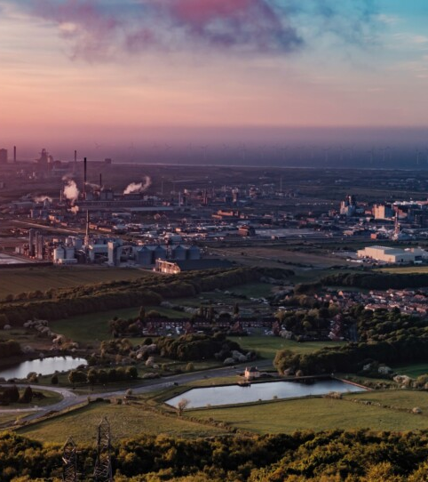
What is happening in the Tees Valley?
Offshore wind farm
Construction at Teesport to support the green energy sector
CCS carbon storage
Net zero Teesside
Hydrogen Valley
Energy from waste plant
Notes:
See if students are aware of any of these projects and made sure CCS and net zero terms are understood. Why is it important for this area that the funding and focus is here and not the South East?

Slide 5

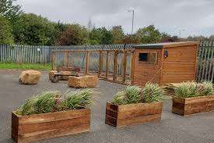
Case Study: Thirteen Group
Image from Thirteen Group
A housing association that provide 100,000 people in the North East with homes and support and have 1500 employees.
Environmental sustainability is a key focus for this company, they have drastically reduced their carbon footprint and are working towards producing 0 emissions by 2050.
Their Billingham recycling centre is powered by solar panels, has a thriving colony of bees, chickens and green space for employees to use.
They upcycle furniture left in properties and give it a new life
They carefully sort and recycle materials to reduce waste.
Notes:
Has anyone heard of thirteen? Talk about the 2050 target and whether the school/ home they attend could realistically meet this target.

Slide 6
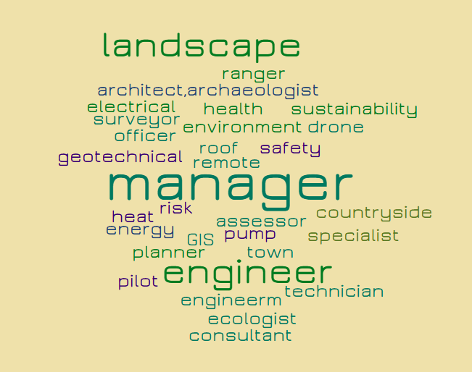
What jobs do you think are needed to build houses?
So many more than you thought of!!!
Notes:
Ask students to say jobs required to build new houses and discuss the wide range that are needed that most people are not aware of.
There are new job roles being created all the time with a green focus and jobs that don’t even exist yet.

Slide 7

Key skills for the green sector
With such huge increases in clean energy in the North East there is a skills gap and demand for jobs in this area.
The following skills are key for students thinking of applying for work experience, apprenticeships and jobs in these areas:
Communication
Critical analysis
Problem solving
Decision making
Adaptability
Notes:
Ask students to assess how many of the skills they think they have and they could rank them in order of importance.

Slide 8

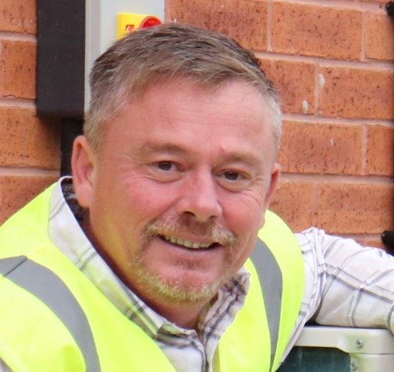
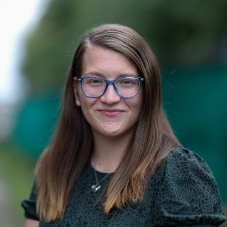
Example job profiles
Mark McGahern
Wes McGeeney
Sammie Bradley
Net Zero Engagement Officer
Helping tenants to reduce their energy usage.
Net Zero Technical Manager
Understand technologies and their impacts on carbon.
Environmental Impact Advisor
Calculate Thirteens carbon footprint and research options to help the company reduce outputs.
Notes:
Go over job profiles, discuss the job titles – are they jobs you are aware of and what do you think they involve?

Slide 9
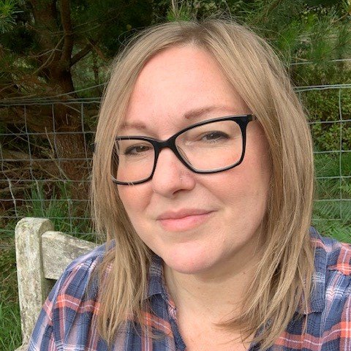
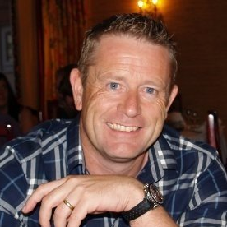
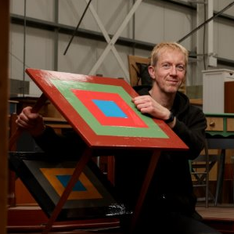
Example job profiles
Sarah Parrot
Michael Hall
Rhys Baker
Policy & Research Lead
Track government policy and respond.
Head of Estate Service
Look after grounds, trees and all property.
Upcycling & Reuse Project Coordinator
Divert waste from landfill.
Notes:
Go over job profiles, discuss the job titles – are they jobs you are aware of and what do you think they involve?

Slide 10
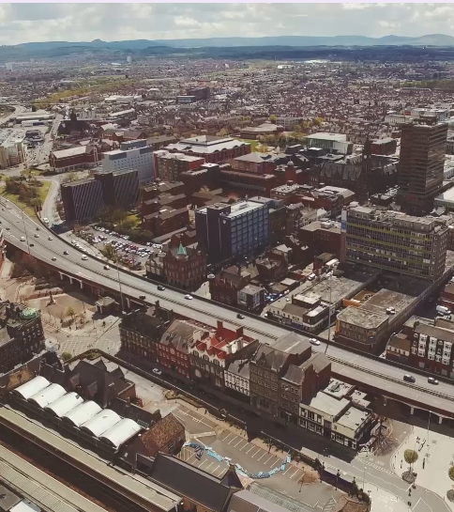
Stay Local, Go Far!
There is a wealth of opportunity for you to enter the clean energy sector in the North East
Talk with your careers advisor
Look for opportunities such as work experience or apprenticeships locally
https://teesvalley-ca.gov.uk/work/careers-hub/
https://www.thirteengroup.co.uk/
https://nationalcareers.service.gov.uk/explore-careers
You are developing knowledge and skills around green energy which can provide you many opportunities.
Notes:
Explain the stay local go far phrase, discuss places that students can go for more information and gauge interest in students that may want to develop links and gain more information.

