Slide 1

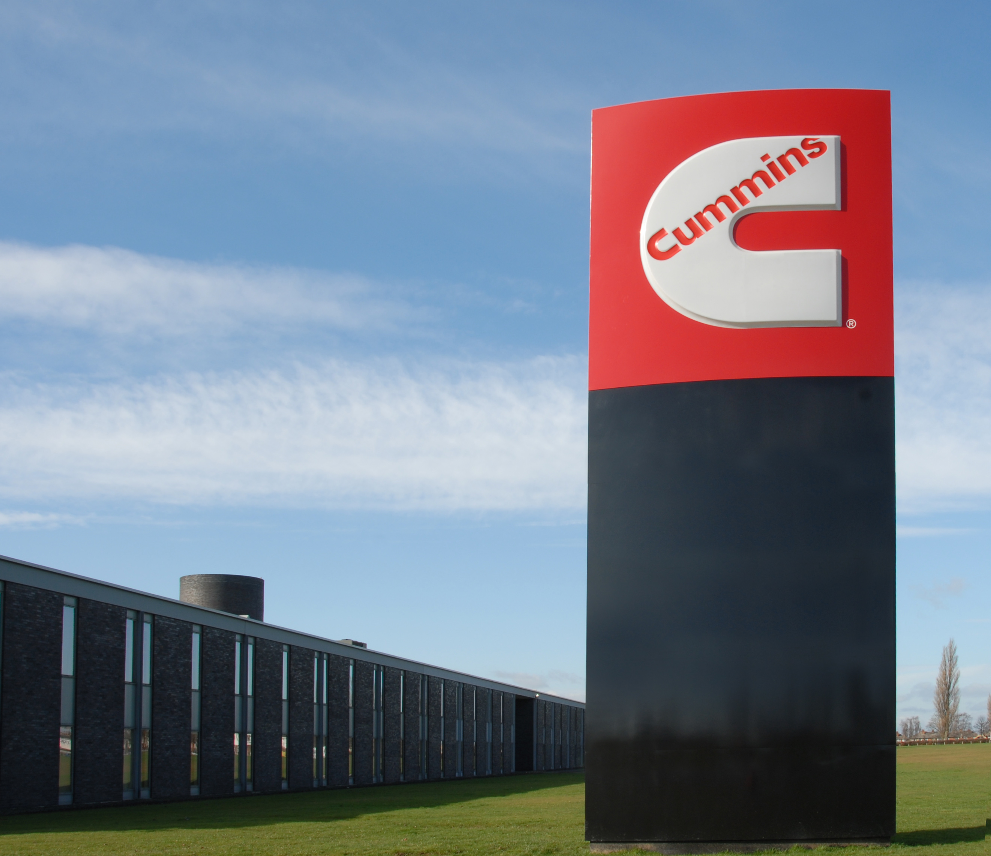



Cummins – KS4 Cosine Rule

Slide 2
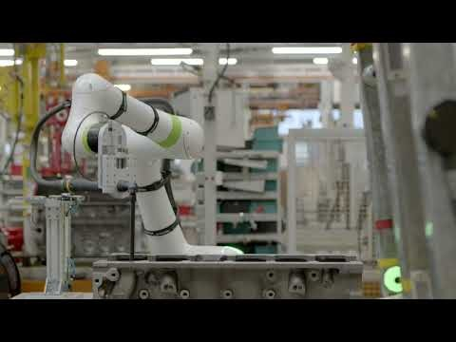
Introduction to Cummins

Slide 3

Introduction to Cummins
There are various job roles within the Cummins factory in Darlington, with jobs in finance, HR, engineering and many more.
We are going to look at a problem that will have been faced by robot programmers in trying to set up the robotic arms that carry out many of the day to day engine building tasks. These arms work alongside human engineers to ensure that the work is completed in a timely manner, while also increasing safety by reducing risks towards human workers.

Slide 4
Trigonometry – Posing a problem – Cosine Rule
Throughout the factory at Cummins, there are many robotic arms that must pivot between different sections of an engine.
They must be coded to understand and recognise the position of each part of the engine they aim to work on. However, in order to code this, the robot must be programmed with trigonometry to calculate the angle it is required to move, and the distance it must travel.

Slide 5
Trigonometry – The Problem
Here we have three points, D, E and F. D and E represent two points on any given engine structure, with the robot arm stationed at point F. If the arm is working at D, and has to move towards point E, it will have to turn through an angle at point F.
D
E
F
Notes:
Here we have three points, D, E and F. D and E represent two points on any given engine structure, with the robot arm stationed at point F. If the arm is working at D, and has to move towards point E, it will have to turn through an angle at point F.

Slide 6
Trigonometry – The Problem
Using the information regarding the movements, we can model this as a triangle. The angle we wish to find we will label x.
D
E
X
F
Notes:
Using the information regarding the movements, we can model this as a triangle. The angle we wish to find we will label x.

Slide 7
Trigonometry – The Problem
Now to solve this problem, we will assume that the robot can calculate the distances between the points in which it needs to travel. The distance from AC will be 1.5 metres, BC will be 1.8 metres, and AB will be 1.65 metres. To work out this missing angle, we shall have to use the cosine rule.
D
1.65m
E
1.5m
1.8m
X
F
Notes:
Now to solve this problem, we will assume that the robot can calculate the distances between the points in which it needs to travel. The distance from AC will be 1.5 metres, BC will be 1.8 metres, and AB will be 1.65 metres. To work out this missing angle, we shall have to use the cosine rule.

Slide 8
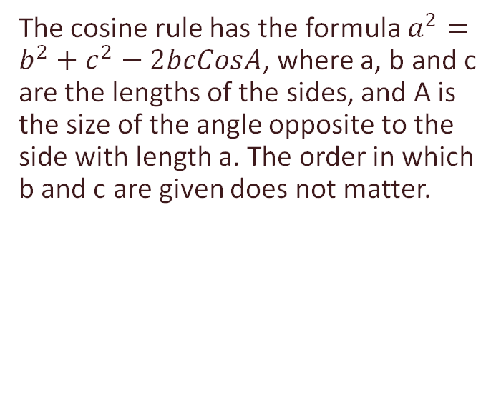
Cosine Rule
The cosine rule has the formula $a^{2}=b^{2}+c^{2}−2bcCosA$, where a, b and c are the lengths of the sides, and A is the size of the angle opposite to the side with length a. The order in which b and c are given does not matter.
B
c
a
A
C
b
Notes:
The cosine rule has the formula $a^{2}=b^{2}+c^{2}−2bcCosA$, where a, b and c are the lengths of the sides, and A is the size of the angle opposite to the side with length a. The order in which b and c are given does not matter, but angle A (the one which is being calculated) must be opposite the side which has been labelled A.
More discussion at teacher discretion can be completed here for explanation and understanding purposes.

Slide 9
Trigonometry – The Solution
a
Applying the cosine rule to this question, we find that a = 1.65, b = 1.8, c = 1.5 and A = x.
D
1.65m
E
1.5m
c
b
1.8m
X
F
Notes:
Applying our knowledge of the cosine rule to this question, we find that a = 1.65, b = 1.8, c = 1.5 and A = x.

Slide 10
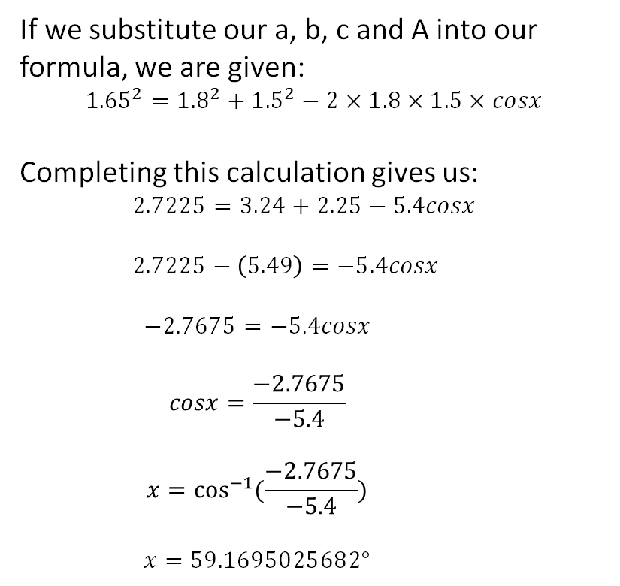
Trigonometry – The Solution
a
If we substitute our a, b, c and A into our formula, we are given:
$${1.65}^{2}={1.8}^{2}+{1.5}^{2}−2×1.8×1.5×cosx$$
Completing this calculation gives us:
$$2.7225=3.24+2.25−5.4cosx$$
$$2.7225−\left(5.49\right)=−5.4cosx$$
$$−2.7675=−5.4cosx$$
$$cosx=\frac{−2.7675}{−5.4}$$
$$x=\cos^{−1}{(\frac{−2.7675}{−5.4})}$$
$$x=59.1695025682°$$
A
1.65m
B
1.5m
c
A
b
1.8m
X
C
Notes:
Completing the calculation on the screen as follows:
If we substitute our a, b, c and A into our formula, we are given:
$${1.65}^{2}={1.8}^{2}+{1.5}^{2}−2×1.8×1.5×cosx$$
Completing this calculation gives us:
$$2.7225−(3.24+2.25)=−5.4cosx$$
$$−2.7675=−5.4cosx$$
$$cosx=\frac{−2.7675}{−5.4}$$
$$x=\cos^{−1}{(\frac{−2.7675}{−5.4})}$$
$$x=59.1695025682°$$

Slide 11
Trigonometry – Solving Problems
1.
2.
D
3m
E
3.5m
E
X
D
X
5m
6m
2.5m
4.5m
F
F
$$a^{2}=b^{2}+c^{2}−2bcCosA$$
Notes:
Answers:
1. 130.541601874
2. 96.3793702084

Slide 12
Trigonometry – Generate your own question
In pairs, try to generate your own questions for another pair in the room to answer. You must have completed your own question with a complete solution before passing it to another pair.
If a pair complete the solution, they can present their solution to the class and have it confirmed or denied by the pair who wrote it.
D
E
F
$$a^{2}=b^{2}+c^{2}−2bcCosA$$

Slide 13
Cummins Research – Find out more:
Head over to the Cummins website and try to find as many different types of mathematical topics used in the day to day running of the factory. Can you combine that with which jobs and careers will use each type of mathematics topic that you find? Use the links that follow to assist you in making a list of any transferable skills between your current learning and those required to work at a company such as Cummins, in whichever department you would choose. https://www.cummins.com/eu/darlington-uk Darlington – https://teesvalley-ca.gov.uk/work/wp-content/uploads/sites/6/2025/01/Darlington-LMI-Tees-Valley-Poster.pdf Automotive Sector - https://teesvalley-ca.gov.uk/business/automotive-and-aerospace/ Workbook - https://teesvalley-ca.gov.uk/work/wp-content/uploads/sites/6/2025/01/Automotive-Aerospace-digital.pdf

Slide 14
Any questions?

