Slide 1




Biology Skills
& Careers in Healthcare
How the skills you learn at A-Level prepare you for the world of work?

Slide 2
Not everyone working in the NHS is a Doctor or a Nurse!
The NHS employs around 1.5 million staff, in over 350 different job roles.
Many of these jobs require science at A Level or as a level 3 vocational qualification, without requiring the high grades and year of study that medicine demands!
Roles could be:
Working directly with patients, as a physiotherapist, occupational health practitioner or nutritionist.
Working indirectly with patients, as a biomedical scientist working in hospital pathologies laboratories, a geneticist investigating the inherited aspects of disease, or a reproductive scientist working behind the scenes in a fertility clinic.
Think about what you like most about biology and healthcare to help you find the right role.

Slide 3
Direct Entry Roles with Biology A-Level
Healthcare Assistant/Support Worker: Entry-level positions requiring good GCSEs and sometimes A-Levels
NHS Administrative/Clerical roles: Biology knowledge helpful for medical terminology
Laboratory Assistant: Biology A-Level may be sufficient for junior positions

Slide 4
Higher Education Pathways
Biology: A-Level is essential or highly recommended for:
Medicine: Typically requires Biology + Chemistry A-Levels (AAA grades typically)
Nursing: Biology often preferred (BBB-CCC depending on university)
Midwifery: Biology beneficial (ABB-BBC typically required)
Paramedic Science: Biology advantageous (BBB-BCC typical requirements)
Radiography: Biology helpful alongside physics (BBB typically)
Physiotherapy: Biology commonly required (AAB-ABB typical offers)
Occupational Therapy: Biology beneficial (ABB-BBC typical range)
Healthcare Science: Biology essential for many specialties
Pharmacy: Biology + Chemistry typically required (AAA-ABB)
Biomedical Science: Biology essential (AAB-BBC typical requirements)

Slide 5
NHS Apprenticeship Routes*
Healthcare Science Apprenticeships: Biology knowledge advantageous
Nursing Associate Apprenticeships: Biology background helpful
Healthcare Support Worker Apprenticeships: Entry with GCSEs + Biology A-Level
*Many NHS apprenticeship routes are for people already working within the organisation, for incense in direct entry roles.

Slide 6
Making Your Biology A-Level Count
Work to achieve the highest grades that you can get (NHS careers are often competitive)
Gain relevant work experience or volunteering
Research specific entry requirements for your chosen profession
Consider combining with Chemistry, Psychology, or Mathematics for broader options
Focus on developing your practical skills!

Slide 7
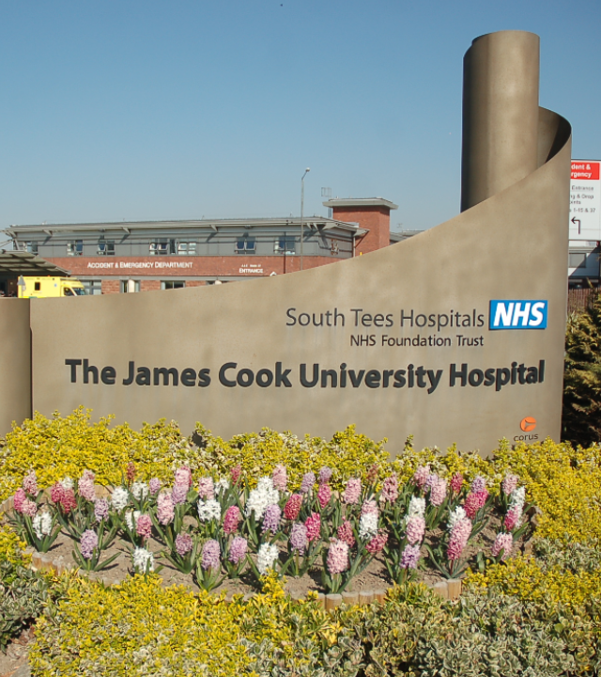
Skills in A-Level Biology: A pathway to an NHS career
A-Level Biology equips students with a toolkit of transferable skills that will be essential in the world of work. The hands-on skills related to practical work directly support a range of NHS roles, where scientific thinking, technical procedures, and teamwork are vital.
Let’s explore how you lab-based learning can lead to real-world impact across healthcare professions.

Slide 8

The Common Practical Assessment Criteria
All A Level sciences share the same overall assessments for students’ practical competency:
Follows written procedures
Applies investigative approaches and methods when using instruments and equipment
Safely uses a range of practical equipment and materials
Makes and records observations
Researches, references and reports
If you can do these five things well, you can be competent in almost any science-related job role!

Slide 9

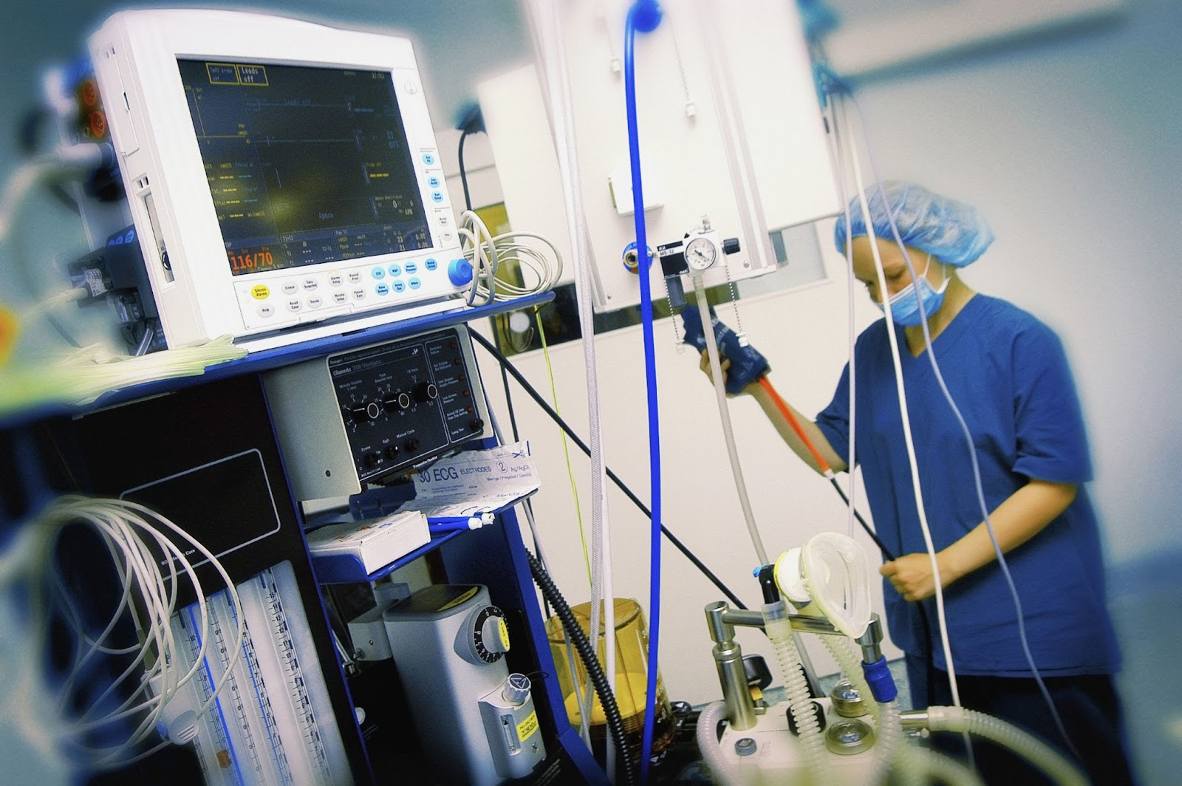
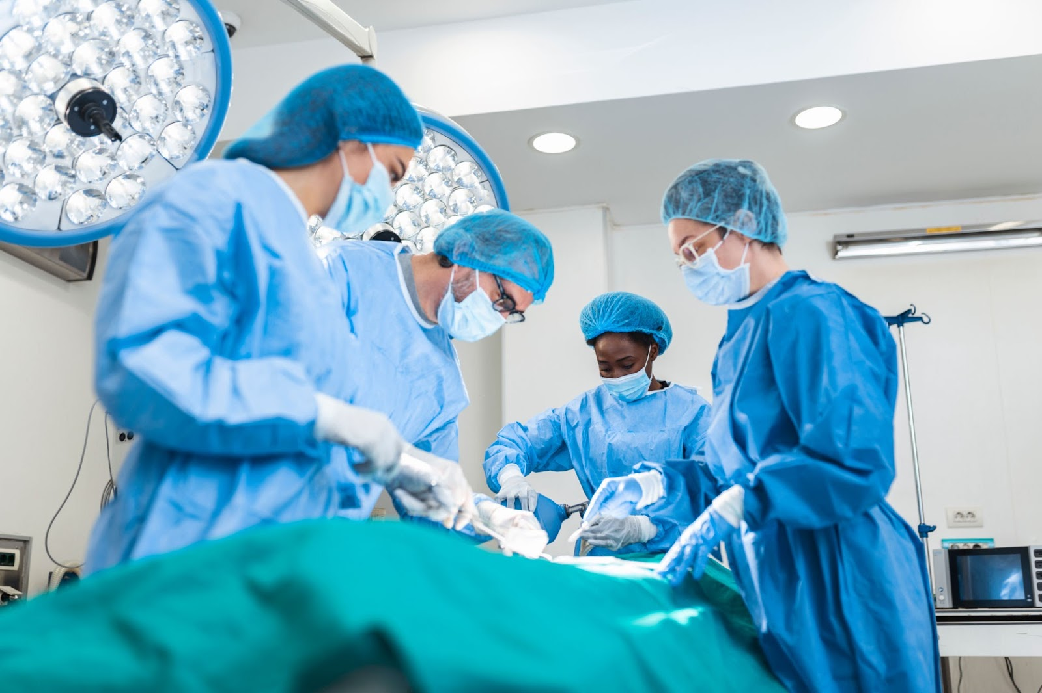
1. Follows Written Procedures
Many activities in healthcare follow SOPs - standard operating procedures
Standard Operating Procedures (SOPs) are detailed, written instructions designed to ensure consistency, quality and safety in performing specific tasks or processes
They are used across all areas of the NHS
In healthcare, not doing a procedure correctly could cost someone their life!

Slide 10

Investigation is a key component of many NHS job roles.
Scientists in the NHS use a wide range of equipment and techniques to help doctors diagnose patients’ conditions.
Many NHS staff are engaged in research as part of their job role - at JCUH, for instance, has specialist research nurses and a team that coordinates research with NHS teams and external partners such as universities.

Slide 11
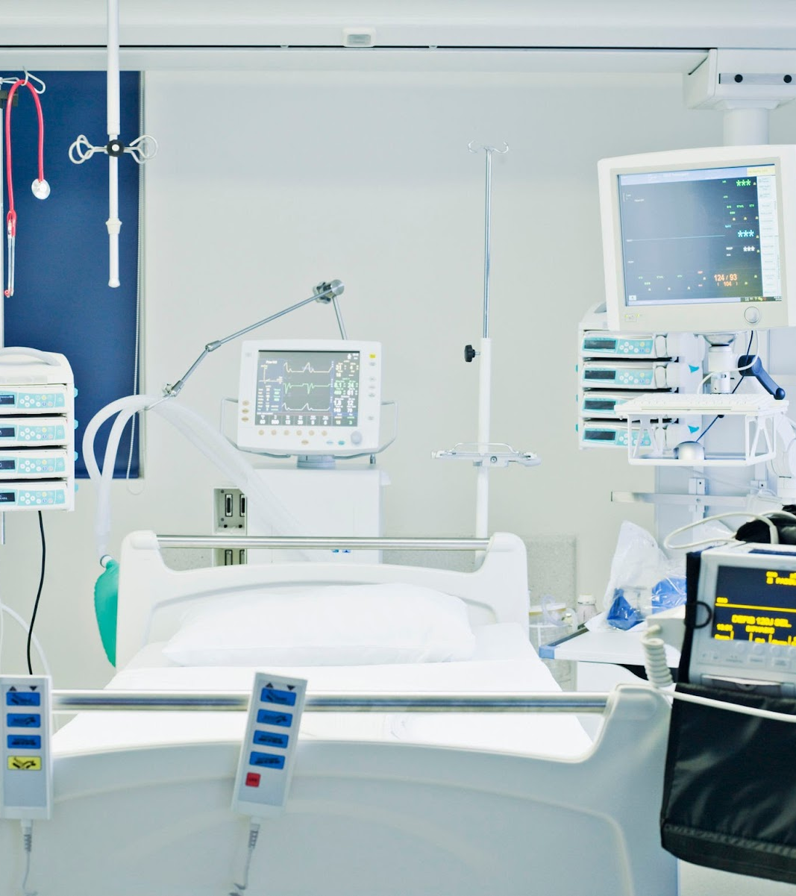
3. Safely Uses a Range Of Practical Equipment and Materials
Safe use of equipment is important in any job.
In NHS healthcare careers is essential, as the equipment and materials will be being used to treat people. Misuse of equipment could cause damage to patients, and cost a lot of money!

Slide 12
4. Makes and records observations
In a healthcare situation, everything must be carefully observed and accurately recorded, for instance:
Information about the patient, from name and date of birth to symptoms and treatments
Information on samples so that the can be correctly transported, tested and the results logged and returned
Results of tests carried out on wards or in labs.

Slide 13

5. Researches, References & Reports
NHS staff regularly engage in research, as clinicians finding out what is wrong with their patients, to research staff developing new treatments.

Slide 14
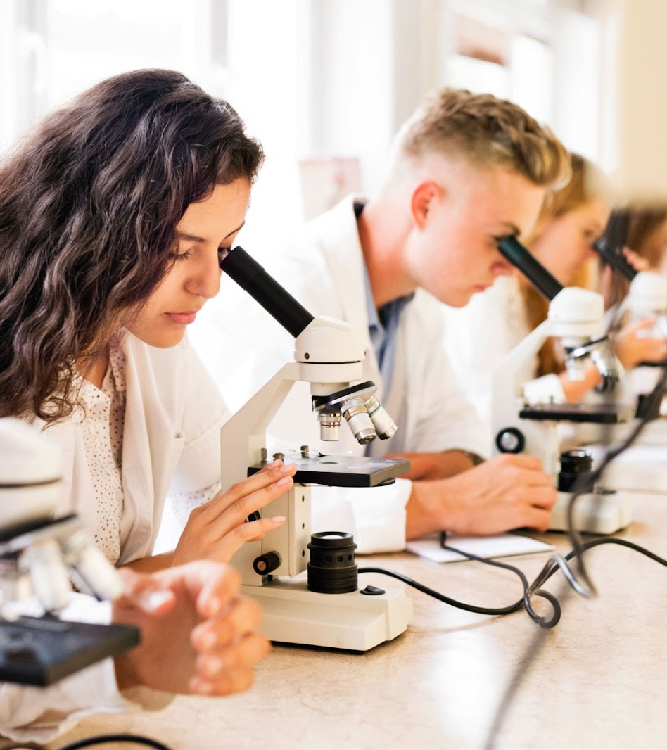
Reflecting On Your Own Skills Development
What practical's have you done in science this year?
What skills did they help you develop?
What careers in the NHS might those skills be useful in?
Are there other skills in science, or in college more generally, that you have developed that could help you in the world of work?

Slide 15
Find Out From The Professionals –
What Skills From Education Do They Use Every Day?
To view the James Cook videos, go here.

Slide 16
What skills would you need?
Select an NHS career that you might be interested in, and think about the skills that you would need. Do some research if you don’t know straight away.
Make a list of the skills for your chosen career.
Write a sentence for each one about how your biology /science lessons and practical training have helped you develop those skills. If you can’t find any direct links to biology, what about your other courses, or college life more generally?

Slide 17
Next steps
NHS careers:
Take our careers quiz | Health Careers
https://www.healthcareers.nhs.uk/
Tees Valley Careers – Health & Life Sciences Booklet:
https://teesvalley-ca.gov.uk/work/wp-content/uploads/sites/6/2025/01/Healthcare-and-Life-Sciences-digital-1.pdf
Search for university courses:
Search | Subject guides | UCAS
Speak to the careers team

