Slide 1

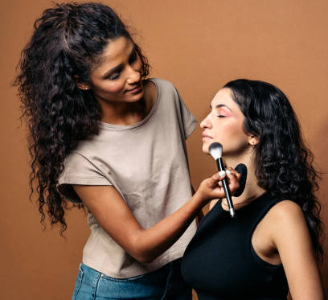


Makeup Artistry Careers in Tees Valley

Slide 2
Qualifications
The first step to any job in the Makeup Industry is having the right qualification, to become freelance in the industry you will need a Level 3 qualification, so you are competent in a range of makeup techniques and styles.
Having a Level 3 qualification will also mean that you can obtain public liability insurance for working with the general public.
It will also be an advantage if you have had some experience in the industry working in TV/Film, Theatre or Fashion or having a part time job working with the public.

Slide 3
Careers
What types of industries can you work in as a Makeup Artist?

Slide 4
Careers
What types of industries can you work in as a Makeup Artist?
Fashion
TV
Film
Theatre

Slide 5
Careers
Using the links provided research what a hair and makeup artist would do on a TV or Film set?
OR
What a Makeup Artist does in Theatrical performances?
Create a spider diagram of what they do in these roles and any key skills attached to these roles/tasks.
https://northeastscreen.org/
https://teesvalley-ca.gov.uk/work/careers-hub/
Hair and make-up artist skills - ScreenSkills
Makeup Artist Roles - Careers In Film, TV, Stage, and Fashion

Slide 6
Job Roles
Makeup Artist on a TV and Film Set
Would create the hair and makeup design based off the script.
Would create hair and face charts for the looks.
Consult with the Producer and Director about the looks they have designed.
They would write step by step application down, to enable anyone working on the team to apply the makeup and hair look suitable for continuity.
Could order and restock products to be used on set.
Would apply makeup and hair daily for the talent.
Makeup Artist on a touring theatrical production.
Maintain the wigs and any makeup garments for the run of the show.
Ensure that all of the products needed were ordered and kept topped up.
Apply makeup and hair to the main actors in the theatrical productions.
Ventilate wigs weekly to maintain their style.
Working in a clean and safe way to ensure no cross contamination of products.

Slide 7
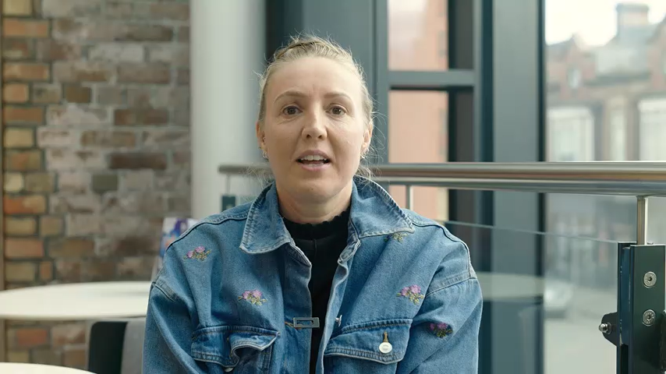
Makeup Artist Currently in the industry
Laura Tallentire is a Hair and Makeup Artist currently working in the North East on a range of sets.
Here is how she got into the industry and what she does in the industry.

Slide 8
Opportunities
Here are a list of opportunities to work in the industry in Tees Valley and the North East:
Makeup artist on set with North East Screen.
Hair and Makeup Artist working on touring productions at Darlington Hippodrome.
Makeup Artist working on in house productions at Stockton Globe Theatre.
Hair and Makeup Artist working with Film buddy on set in the North East.
Hair and Makeup Artist for photoshoots working with modelling agencies such as TTM and Savalas.

Slide 9
Next Steps
If these are the type of roles you would enjoy working in, the next steps would be to contact the business involved, below are some handy links:
https://www.darlingtonhippodrome.co.uk/
https://northeastscreen.org/
https://teesvalley-ca.gov.uk/work/careers-hub/
https://nationalcareers.service.gov.uk/explore-careers

