Slide 1




Software Development Methodologies in Game Development

Slide 2
Objectives
By the end of this lesson, students will:
Understand about Double Eleven as an employer and their values
Understand Waterfall and Agile methodologies.
Learn how game development studios like Double Eleven apply these methodologies.
Discuss why game studios may mix methodologies depending on project needs.
Be able to research the Digital sector and potential career pathways in Tees Valley
Notes:
Lesson Outline
Introduction to Software Development in Game Development (10 minutes)
Explain that software development methodologies are crucial in game development, where projects can be:
Large-scale (AAA games) or small indie projects.
Require strict deadlines (publisher-driven) or allow flexibility.
Need fast iteration (prototypes) or structured planning (final production).
Introduce Double Eleven as a UK-based studio that works on ports, remasters, and original games.
Highlight that they use both Agile and Waterfall, depending on the project.

Slide 3
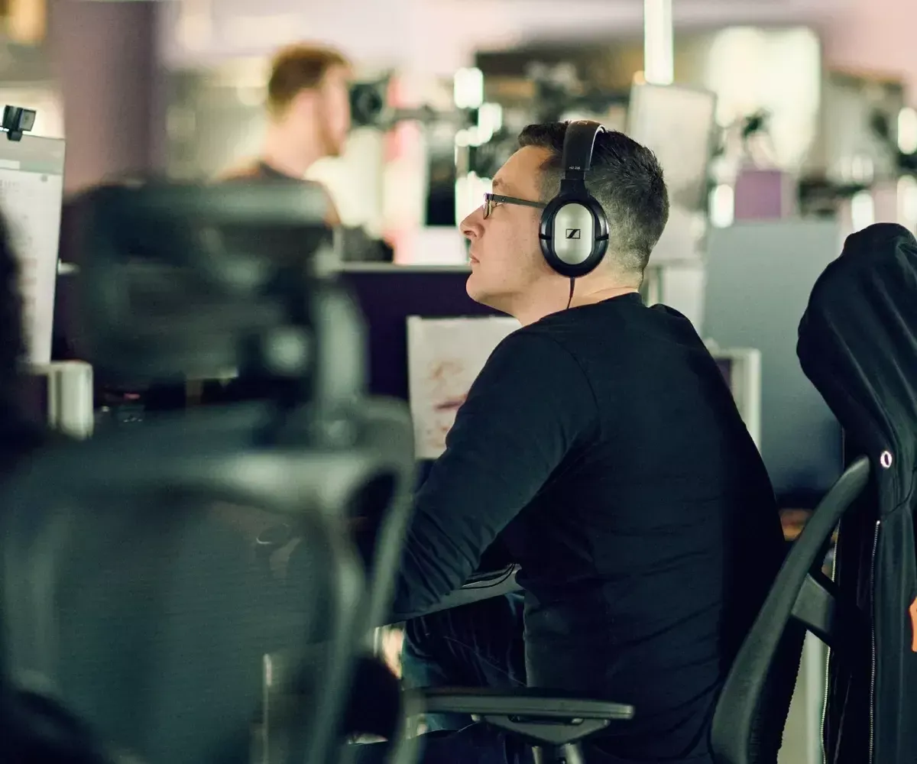

Double Eleven- Who are they?
Double Eleven was founded in 2009 in the North East on the idea of creating a company that puts people first, a place where you get to work on exciting projects, while also having a great work-life balance. They are proud that their 'people first profit' philosophy is still at the heart of the business today as it was back then.
Since then, they have grown into a full-service game developer and publisher comprising of brilliant programmers, designers, artists, producers, audio designers, publishing experts and support teams, led by a passionate and principled leadership team who want to nurture their people to be their best.
Independent Games Studio - Double Eleven
Notes:
Give a brief insight into Double Eleven, weblink is shown at the bottom of the page to show the students

Slide 4
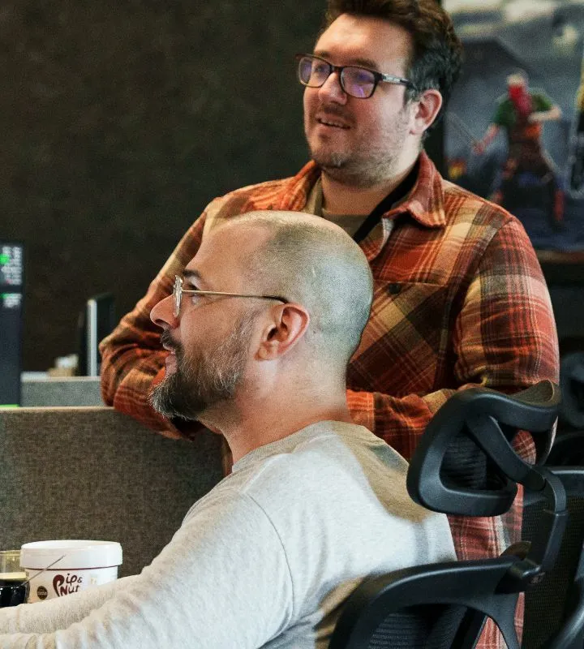
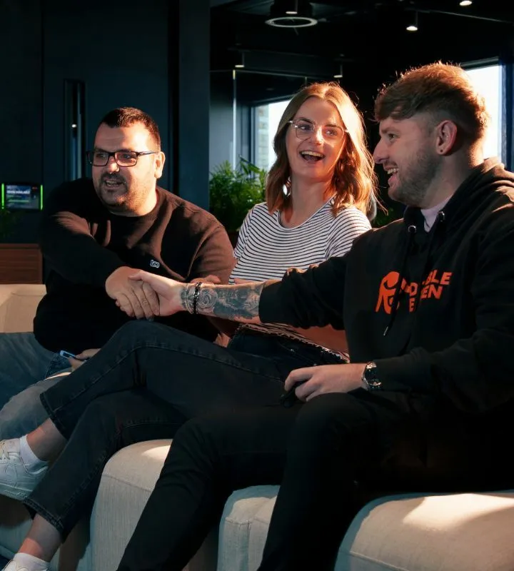

Double Eleven- Who are we?
440 strong
20+ different titles
30 nationalities in their team
14 years of experience
3 generations of consoles
3 Best Place to Work awards
2 studio locations
100% independent
Our World - Double Eleven
Our Values
Integrity – We work with honesty and consistency, collaborating openly and always seeking the right thing to do
Humanity – Our people are the heart of our evolution and we nurture them to be their best. Without them our vision would fail
Ambition – Ambition is in our blood. It is this drive that pushes us to create the best games possible, going above and beyond for our teams, partners and players.
Notes:
Celebrate the success of the company and discuss their values with the students, why are they the company is successful and how important are the values?
Can the students evidence their own values, can they produce three important values they feel they have that employers may look for.
Again, the weblink is added to look at the company further

Slide 5
Waterfall in Game Development
Why Waterfall?
Some game projects require strict planning, especially when working with external publishers or remastering existing games.
Double Eleven might use Waterfall when:
A game design is well-defined from the start (e.g., working with a big publisher like Rockstar Games).
They are porting a game to a new platform (e.g., no major design changes, just technical adjustments).
There are fixed deadlines and milestones (e.g., contractual obligations).

Slide 6
Activity
Scenario: Double Eleven ported Red Dead Redemption 2 (RDR2) to the Nintendo Switch. They had to ensure the game remained faithful to the original while optimizing it for the new hardware.
Task: In groups, students will apply the Waterfall methodology to plan the porting process of Red Dead Redemption 2 from start to finish, focusing on each of the key stages:
Requirements Gathering – What are the core technical specifications of the Nintendo Switch? What limitations and requirements need to be considered (e.g., graphics, storage)?
System Design – How will the game’s design be adapted to the Switch? What changes are needed to the control scheme, graphics, and user interface?
Implementation – What are the key development tasks to be completed (e.g., optimizing textures, ensuring compatibility with Switch controls)?
Verification – How will you test the game to ensure it runs smoothly on the new platform? What performance tests will be run?
Maintenance – After the port is released, what steps will be taken for bug fixes and performance improvements?
Notes:
(25 minutes)
Each group will create a detailed project timeline outlining their approach for each stage. They will divide the work into phases and assign milestones to help visualize how Waterfall methodology would work in this scenario.
Discussion (10 minutes):
Once the groups finish, each group will present their timelines to the class.
Discuss the key steps and why Waterfall is suited for this type of project, focusing on the need for clear milestones, fixed requirements, and a structured development process.

Slide 7
Agile in Game Development
Why Agile?
Game development is unpredictable—features change based on testing and feedback.
Double Eleven might use Agile when:
Developing an original game where mechanics need frequent iteration.
Working with an evolving game (e.g., live-service updates, DLC).
Prototyping new mechanics before committing to full development.

Slide 8
Activity
Scenario: Double Eleven developed their own original game, Blindfire, which was released in October last year.
Task: Divide students into pairs and ask them to create a simple, low-fidelity prototype for one feature of Blindfire using paper and markers.
For example, design the user interface for a skill progression screen where players can see their character’s improvement.
Notes:
20mins
Students should focus on core functionality (e.g., how the player interacts with the screen, where skills are shown, and how the player upgrades them).
They should create a sketch of the screen and write a user story for it, such as:
As a player, I want to see a progress bar for my character’s skill development so I can track my performance in real-time.
This mimics how Agile would iterate upon features in a game and is an easy way to visualize and test ideas quickly.

Slide 9
Lesson Summary
How do Double Eleven balance Waterfall and Agile depending on project needs?
Key Takeaways:
Game development is flexible: Studios like Double Eleven use both Waterfall and Agile based on the project.
Waterfall is great for structured projects (ports, remasters).
Agile works well for new and evolving games.
Notes:
5mins
Answer any student questions.

Slide 10
Additional Resources
OCR A Level Specification (1.2.3 Software Development)
Double Eleven Careers & Project Info
Game Development & Agile: Why It Works
Notes:
5mins
Answer any student questions.

Slide 11
What Next?
Are you interested in a career in the Digital Sector, or would you like to know more? If so, please look at the links below for further research:
Tees Valley Careers
https://teesvalley-ca.gov.uk/work/careers-hub/
Tees Valley Key Priority Sectors
https://teesvalley-ca.gov.uk/business/invest/key-sectors/
Tees Valley Labour Market Information (LMI) Factsheets
https://teesvalley-ca.gov.uk/work/wp-content/uploads/sites/6/2025/03/6-x-LMI-Tees-Valley-Posters-digital-friendly.pdf
Digital & Creative Sector Workbook
https://teesvalley-ca.gov.uk/work/wp-content/uploads/sites/6/2025/01/Digital-Creative-digital-1.pdf
Double 11|
https://double11.com/
Double 11 – Our World
Our World - Double Eleven
National Careers Service
Careers advice - job profiles, information and resources | National Careers Service
Amir Satvat
https://amirsatvat.com
Indie Games Career Pathways
Career Paths
Teesside University Animex Festival
Animex Festival
Notes:
Discuss the weblinks and explain how the students can use them further research Careers in Tees Valley and the Digital Sector

