Slide 1

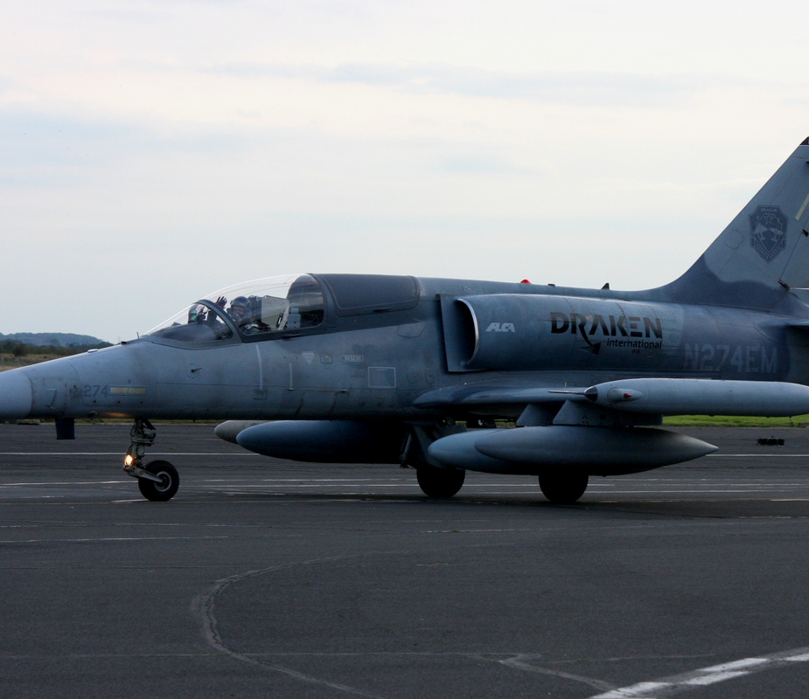


Aviation Sector Stay Local, Go Far

Slide 2

What career options do you think of when you see the logo below?
Notes:
Typically students will suggest; pilot, customs, cabin crew, air traffic control, customer service

Slide 3

Did you think about any of these?
Notes:
Discuss some of the roles – use Teesside International Airport website & National Careers Service Website (see links below)
https://www.teessideinternational.com/
https://nationalcareers.service.gov.uk/explore-careers

Slide 4
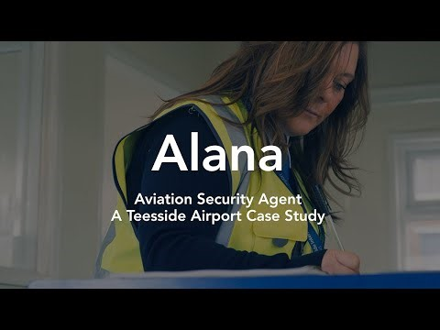
Aviation Security Agent
What do they do?
Keep the airport grounds secure;
Deliveries
Cargo
Site
Keep the airport and passengers safe:
Passport check in
Security to go air side
Luggage searches
Whilst aviation security agents are specific to airports, their job requires them to use a number of different skills.
Listen to what Alana does and identify the different skills she will need to carry out her role.
https://www.youtube.com/watch?app=desktop&v=E5OTA7L2pGU&pp=ygUbVGVlc3NpZGUgYWlycG9ydCBjYXNlIHN0dWR5
Notes:
Watch the video case study

Slide 5
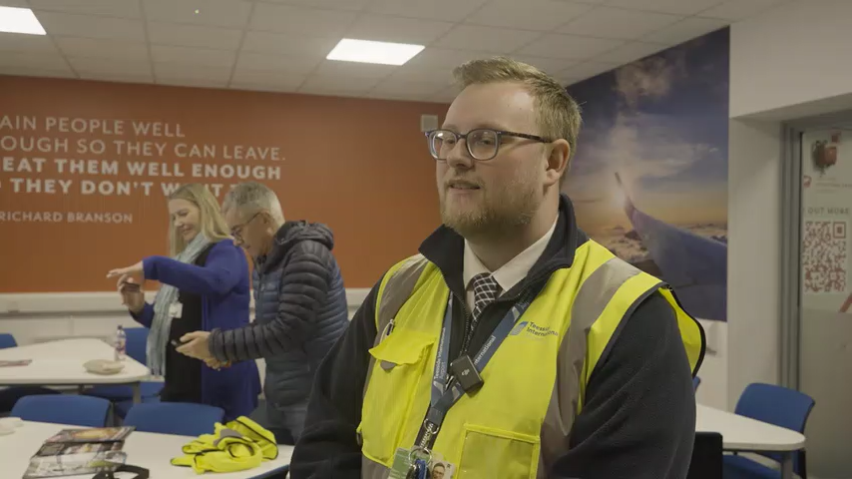
Tom’s Journey
Tom has a managerial role at Teesside International Airport. Listen to his story, did he start off as a manager?
Tom talks about everything at Teesside International Airport as being ‘in house’. This means every employee there is employed by the airport. This includes:
Air Traffic Control
Fire Services
Check in Agents
Café Assistants
Baggage Handlers
Security Officers
Ground Crew
Do you think this will have an impact on career progression?
Notes:
Tom’s video will need to be played here.
Tom started off as a check in agent at Leeds Bradford Airport
Having everything in house means that there is increased variety with peoples workload – people can fulfil multiple roles and gain experiences in lots of different areas. This means that they will have more skills.

Slide 6
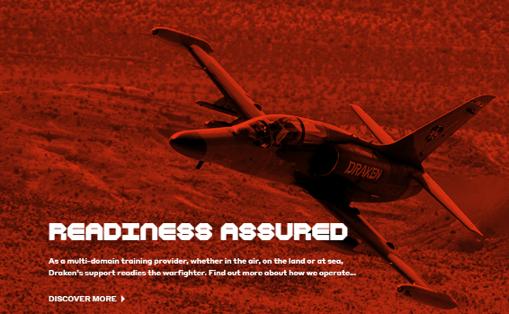

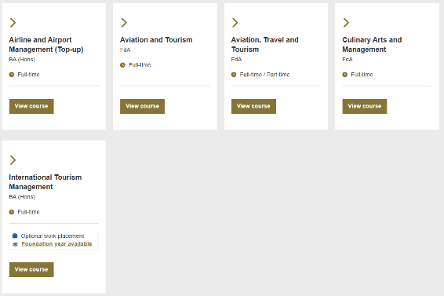

Exciting Airport
Draken have a permanent base at the airport.
From here they prepare the Royal Air Force to survive the fight with training exercises.
With this they employ:
Engineers
Support Staff
Planning Officers
Pilots
https://www.draken.aero/
Teesside International Airport is unlike any other.
The Aviation Academy at Teesside University have a lecture room there, this means those interested in a career in aviation, can study a number of different degree courses, as an under or post graduate.
https://www.tees.ac.uk/sections/about/aviationacademy.cfm
Notes:
Teesside University and Draken show that there isn’t just your typical aviation roles available, the possibilities are endless.

Slide 7

What Next?
You can use the Aerospace Section of this workbook to look at the skills and possible pathways for when you leave school.
https://teesvalley-ca.gov.uk/work/wp-content/uploads/sites/6/2025/01/Automotive-Aerospace-digital.pdf
Notes:
Students can research what they are interested in and type their career pathway into the last page of the book and save for future reference.

