Slide 1

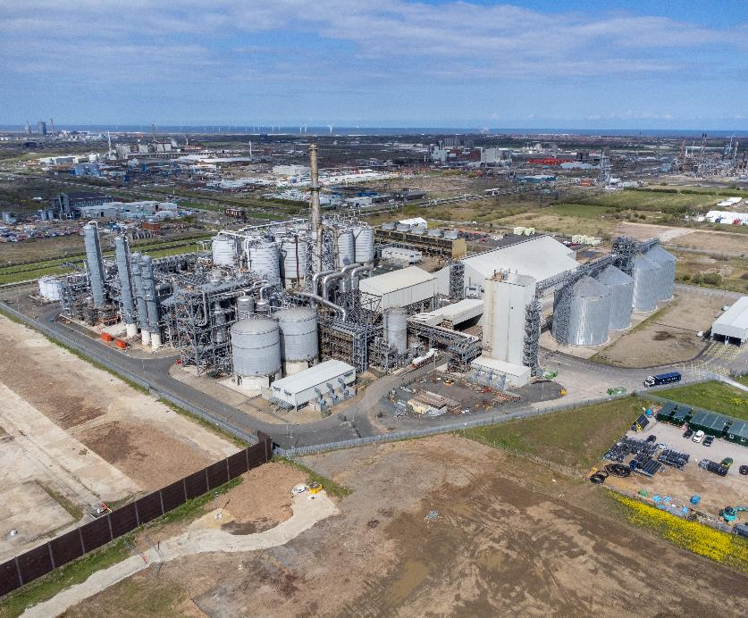


Tees Valley Engineering – Past Present and Future

Slide 2
Past: The Industrial Roots of Teesside Engineering

Slide 3


Past: Key Engineering Milestones in Teesside
1825 – Stockton & Darlington Railway
First passenger railway in the world, engineered by George Stephenson.
Dorman Long Bridges
Teesside steel used in the Tyne Bridge and Sydney Harbour Bridge.
Middlesbrough Transporter Bridge (1911)
Unique solution for crossing the Tees without blocking ships.
ICI Chemical Plants
Major developments in fertilisers, plastics, and fuels at Billingham and Wilton.
Wilton & Teesport
Growth of shipping, petrochemicals, and industrial logistics.

Slide 4
Present: Today’s Engineering in Teesside

Slide 5
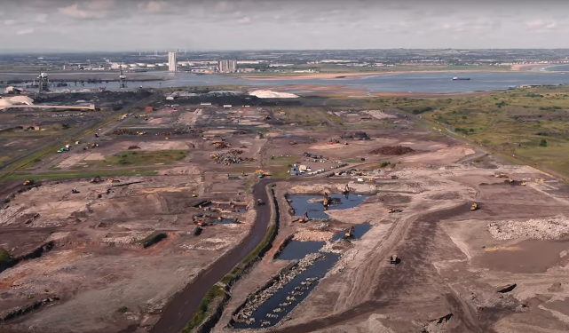
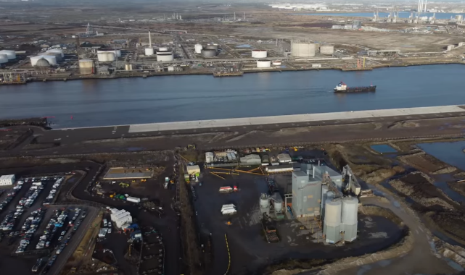
Present: Today’s Engineering in Teesside
Teesworks: UK’s largest industrial regeneration site, focused on clean energy and manufacturing.
Net Zero Teesside: Aiming to be the UK’s first decarbonised industrial cluster.
Strong chemical and process industries, with firms like SABIC, Venator, and Sembcorp.
Ongoing infrastructure projects: roads, ports, and flood defences.

Slide 6
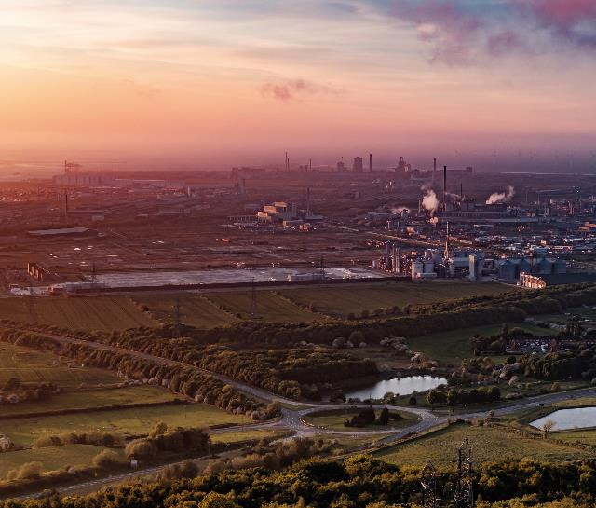
Present: Engineering Sectors in Teesside Today
Energy & Renewables: Growth in wind power, hydrogen, and carbon capture projects.
Civil & Structural Engineering: Supporting housing, transport, and coastal protection.
Mechanical & Electrical Engineering: Key to manufacturing, maintenance, and plant operations.
Digital & Automation: Increasing demand for control systems, robotics, and smart technologies.
Strong need for skilled engineers, apprenticeships, and graduates across sectors.

Slide 7

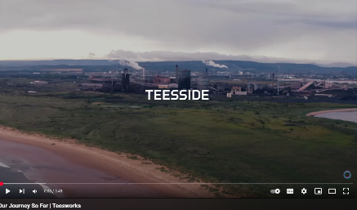
Present: Teesworks
Our Journey So Far | Teesworks

Slide 8
Future: Shaping Tomorrow’s Industry on Teesside

Slide 9
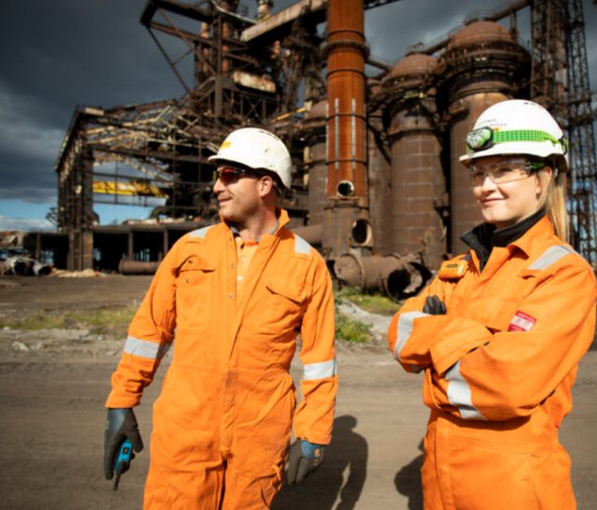
Future: The Future of Engineering in Teesside
Green energy is at the heart of future growth – especially hydrogen, carbon capture, and offshore wind.
Teesworks and Net Zero Teesside will create thousands of skilled engineering jobs.
Demand for sustainable design, smart tech, and automation will continue to rise.
Strong focus on training and apprenticeships to meet future skills needs.
Teesside aims to be a global leader in clean, modern, and advanced engineering.

Slide 10

Future – Challenges and Innovations in Teesside Engineering
Meeting net zero targets while maintaining industrial output.
Integrating renewable energy with existing infrastructure.
Adopting digital technologies like AI, IoT, and automation in engineering processes.
Developing sustainable materials and eco-friendly manufacturing.
Building a diverse and skilled workforce to support evolving industry needs

Slide 11
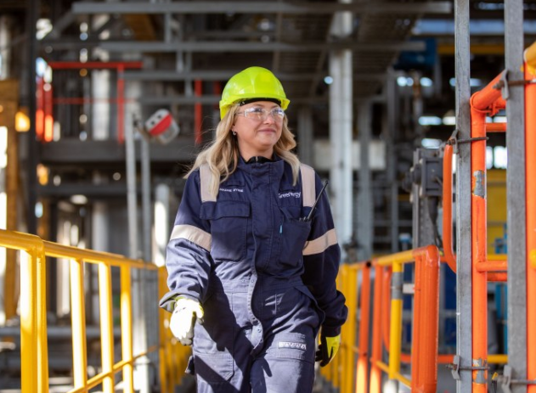
Future: Essential Skills for Engineering in Teesside
Sustainable Engineering: Knowledge of green technologies and environmental standards.
Digital Competence: Skills in automation, AI, data analysis, and smart systems.
Project Management: Ability to lead complex, multi-disciplinary projects.
Problem Solving & Innovation: Creative thinking to develop new solutions.
Technical Expertise: Strong foundation in mechanical, civil, chemical, or electrical engineering.
Communication & Collaboration: Working effectively across teams and with stakeholders.
Health & Safety Awareness: Ensuring safe practices in industrial and construction settings.
Adaptability & Lifelong Learning: Staying current with evolving technologies and methods.

Slide 12
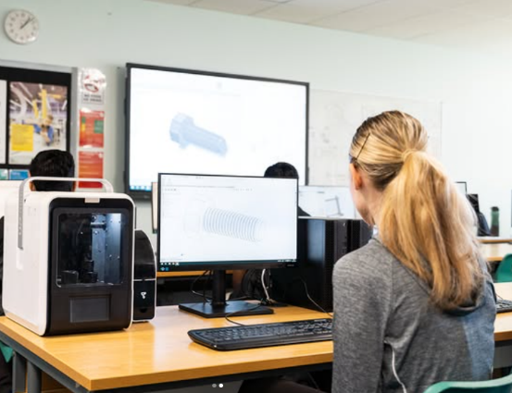
Options for Aspiring Engineers
Further Education
Study engineering at a local college or University.
Stockton Sixth Form College
Apprenticeships
Combine work and study with local engineering firms.
Entry-Level Jobs
Start as an engineering assistant or intern.
Online Learning
Build skills in CAD, programming, and project management.
Career Support
Use school services, job centres, and attend career fairs. Gain work experience to stand out from others.
Stockton Sixth Form College | Engineering

Slide 13
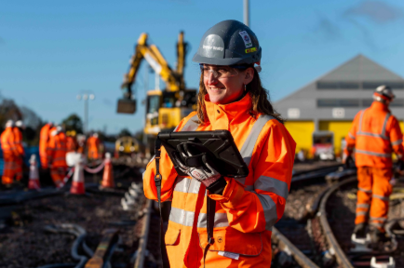
Company Focus: Balfour Beatty
Founded in 1909, Balfour Beatty is a global infrastructure company.
Specialises in construction, civil engineering, and project management.
Active in Teesside on major projects including roads, bridges, and housing developments.
Known for delivering large-scale infrastructure with a focus on safety, sustainability, and innovation.
Offers apprenticeships and graduate schemes supporting local engineering talent.
Links:
Early Careers
Balfour Beatty - YouTube
Understanding Balfour Beatty

Slide 14
Company Focus: Balfour Beatty
To view Damini’s video, go here.
To view Lee’s video, go here.

Slide 15
Engineering Futures: Useful Links
Tees Valley Careers - https://teesvalley-ca.gov.uk/work/careers-hub/
Key Priority Sectors - htt ps://teesvalley-ca.gov.uk/business/invest/key-sectors/
Tees Valley Labour Market Information Posters - https://teesvalley-ca.gov.uk/work/wp-content/uploads/sites/6/2025/03/6-x-LMI-Tees-Valley-Posters-digital-friendly.pdf
Engineering & Clean Energy Sector Workbooks - https://teesvalley-ca.gov.uk/work/wp-content/uploads/sites/6/2025/01/Advanced-Manufacturing-Engineering-Digital-2.pdf
Teesworks - https://www.teesworks.co.uk/
Balfour Beatty - https://www.balfourbeatty.com/
Balfour Beatty Academy - https://education.balfourbeattyacademy.com/

